Slide 1
Chapter 9: Preferential Trade Agreements
An Introduction to International Economics: New Perspectives on the World Economy

Slide 2
Analytical Elements
Countries
Sectors
Tasks

Slide 3
Introduction
The term multilateralism refers to the GATT/WTO system and the trade negotiations that take place within it
One of the founding principles of this system is nondiscrimination
Involves the most favored nation (MFN) and national treatment (NT) sub-principles
“Regionalism” refers to a violation of the nondiscrimination principle in which one member of a regional trade agreement (RTA) discriminates in its trade policies in favor of another member of the RTA and against nonmembers
Has been allowed by the GATT/WTO under certain circumstances:
Free trade areas (FTAs)
Customs unions (CUs)
Interim agreements leading to an FTA or CU “within a reasonable length of time”

Slide 4
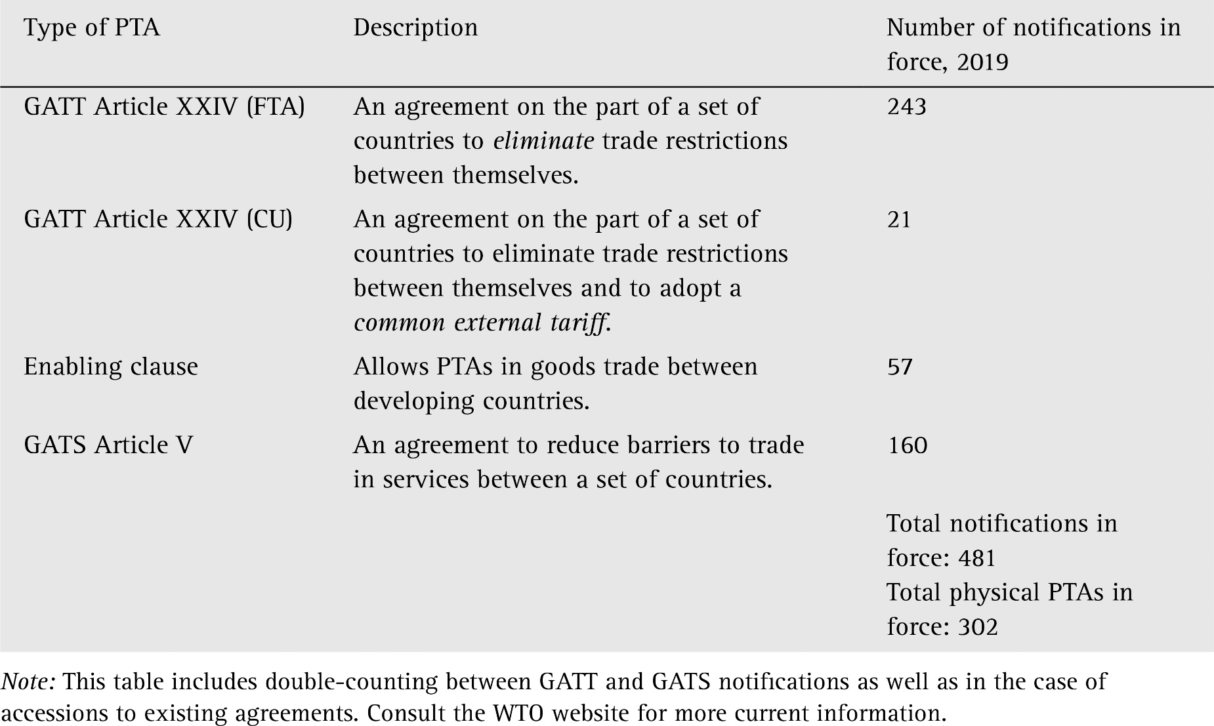
Table 9.1: Types of Preferential Trade Agreements

Slide 5
The WTO and PTAs
WTO members who wish to form FTAs or CUs may do so
However, there are certain requirements
Trade barriers against non-members cannot be “higher or more restrictive than” those in existence prior to the FTA or CU
FTA or CU must be formed “within a reasonable length of time”
FTA or CU must eliminate trade barriers on “substantially all the trade” among the members
With regard to services, the General Agreement on Trade in Services (GATS) requires that the FTA or CU involve “substantial sectoral coverage”

Slide 6
Types of Preferential Trade Agreements
“Understanding” on PTAs established in the Marrakesh Agreement: the relevant measures to assess restrictiveness against non-members is a weighted average of tariff rates and that the length of time allowable for the elimination of trade barriers within FTAs and CUs is to be no more than 10 years.
There has never been any serious evaluation or enforcement of PTAs under either the GATT or the WTO
No WTO member has the incentive to challenge PTAs through WTO dispute settlement, because nearly all important WTO members are themselves members of at least one PTA.
This “cooperative equilibrium” has proved to be quite durable.

Slide 7
The WTO and PTAs: Enforcement
The WTO’s Committee on Regional Trade Agreements (CRTA) has built an improved database of FTAs and CUs, but transparency is not enforced.
Although many PTAs are not regional, some PTAs are true attempts to build regional integration between contiguous countries.
Steps on the way to regional integration are described in Table 9.2

Slide 8
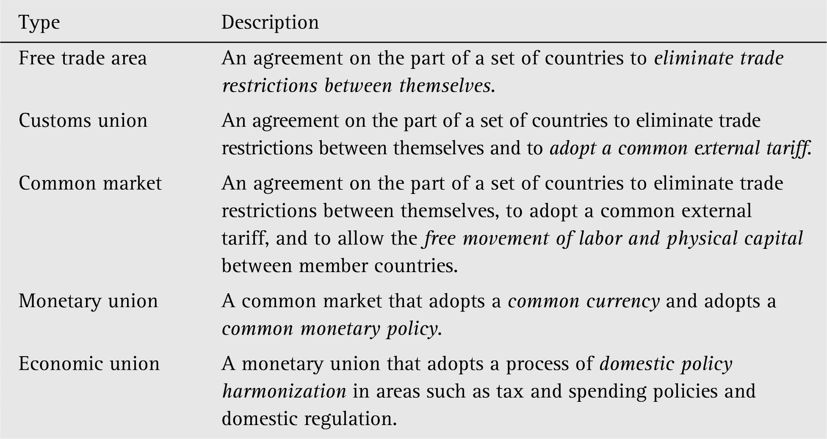
Table 9.2: Steps to Regional Integration

Slide 9
Rules of Origin
Tariff rate arbitrage: in FTAs (but not CUs), a product can be imported into a low-tariff member and then resold in a high-tariff member
Rules of origin (ROOs) protect against this
Domestic content
Change in tariff heading
Specific processes
Substantial transformation

Slide 10
Economic Effects of PTAs
Trade creation
Occurs when the formation of an FTA or CU leads to a switching of imports from a high-cost source to a low-cost source
Tends to improve welfare
Trade diversion
Occurs when imports switch from a low-cost source to a high-cost source
Tends to worsen welfare

Slide 11
Trade Creation and Trade Diversion
Trade creation and trade diversion using the absolute advantage model of Chapter 2
Along with Brazil (B) and Argentina (A), we are also going to refer to a third country, El Salvador (S)
Brazil and Argentina are members of a PTA, whereas El Salvador is not
A PTA that involves trade creation is presented in Figure 9.1.

Slide 12
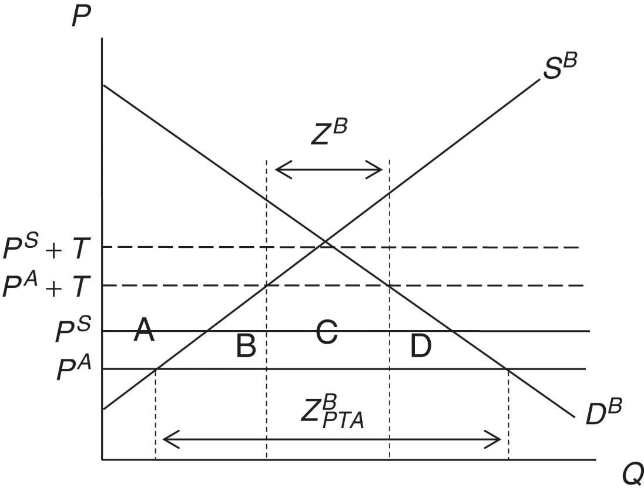
Figure 9.1: Trade-Creating PTA
Argentina is the lower-cost producer in comparison to El Salvador.
Before the PTA, Brazil has in place a specific tariff of T on imports from both Argentina and El Salvador.
Since P^{A}+T< P^{S}+T, Brazil imports from Argentina at the level of Z^{B}
After Brazil joins the PTA with Argentina, the tariff is removed from imports from Argentina.
Since P^{A}< P^{S}+T, Brazil continues to import the good from Argentina, with a higher level of $Z_{PTA}^{B}$, price fall from P^{A}+T to P^{A}
Consumer surplus in Brazil increases while producer surplus and government tariff revenue falls
Net increase in welfare due to trade creation

Slide 13
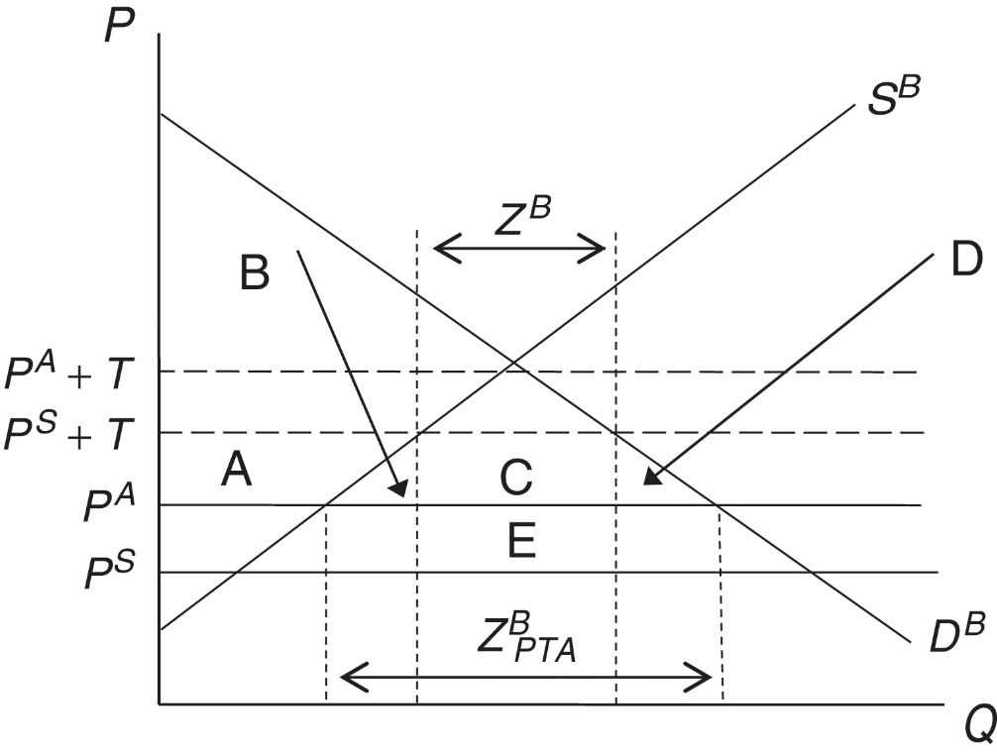
Figure 9.2: A Trade-Diverting PTA
Before the PTA, Brazil has in place a specific tariff on imports from both Argentina and El Salvador
El Salvador is the lower-cost producer in comparison to Argentina
Brazil imports the good from El Salvador
Once Brazil joins a PTA with Argentina, Brazil switches to Argentina as an import supplier
Imports expand as the domestic price falls
Consumer surplus in Brazil increases while producer surplus and government revenue fall
Whether net welfare effect is positive or negative is ambiguous

Slide 14
Summary of Economic Effects of PTAs
PTAs can be either welfare-improving or welfare-worsening.
Whether an PTA is welfare-improving or welfare-worsening is something that must be assessed on a case-by-case basis, based on evidence on the relative strengths of trade creation and trade diversion.

Slide 15
Table 9.3 The evolution of the European Union
Year | Initiative | Treaty | Members Added
1951 | European Coal and Steel Community | Treaty of Paris | France, Germany, Italy, Luxembourg, Netherlands
1958 | European Economic Community | Treaty of Rome
1973 | Enlargement |  | Denmark, Ireland, United Kingdom
1981 | Enlargement |  | Greece
1986 | Enlargement |  | Portugal, Spain
1992 | European Union | Maastricht Treaty
1995 | Enlargement |  | Austria, Finland, Sweden
1999 | European Monetary Union |  | United Kingdom, Sweden and Denmark not included
2002 | Common EMU currency: the euro |  | United Kingdom, Sweden and Denmark not included
2004 | Enlargement |  | Cyprus, Czech Republic, Estonia, Hungary Latvia, Lithuania, Malta, Poland, Slovakia, Slovenia
2007 | Enlargement |  | Bulgaria, Romania
2007 | EU Constitution | Lisbon Treaty
2013 | Enlargement |  | Croatia
2016 | Brexit vote |  | United Kingdom votes to eventually leave the EU

Slide 16
Economic Assessment of the EU
Some studies have suggested that trade creation has dominated trade diversion in the EU
However, the role of non-tariff measures (motor vehicles, VCRs, and footwear) and subsidies (aircraft, steel, shipbuilding, and agriculture)
An intermediate view: overall trade creation in manufactured goods and overall trade diversion in agricultural goods (largely due to the Common Agricultural Policy)
Significant trade creation between EU members but only limited trade diversion because of the expanding set of external PTAs
Lagging in trade in services: stalled progress in harmonizing the regulation of services
Positive effects of the EMU on intra-EMU trade

Slide 17
North American Free Trade Agreement
In January 1994 an FTA between Canada, Mexico and the United States took place (NAFTA)
Ambitious in scope:
Trade in goods
Financial services
Transportation
Telecommunications
Foreign direct investment
Intellectual property rights
Government procurement
Dispute settlement

Slide 18
NAFTA Issues
Trade and labor
North American Agreement on Labor Cooperation
Trade and the environment
North American Agreement on Environmental Cooperation
NAFTA ROOs
Substantially limit market access for Mexico in all but textiles and clothing
Detrimental impacts on Mexico’s corn producers
Truck transportation not liberalized until 2011
Migration a continued political issue

Slide 19
Mercosur
PTA among Argentina, Brazil, Paraguay, and Uruguay
Launched in 1991 with the Treaty of Asunción
Took on Chile and Bolivia as associate members in 1996 and 1997, respectively
Peru, Colombia and Ecuador became associate members in 2003-2004
Venezuela signed a partnership agreement in 2006
Not actually a common market but a CU. Far from free movement of labor and physical capital
Troubled by two asymmetries
An EU-Mercosur FTA?

Slide 20
The FTAA
In 1994, governments of 34 countries in Western Hemisphere agreed to pursue a Free Trade Area of the Americas
Negotiations were launched at the Second Summit of the Americas in 1998.
Would have represented the largest free trade area in the world, in terms of both market size and territory, had it been successful.

Slide 21
The FTAA
The 2004 Summit of the Americas was stymied by a number of issues
Agriculture
Anti-dumping
The 2005 Summit of the Americas ended negotiations on the FTAA
Venezuela and Argentina blocked progress in opposition to US-backed “neo-liberalism”
No serious discussions about reviving it

Slide 22
ASEAN and AFTA
Association for Southeast Asian Nations (ASEAN) includes Brunei, Cambodia, Indonesia, Laos, Malaysia, Myanmar, the Philippines, Singapore, Thailand and Vietnam
Beginning in 1992, members began to form the ASEAN FTA or AFTA, which now includes all 10 members
ASEAN is linking its AFTA to other countries in the region through a number of initiatives
In 2015 ASEAN moved beyond AFTA to begin to take steps towards an ASEAN Economic Community (AEC) – will be difficult
Positive trade impacts: intra-ASEAN trade grew along with ASEAN’s trade with the rest of the world

Slide 23
The Trans-Pacific Partnership
The Trans-Pacific Partnership (TPP) was to be an FTA between 12 Pacific Rim countries: Australia, Brunei, Canada, Chile, Japan, Malaysia, Mexico, New Zealand, Peru, Singapore, the United States, and Vietnam.
Conceived in 2011, signed in 2016 (the signature trade agreement of the Obama administration)
Ambitious: way beyond standard trade issues, to include environmental issues, investor–state dispute settlement (ISDS), labor standards, and regulatory cooperation.
The Trump administration pulled out of the TPP in 2017
The remaining 11 countries signed in 2018 the Comprehensive and Progressive Agreement for Trans-Pacific Partnership (CP-TPP, or TPP-11)

Slide 24
Regionalism vs. Multilateralism
Represent two alternative trade policy options available to the countries of the world
The 1950s and 1960s saw “first wave” of PTAs in developing world
The 1980’s saw beginning of “second wave” of PTAs, which has not ended.
Will the second wave of PTAs complement the multilateral framework or work at cross-purposes to this framework?
“building blocks” to multilateral trade liberalization
“open regionalism” in contrast to the first wave, “multilateralized regionalism:
Can distract from multilateral trade negotiations

Slide 25
Regionalism vs. Multilateralism
“Spaghetti bowl”: overlapping nature of most PTAs, with most WTO members holding simultaneous membership in many PTAs at once
Some warn of a movement towards “numerous and crisscrossing [PTAs] and innumerable applicable tariff rates depending on arbitrarily-determined and often a multiplicity of sources of origin”
Trading blocs and customs unions (and their increased levels of trade and FDI) can have a role in reducing international conflict
The tensions between regionalism and multilateralism can be lessened, but not eliminated

Slide 26
GATS-Plus and TRIPS-Plus
Since the Marrakesh Agreement, further services and intellectual property rights agreements have taken place within PTAs → known as GATS-Plus and TRIPS-Plus agreement
locking in of previous unilateral regulatory liberalization that has taken place since GATS took effect in 1995 (these are preferential and can violate MFN and NT non-discrimination principles)
Approximately one half of the PTAs signed since 2000 have TRIPS-Plus agreements.
TRIPS-Plus agreements can impose enforcement costs on LMICs that are not in a good position to absorb them

