Slide 1
Chapter 22: Growth and Development
An Introduction to International Economics: New Perspectives on the World Economy

Slide 2
Analytical Elements
Countries
Factors of production

Slide 3
Introduction
Economists are increasingly concerned with explanations of per capita GDP levels and their rates of growth
For such explanations, economists turn to what is known as growth theory
Here we consider two variants of growth theory
“old” growth theory or the Solow model
“new” or “endogenous” growth theory
We also consider the inter-relationships among human capital, trade, institutions and growth
An appendix to the chapter presents some of the algebraic details of growth theory

Slide 4
Robert Solow: Originator of Modern Growth Theory

Slide 5
Growth
Outcome assessment: the process of embracing some metric(s) to judge the progress of countries over time and to compare the progress of one county with others.
An early and persistent conception of economic development is in terms of the sustained increase in either per capita production or per capita income → growth
GDP per capita is an important measure of the level of economic development, and the growth rate of GDP per capita is an important measure of the pace of economic development over time.

Slide 6
Growth
The growth perspective based on GDP per capita has many limitations:
Per capita GDP is not a measure of welfare
Per capita GDP does not account for factor income flows between the countries of the world
Per capita GDP includes only market activities, and many activities in low- and middle-income countries take place outside the market
Per capita GDP does not account for certain costs associated with development (the use of non-renewable resources, the loss of biodiversity, and pollution)
Per capita GDP is an average measure that hides the distortion of income between households of a country
Per capital GDP is not always an accurate predictor of human development, such as in the form of education and health.
The nominal or currency exchange rates used to convert GDP into US dollars for comparison between countries are misleading.

Slide 7
Growth
There is another way to consider GDP and GNI in terms of deprivations.
Income deprivations are central measure of poverty.
As shown in Figure 22.1, income poverty is measured by the World Bank in three forms:
Living on US$1.90 per day or less
Living on US$3.20 per day or less
Living on US$5.50 per day or less

Slide 8
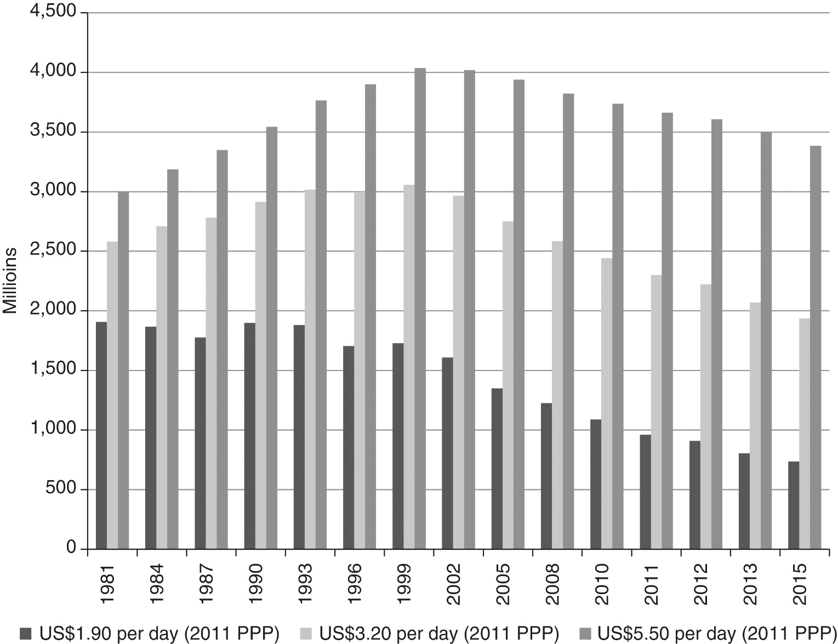
Figure 22.1 Recent evolution of world poverty (millions of persons)

Slide 9
Growth
Analyzing the relationship between growth and poverty takes note of the fact that poverty reduction depends on initial inequality levels and changes in inequality as well as growth itself. It also gives rise to what has come to be known as pro-poor growth.
This line of thinking considers what is known as the growth elasticity of poverty, namely the ratio of the percentage change in a poverty rate to the percentage change in growth measure such as GDP per capita.

Slide 10
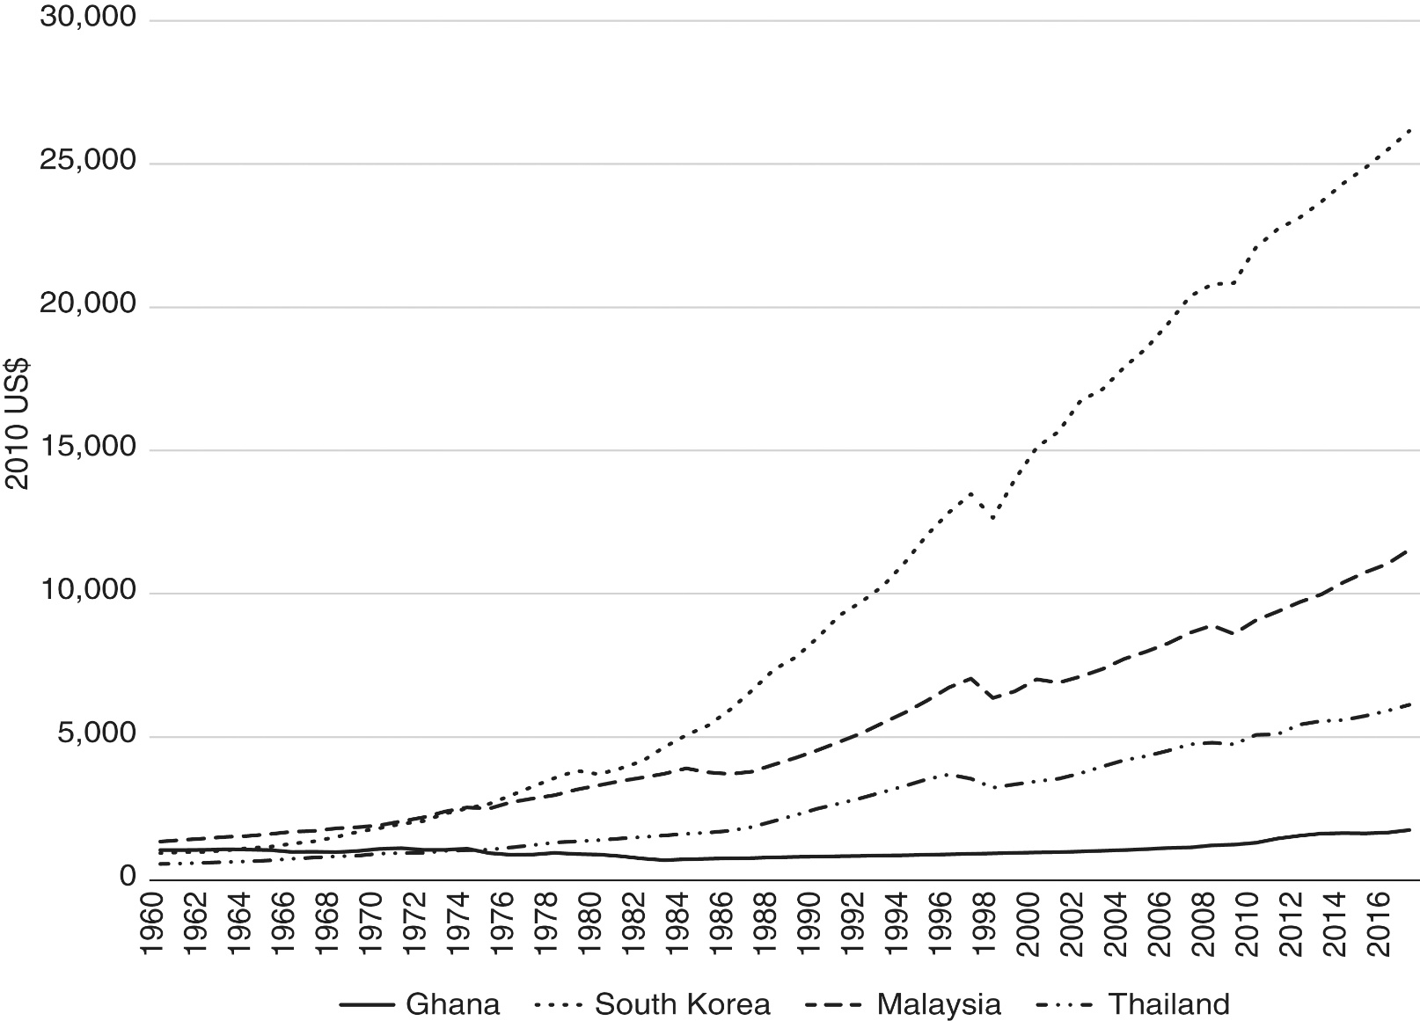
Figure 22.2 Real GDP per capita for Ghana, South Korea, Malaysia, and Thailand (2010 US$)

Slide 11
Old Growth Theory: Production Function
Growth theory began with Nobel Laureate Robert Solow (1956) in what is now known as “old” growth theory
Growth theory uses what economists call a production function, in particular, the intensive production function illustrated in Figure 22.3

Slide 12
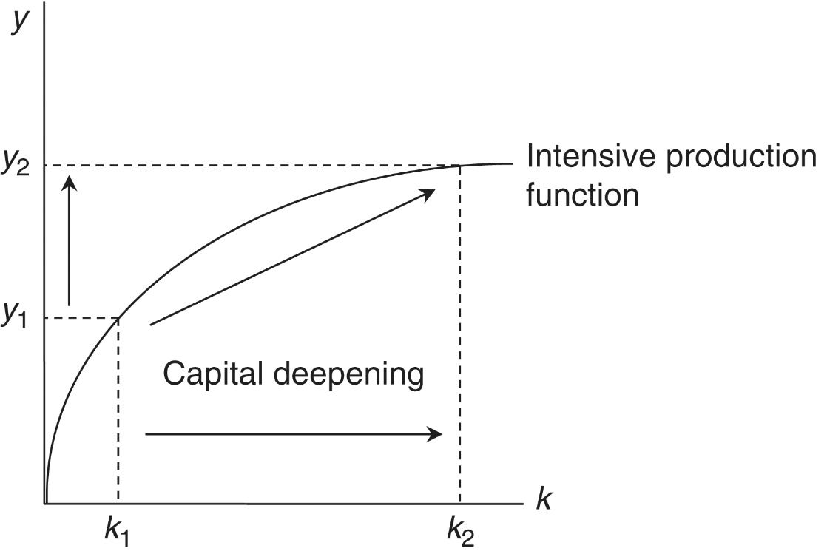
Figure 22.3: Intensive Production Function and Capital Deepening
The intensive production function relates two economic variables
Per capita GDP denoted by $y=Y/L$ where $Y$ is GDP and $L$ is the labor force/population
The capital-labor ratio denoted by $k=K/L$ where $K$ is the total amount of physical capital

Slide 13
Old Growth Theory: Production Function
Figure 22.3 indicates that there is a positive relationship between the capital-labor ratio and per capita GDP
As the capital-labor ratio increases and each worker has more physical capital to work with, per capita GDP increases
This is a process known as capital deepening
Figure 22.3 also indicates that the relationship between the capital-labor ratio and per capita GDP is decreasingly positive (the slope of the graph becomes flatter as increases)
This is the result of diminishing returns to labor and capital

Slide 14
Old Growth Theory: Technological Change
There is a set of other possible source of increases in per capita income
This we will refer to as shift factors because they shift the intensive production function as in Figure 22.3
Solow had referred to this as technological change, but this turns out to be only one possible shift factor
As a result of these shift factors, at a given capital-labor ratio, $k_{1}$, per capita income increases from $y_{1}$ to $y_{2}$
Increases in per capita incomes can come about through increases in the capital-labor ratio (capital deepening) or through other shift factors such as improvements in technological efficiency

Slide 15
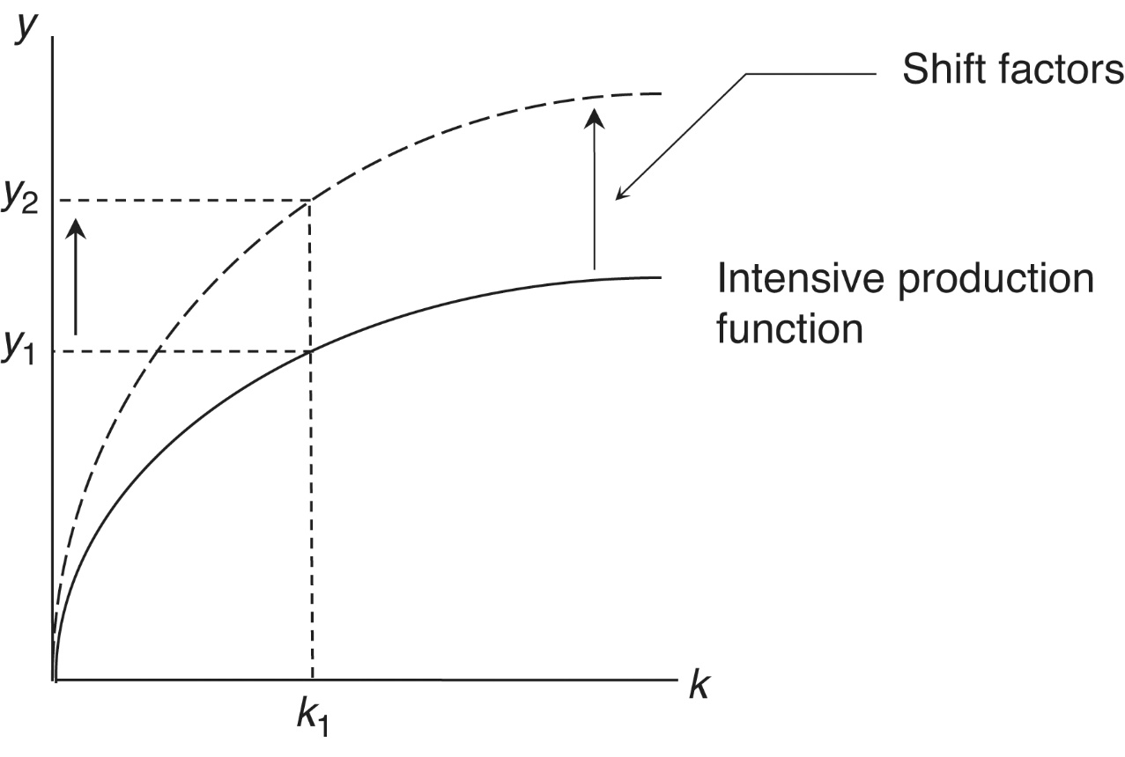
Figure 22.4: Technological Change in the Intensive Production Function

Slide 16
Old Growth Theory
Some additional requirements for economic growth based on capital deepening:
Increases in capital-labor ratio, k, require increases in the capital stock that more than offset any increases in population.
Increases in capital stock, in turn, require investment.
Investment requires saving.
Domestic investment = Domestic savings + Foreign savings

Slide 17
Old Growth Theory
In the absence of shift factors such as technological improvements, increases in domestic and foreign savings are the only sources of growth in per capita incomes.
If the increase in the capital stock is not large enough, k and y will fall because of population growth, known as capital shallowing.
Increasing household savings is often a matter of making institutions available to the households of the economy to facilitate savings.
Increasing government savings is a matter of decreasing government expenditures and increasing government tax revenues, moving the government budget towards surplus.
Some types of government expenditures (e.g. education) can positively affect the level of technology.
Some government investments (e.g. infrastructure) are complementary to private investments.
Increasing foreign savings is a matter of increasing the capital/financial account surplus on the balance of payments.

Slide 18
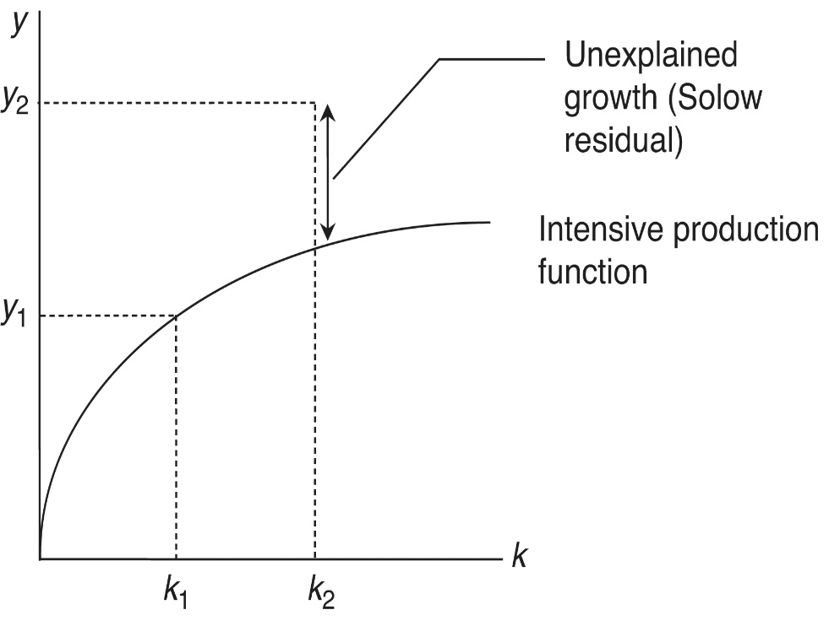
Old Growth Theory
“Old” growth theory draws our attention to savings and shift factors such as technology as central variables that can be affected by various institutional and policy regimes.
However, this theory leaves a lot to be explained, as represented in Figure 22. 5
The vertical, double-headed arrow in this diagram indicates the amount of the unexplained growth in per capita incomes, which is known as the Solow residual.
In practice, Solow residuals can be large
Figure 22.5 Unexplained growth in per capita incomes

Slide 19
New Growth Theory and Human Capital
New growth theory attempts to explain some of these Solow residuals
The models of the new growth theory are varied
A number of new growth theory models emphasize the role of a third factor of production in addition to labor and physical capital, namely human capital
Because productive knowledge can be embodied in workers, there appears to be a positive link between human capital and technological efficiency
This leads to a modification of the intensive production function so that increases in human capital shift it upward through a positive impact on technological efficiency

Slide 20
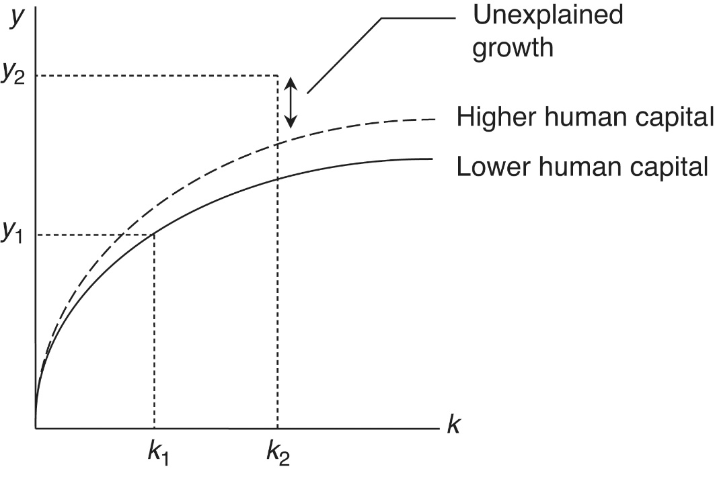
Human Capital
In this intensive production function of new growth theory, technology is an endogenous variable that can be influenced by levels of human capital, measured perhaps as literacy rates or years of education.
The implication of this can be seen in Figure 22.6: an increase in human capital from period 1 to period 2 shifts the intensive production function upwards.
The amount of unexplained growth from Figure 22.5 (the Solow residual) declines, and changes in human capital are an important component in this decline.
Figure 22.6 Human capital and unexplained growth in per capita incomes

Slide 21
Empirical Evidence
Early attempts to address this possibility indicated the human capital was empirically important
However, subsequent work questioned the empirical importance of human capital as education in explaining development as growth
One suggestion was that it is difficult to establish the role of education in growth due to measurement errors
This can relate to an important distinction to be made between educational attainment and educational achievement.
Educational attainment refers to the number of years of education an individual has completed.
Recent studies seem to have resolved the measurement error difficulties by establishing a non-linear relationship between education and human capital
Once this is done, it appears that education does indeed contribute to development as growth

Slide 22
Rate of Return to Education
Further evidence on the importance of human capital in the form of education comes from research on the rate of return to education (RORE). Standard results from this body of research suggest that:
The private/market RORE is generally higher than the rate of return on physical capital investments
The private/market RORE is generally higher at lower levels of education
The private/market RORE is generally higher at lower levels of GDP per capita
There is also a growing body of research looking at female education that suggests that the human capital of girls and women is particularly important

Slide 23
Human Development and Growth
It is important to recognize that human capital includes health and well as education
It is Important to include a broader definition of human capital (encompassing health and nutrition as well as education)

Slide 24
Trade and Growth
Many development and trade economists have suggested that countries’ openness to international trade has a positive impact on growth in per capita GDP and, therefore, on poverty alleviation and human development
This argument actually has a number of components
Increased exports can support increased employment and wage incomes, with the latter being reinvested in increases in human capital
Increased trade (both imports and exports) can in some circumstances improve competitive conditions in domestic markets
Exports can contribute to improved technological efficiency as a shift factor in the intensive production function diagram

Slide 25
Trade and Growth: Technological Efficiency
Technological efficiency responds to two impulses
The first impulse is domestic innovation, which is positively affected by human capital accumulation in some new growth theory models
The second impulse is the absorption of new technology from the rest of the world
Therefore, exports are sometimes seen as having a positive externality for the exporting country
Exports generate additional technology gains on the supply side of the economy

Slide 26
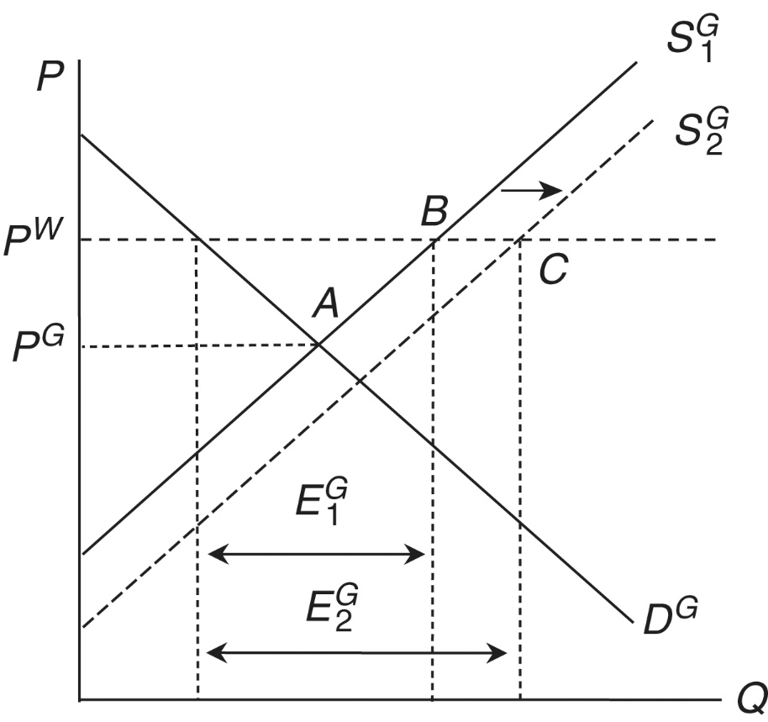
Export Externalities
Potential export externalities are considered in the absolute advantage diagram of Figure 22.7
$P^{G}$ is Ghana’s autarky price, and $P^{W}$ is the world price
Without a positive export externality, as the price increases from $P^{G}$ to $P^{W}$in the movement from autarky to trade, quantity supplied increases from point A to point B, and exports of $E^{G1}$appear
In the presence of export externalities, the initial export level, $E^{G1}$, improves production technology and makes possible an increase in supply or a shift in Ghana’s supply curve from $S^{G1}$ to $S^{G2}$
Given $P^{W}$, Ghanaian firms move from point B to point C, and exports expand to $E^{G2}$
Figure 22.7 Export externalities for Ghana

Slide 27
Evidence of Export Externalities
Export externalities are often justified with the historical experience of East Asia
More formally, early studies in the 1990s deployed statistical techniques to show that the more open countries are to international trade, the faster their growth in per capita GDP
these externalities are notably absent in the case of primary product exports, which characterize many developing countries
More recent studies based on extended and improved indicators do seem to support the trade and growth link
There are other caveats to the role of exports in economic growth
There is some agreement that the accumulation of human capital is an important prerequisite to the absorption of technology from abroad.
human capital and manufactured exports interact positively in supporting the growth of per capita incomes

Slide 28
Institutions and Growth
Increasing recognition has gone to the role of institutions in growth as an additional shift factor in the intensive production function diagram
Table 22.1 presents some relevant institutional categories and their potential contributions to growth
These include
Rule of law
Property rights
Contract enforcement
Regulation
Social insurance

Slide 29
Table 22.1: Institutions and Growth
Category | Elements | Relevance
Rule of law | Political representation Elections Independent judiciary Civil liberties Consistency | Prevents violent conflict and provides for legitimacy in political decision-making
Property rights | Secure ownership or control of assets Right to returns on assets Asset distribution | Ensures that the use of productive assets will result is appropriable returns that will, in turn, provide incentives for further development and use
Contract enforcement | Contract design Escape clauses Recourse | Allows for parties to enter into long-term, productive arrangements with a minimum degree of certainty
Regulation | Prudential regulation of finance Macroeconomic management Health and safety regulation | Addresses well-known instance of market failure
Social insurance | Transfer payments Employment practices Traditional social arrangements | Ensures that market dislocations are managed so as not to impede human development
Source: Rodrik (2007) and others

Slide 30
Institutions and Growth
What is the evidence on the role of institutions in economic growth?
The entire classical literature on economics from Adam Smith on, as well as the entire early development economics literature, both addressed precisely this question
A set of new quantitative studies of the role of institutions in growth, and, taken as a whole, they indicate that institutions (in multiple dimensions) do matter.
The task of actually constructing effective institutions is difficult given the “overwhelmingly incremental” nature of institutional change.

Slide 31
Summary
Increases in per capita incomes can come about through increases in the capital–labor ratio (capital deepening) or through other shift factors, such as improvements in technological efficiency, improvement in human development (education and health), export expansion, and improvements in institutional quality.

Slide 32
Appendix 22.1: Growth Theory Algebra
Growth theory begins with what economists call a production function:
$$Y=A×F\left(L,K\right)$$
This equation presents what is known as the aggregate production function
In this equation
$Y$ is total output and total income
$L$ is the aggregate labor force
$K$ is the aggregate stock of physical capital
$A$ refers to an exogenous measure of technology

Slide 33
Appendix 22.1: Growth Theory Algebra
Old” growth theory assumes that production takes place according to constant returns to scale
means that a doubling of both $L$ and $K$ will lead to a doubling of $Y$
More generally, multiplying both $L$ and $K$ by some constant $θ$ will increase $Y$ by that same factor
In other words
$$θY=A×F\left(θL,θK\right)$$
If we set $θ=1/L$ , then
$$\frac{1}{L}Y=A×F\left(\frac{1}{L}L,\frac{1}{L}K\right)$$

Slide 34
Appendix 22.1: Growth Theory Algebra
We define the terms of the last equation on the previous slide as
GDP per capita or $y=Y/L$
A constant in the form of $L/L=1$
Physical capital per capita or $k=K/L$
This gives us the intensive form of the production function used in old growth theory or the Solow model
$$y=A×f\left(k\right)$$
This equation is the intensive production function

Slide 35
Appendix 22.1: Growth Theory Algebra
New growth theory works with a modification of this intensive form of the production function that includes per-capita human capita ($h$)
$$y=A\left(h\right)×f\left(k\right)$$
where h is a measure of per capita human capital, h = $H/L$ .
Trade issues in new growth theory involve adding an additional variable to this equation, as follows:
y=A(h$×e_{M}$) $×$ $f\left(k\right)$

