Slide 1
Chapter 21: Monetary Unions
An Introduction to International Economics: New Perspectives on the World Economy

Slide 2
Analytical Elements
Countries
Currencies
Financial assets

Slide 3
Introduction
Monetary unions are groups of member countries in a common market all using a common currency.
The most notable example is the European Monetary Unions (EMU).
Monetary unions also exist in Africa
  Communauté Financière Africaine (CFA) franc zone in central and west Africa
  The rand zone or Common Monetary Area (CMA) in southern Africa
This chapter analyzes the promises and perils of monetary unions

Slide 4
The European Monetary Union at a Glance
The European Monetary Union (EMU) is a monetary union among 19 countries (as of 2019) in which the euro (€) serves as the shared currency
The euro is administered by the European Central Bank (ECB)
The member countries are listed in Table 21.1
Table 21.2 lists the EU members that are not members of the EMU
With the exceptions of the United Kingdom and Denmark, with their opt-outs, all EU members are expected to eventually join the EMU.

Slide 5
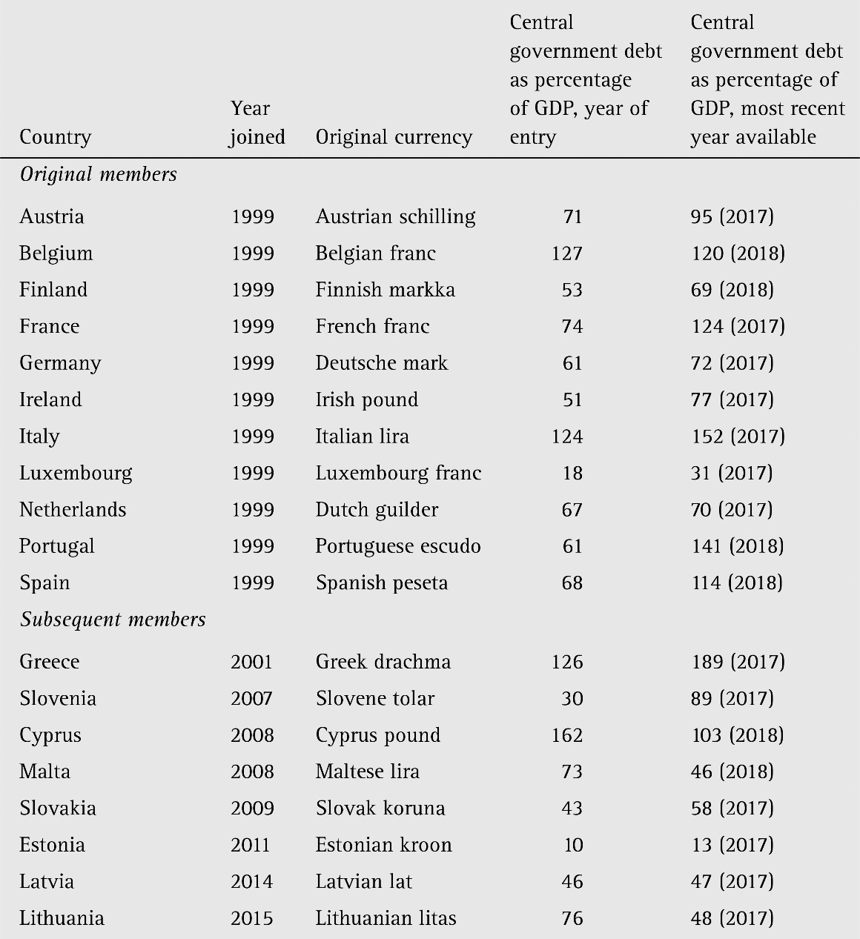
Table 21.1: EMU Membership

Slide 6
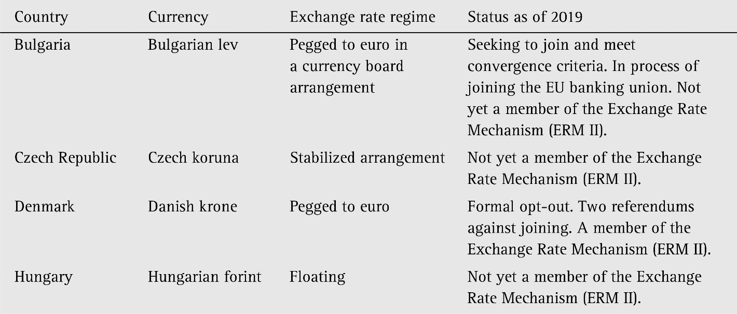
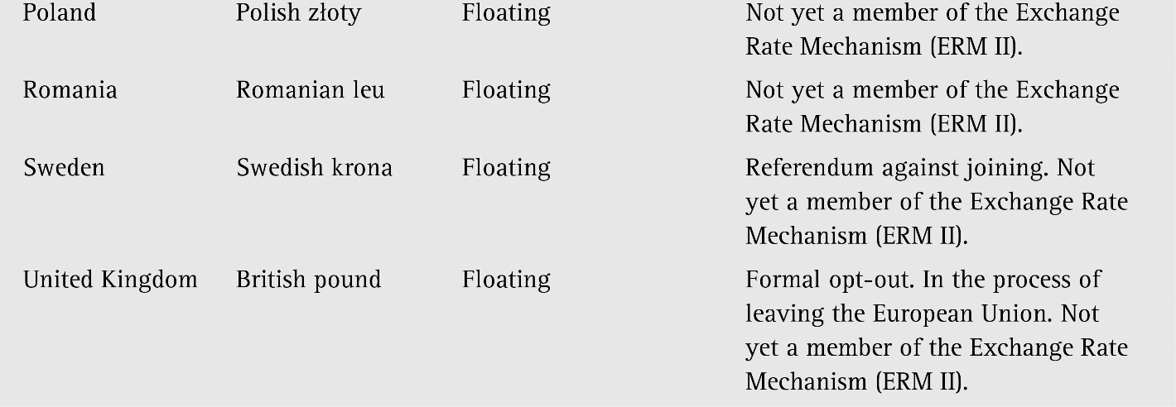
Table 21.2 In but out: countries that are members of the EU but not the EMU

Slide 7
Planning the EMU: Initial Steps
The history of the EU is summarized in Table 21.3
The monetary union initiative began in 1970 when a commission chaired by the then Prime Minister of Luxembourg, Pierre Werner, issued a report providing a detailed plan for a step-by-step movement to an EMU by 1980
However, the early 1970s were characterized by the demise of the Bretton Woods system (see Chapter 19)
During 1971, key European currencies, including the German Deutsche mark began to float as the previous monetary era came to an end

Slide 8
Planning the EMU: The EMS
The EMS came into being as a fixed-rate system in 1979
The original hope was that each country would peg their currency to a European Currency Unit (ECU)
  Instead, countries began to peg their currencies to the German mark
In 1988, the European Council called upon then President of the European Commission, Jacques Delors, to study the steps required to move towards a monetary Union
The subsequent Delors Report was issued in 1989
  The report called for a single currency and an integrated system of European central banks

Slide 9
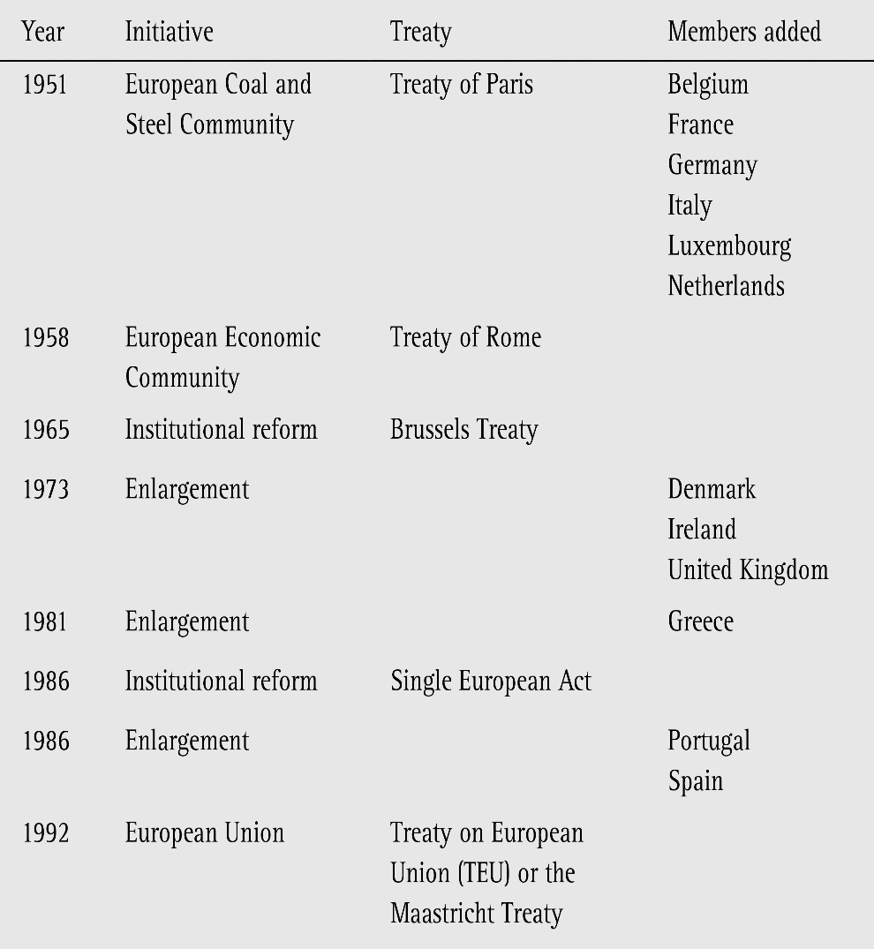

Table 21.3: The Evolution of the European Union

Slide 10
Planning the EMU: The Snake
In response to the end of Bretton Woods, the members of the EEC decide to bind their exchange rates within 2.25 percent of each other
This became known as the “snake in a tunnel” or “snake”
Despite a number of instances when European currencies were forced out of the snake, it continued through 1978
In 1977, European Commission President Roy Jenkins called for Europe to return to the Werner vision and adopt monetary union as a goal
Negotiations began to create a European Monetary System (EMS) in 1978

Slide 11
Planning the EMU: The Maastricht Treaty
In 1991, a meeting of the European Community took place in the Dutch town of Maastricht.
The Maastricht Treaty, agreed to at this meeting, was to serve as a constitution of the new European Union or EU, replacing the Treaty of Rome
It was signed in 1992
The Maastricht Treaty set 1999 as a target date for the EMU

Slide 12
Planning for the EMU: The EMI
In 1994, as specified by the Maastricht treaty, a European Monetary Institute (EMI) came into being
The EMI was to plan for the future European System of Central Banks or ESCB and to plot the course towards monetary integration
The EMI was to also monitor the progress of member countries toward meeting a set of convergence criteria
  These criteria concerned price stability, levels of government deficits and debt, exchange rate targets, and interest rate targets.
  Government deficits (a flow) were required to be less than 3 percent of gross domestic product (GDP), and government debts (a stock) were required to be less than 60 percent of GDP

Slide 13
Planning for the EMU: Problems with the EMS
The evolution towards the EMU proved to be more difficult than envisioned
In 1990, East and West Germany had reunified and this required unprecedented increases in public expenditure on the part of the German government
To prevent the German economy from expanding too quickly, the German central bank pursued a tight or restrictive monetary policy
This kept German interest rates high and put downward pressure on the value of other European currencies
The EMS par-value system consequently came under pressure

Slide 14
Implementing the EMU: Final Decisions
In May 1998, the European Council met in Brussels to determine which countries were to take part in the EMU on January 1^{st,} 1999
Figure 21.1 plots inflation rates for the six countries ultimately included in the EMU with the highest inflation rates in 1990
  There was a significant degree of convergence in inflation rates between 1990 and 1998
The second and third convergence criteria concerned central government deficits and debt
  Belgium and Italy did not meet these criteria
However, there was a political decision made to admit these countries, as well as Greece in 2001

Slide 15
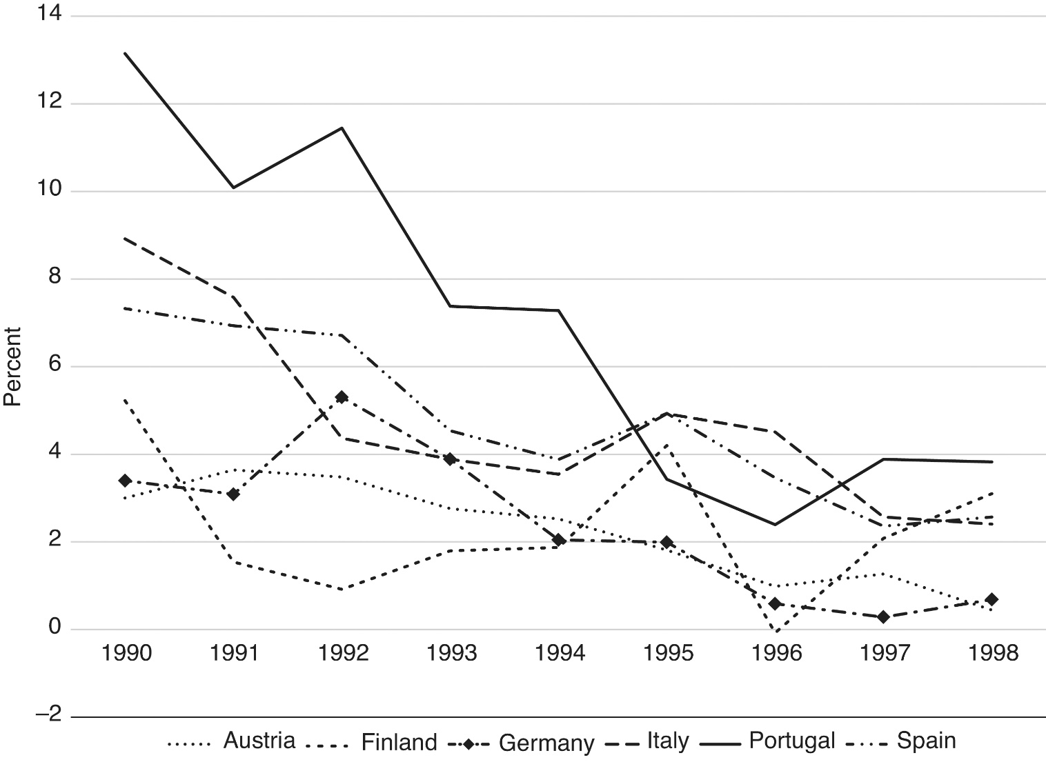
Figure 21.1 Inflation rates (GDP price deflator) in selected euro countries, 1990–1998

Slide 16
The European Central Bank
The centerpiece of the EMU is the Frankfurt-based European Central Bank (ECB)
As specified in the Maastricht Treaty, the primary objective of the ECB in its monetary policy decisions is to maintain price stability within the EMU
  The ECB is required to maintain annual increases in a Harmonized Index of Consumer Prices (HICP) at or below 2 percent
This is widely regarded as a very stringent rule
The organizational structure of the ECB is presented in Figure 19.2

Slide 17
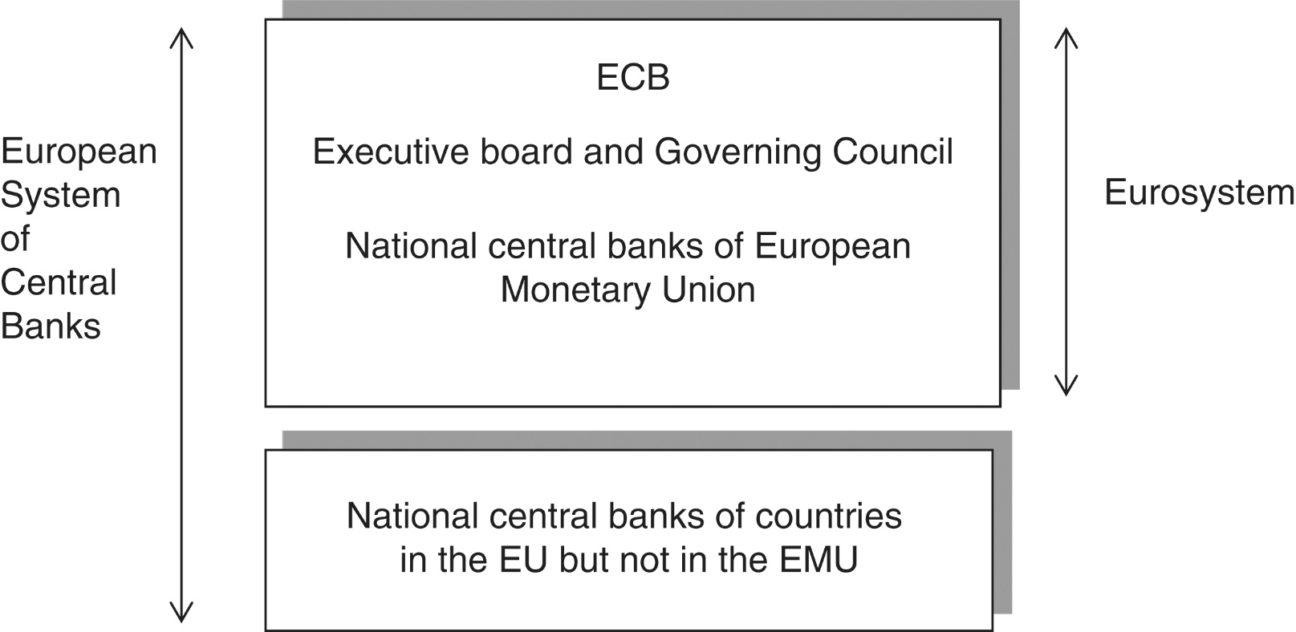
Figure 21.2: Organizational Structure of the ECB

Slide 18

The ECB “Euro Tower"

Slide 19
The Euro
The euro was launched in January 1999
EMU member exchange rates became “irrevocably” locked, and monetary policy was transferred to the ECB
The value of the euro was initially set at 0.85 €/US$ or 1.18 US$/€ in a flexible exchange rate regime
As seen in Figure 21.3, the euro’s value initially fell against the US dollar and the Japanese yen, despite predictions that it would appreciate
From 2001 through 2008, the euro strengthened against the yen and dollar, but with the onset of crises in selected euro countries, the euro began to weaken again

Slide 20
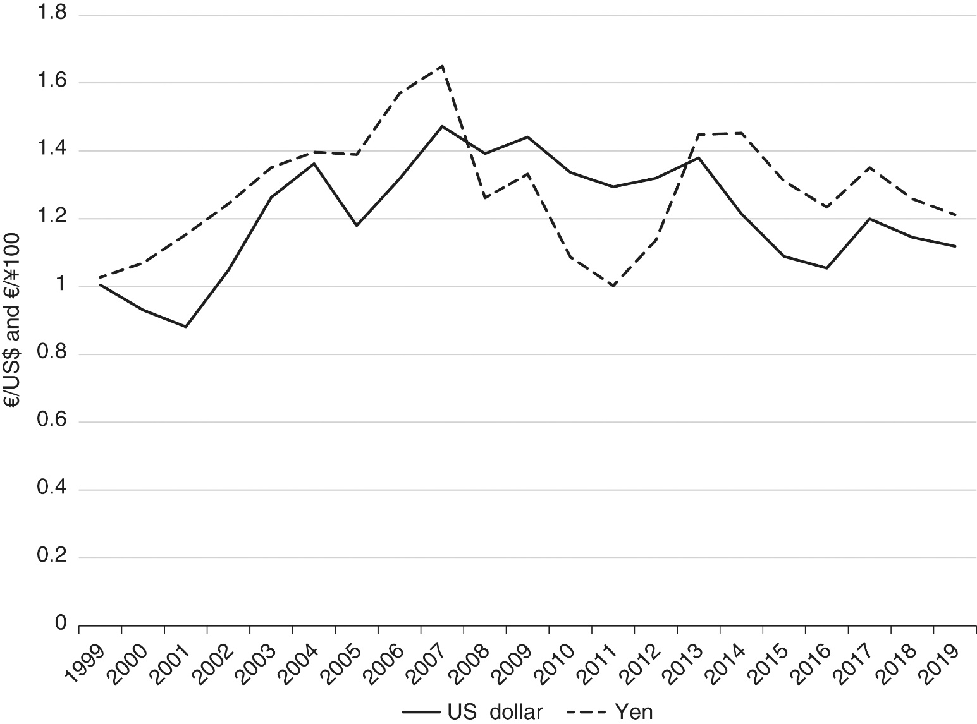
Figure 21.3 The euro/US dollar and euro/100 yen exchange rates, 1999–2019

Slide 21
The Euro
The HICP inflation rate in the euro area is presented in Figure 21.4.
From the anti-inflationary point of view, the ECB was able to keep the annual change in the HICP below 2.0 percent (with the exceptions of 2008, 2011, and 2012). But there were two near-deflationary episodes (in 2009 and 2014-16)

Slide 22
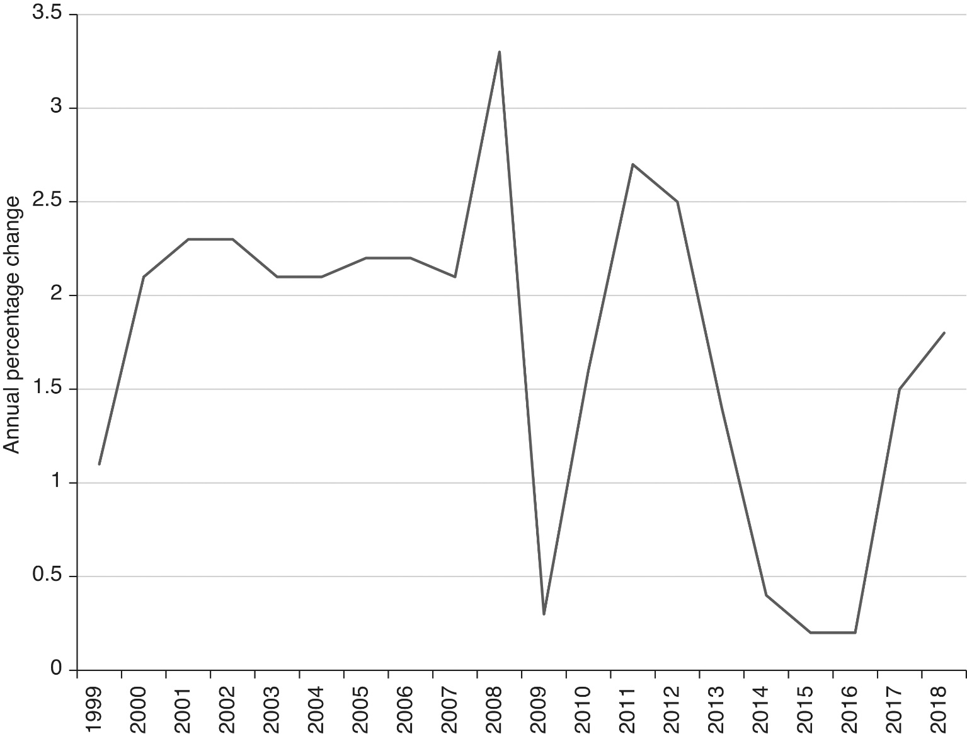
Figure 21.4 Annual inflation rate in euro area, 1999–2018 (percentage change in HICP)

Slide 23
Optimum Currency Areas and Adjustment in the EMU
An optimum currency area is a collection of countries characterized by the following
  Well-integrated factor markets
  Well-integrated fiscal systems
  Economic disturbances that affect each country in a symmetrical manner
It is not clear that the EMU is an optimum currency area
  There are limits to the mobility of labor and physical capital among the countries of the EMU
  The budget of the EU is relatively small in proportion to the size of the economies involved, indicating a lack of fiscal integration of the EMU economy
  Business cycles among the members of the EMU are somewhat asymmetrical

Slide 24
Adjustment in the EMU
The absence of an optimum currency area in the EMU leaves some room for worry over how economic adjustment will occur within it
In a face of a recession in one country, unemployment can be addressed in four ways:
  An overall decline in wage rates leading to increases in quantity demanded for labor
  Labor mobility out of areas of unemployment
  Expansionary monetary policy (at the EU level)
  Expansionary fiscal policies (at the member country level)
In practice, these adjustment pathways prove to be difficult

Slide 25
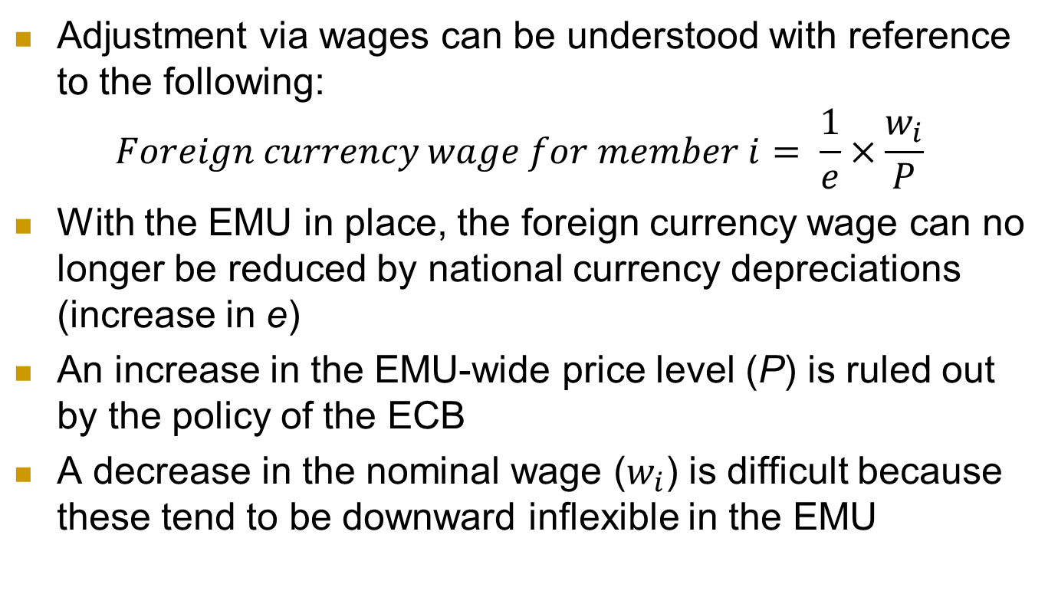
Adjustment in the EMU
Adjustment via wages can be understood with reference to the following:
$$Foreign currency wage for member i= \frac{1}{e}×\frac{w_{i}}{P}$$
With the EMU in place, the foreign currency wage can no longer be reduced by national currency depreciations (increase in e)
An increase in the EMU-wide price level (P) is ruled out by the policy of the ECB
A decrease in the nominal wage ($w_{i}$) is difficult because these tend to be downward inflexible in the EMU

Slide 26
Adjustment in the EMU
Adjustment via labor mobility is limited in the EMU
Adjustment via monetary policy is limited by the ECB’s rules of operation
Adjustment via national fiscal policy is limited by the EU’s Stability and Growth Pact that limits deficits and debt
These considerations have left some observers worried about how the EMU would operate in practice as a less-than-optimal currency area

Slide 27
The EMU in the Global Financial Crisis
The GFC hit European shores in 2008 with bankruptcy and rescue of the London-based AIG Financial Products.
The initial response of the ECB was to tighten monetary policy in the middle of 2008, but circumstances forced it to quickly change course as the Eurozone entered into recession.
The difficulties hit a sub-group of countries (Greece, Italy, Ireland, Portugal, and Spain) known as GIIPS
  The ramifications of these issues on external accounts can be seen in Figure 21.5, which reports their current account balances
  Countries are experiencing long-term current account deficits through 2008, some of large magnitudes relative to GDP

Slide 28
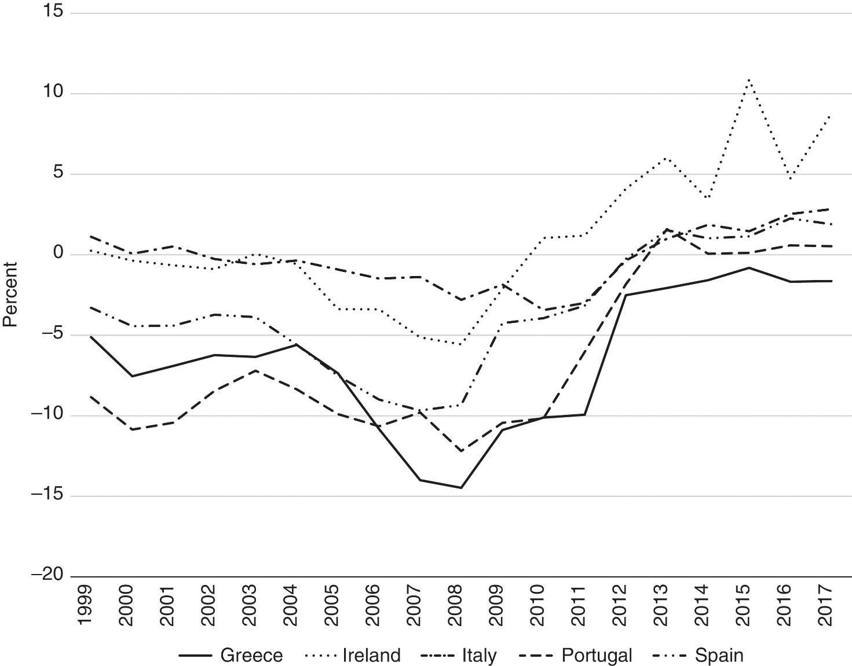
Figure 21.5: Current Account Balances in the GIIPS countries, 1999-2017 (percentage of GDP)

Slide 29
The EMU in the Global Financial Crisis
In mid 2010, first Greece and then Ireland were caught up in market speculation of government or sovereign default
  Bond yield spreads widened, with Greece (at approximately 12%) and Ireland and Portugal (at approximately 6 %) paying much higher rates than Germany (at approximately 2%) on new 10-year bond issues
The EU set up the European Financial Stability Facility (EFSF) and it and the IMF began to commit funds in order to help soothe the markets
Eventually, the EFSF morphed into the European Stability Mechanism (ESM), a permanent bail-out fund

Slide 30
The EMU in the Global Financial Crisis
During this time, a focus was on Greece, which even in 2011 had a current account deficit of approximately 10 percent of GDP and received large bailouts in 2011 and 2012
In early 2012, holders of Greek government debt underwent a “haircut,” having to exchange old bond for new worth less than half of the original value
  This was the largest sovereign default in history
The Greek crisis set in motion an overreaction.
  Spain and Ireland had run budget surpluses up until the GFC.
  Nonetheless, fiscal consolidation became the go-to policy in the EMU, leading to EMU-wide recession.

Slide 31
The EMU in the Global Financial Crisis
Ireland had a banking sector that had over-borrowed abroad, and had over-lent to the property and construction sector
  When the property bubble burst in 2007, a banking crisis ensued.
  The banking crisis morphed into a general financial crisis
All eyes fell on Portugal and Spain as the next potential EMU crises.
  Portugal did not have the debt problem of Greece or the banking problem of Ireland, yet, it entered into a recession.
  Spain did have an Irish-style property market collapse and entered a recession as well.
  Spain had to be bailed out by the European Stability mechanism

Slide 32
The EMU in the Global Financial Crisis
From 2010 to 2012, EU handling of what proved to be an ongoing crisis was not adept, seeming to lurch from one half-measure to another
One way to appreciate the intractable nature of the euro crisis is to begin considering it in light of macroeconomic adjustment.
  Wolf (2012): having removed one macroeconomic adjustment mechanism (currencies and exchange rates), the Eurozone has made credit crises more likely.

Slide 33
The EMU in the Global Financial Crisis
In 2012 events seem to take a turn for the better.
  Germany’s constitutional court approved ESM
  The European Commission set out its plan for an EU-wide banking union.
  ECB announced that it would begin to purchase GIIPS bonds to aid in their adjustment and thus begin to act as a lender of last resort.
The crisis reasserted itself in 2013 with a banking crisis in Cyprus.
The effects of the crisis linger to this day.
  Consider Greece: shrunk output, poverty, unemployment, debt

Slide 34
Monetary Unions in Africa
Monetary unions in Africa include the CFA franc zone in central and west Africa and the rand zone in southern Africa
The Communauté Financière Africaine (CFA) franc zone is a monetary union among 14 member countries that have adopted the CFA franc as a common currency
  The CFA franc zone actually consists of two sub-unions, the West African Monetary Union (WAMU) and the Central African Monetary Area (CAMA), associated with the Central Bank for West African States and the Bank for Central African States, respectively
Membership is listed in Table 21.4

Slide 35
Table 21.4: Members of the CFA franc zone
Member | Sub-zone | Former Colonial Power | Member Since
Benin | West | France | 1945
Burkina Faso | West | France | 1945
Cameroon | Central | France | 1945
Central African Republic | Central | France | 1945
Chad | Central | France | 1945
Côte d'Ivoire | West | France | 1945
Equatorial Guinea | Central | Spain | 1985
Gabon | Central | France | 1945
Guinea-Bissau | West | Portugal | 1997
Mali | West | France | 1945, left 1962, rejoined 1984
Niger | West | France | 1945
Republic of the Congo | Central | France | 1945
Senegal | West | France | 1945
Togo | West | France | 1945

Slide 36
Monetary Unions in Africa
The CFA franc was pegged to the French franc and underwent a notable devaluation in 1994
In 1999, the CFA franc was pegged to the euro
The rand zone or Common Monetary Area (CMA) is a smaller endeavor than the CFA franc zone and includes South Africa, Lesotho, Namibia and Swaziland
  The South African rand is legal tender in all CMA countries, but the countries also circulate their own currencies at a one-to-one par.
  Unlike the CFA franc, the rand floats against other major currencies, as South Africa pursues an inflation-targeting monetary policy.
  There is a significant amount of liberalization within the CMA.

