Slide 1
Chapter 18: Fixed Exchange Rates
An Introduction to International Economics: New Perspectives on the World Economy

Slide 2
Analytical Elements
Countries
Currencies
Financial assets

Slide 3
Introduction
Alternative exchange rate regimes:
  “fix”←→ “flexible”
The case of fixed exchange rates
The role of interest rates and credibility in maintaining fixed exchange rate regimes
The impossible trinity

Slide 4
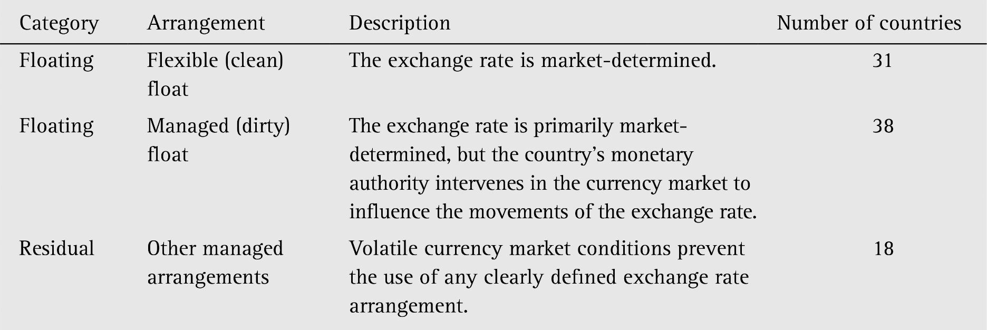
Alternative Exchange Rate Regimes
Table 18.1: De facto exchange Rate Arrangements, 2017
(Source: www.imf.org)

Slide 5


Alternative Exchange Rate Regimes
Table 18.1: De facto exchange Rate Arrangements, 2017
(Source: www.imf.org)

Slide 6

Alternative Exchange Rate Regimes
Table 18.1: De facto exchange Rate Arrangements, 2017
(Source: www.imf.org)

Slide 7
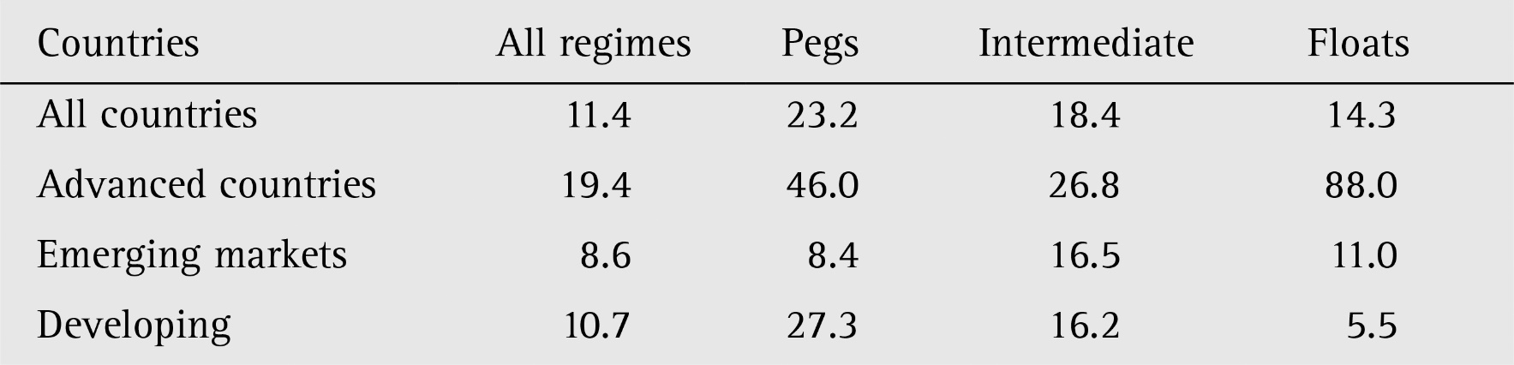
Alternative Exchange Rate Regimes
One issue that has arisen in the analysis of exchange rate regimes is their durability or ability to persist over time without a necessary change or transition to another regime. (The regime characterization of Table 18.1 is a snapshot in time.)
A more thorough analysis based on a more sophisticated conception of regime change is presented in Table 18.2.
Table 18.2 The durability of exchange rate regimes, 1975–2001 (years)
Source: Husain, Mody and Rogoff (2005) based on Reinhart and Rogoff (2004)

Slide 8
A Simple Model of Fixed Exchange Rates
In contrast to flexible or floating exchange rate regime, we will consider the polar opposite case of a fixed exchange rate regime
  Mexico will be our home country
  United States will be our foreign country
Under a fixed exchange rate regime, when Mexican government raises/lowers e and thereby decreases/increases value of peso
  Called a devaluation/revaluation of peso
  Contrasts with a market-driven, upward movement in e under a flexible exchange rate regime known as a(n) depreciation/appreciation
In practice, devaluations are more common than revaluations

Slide 9
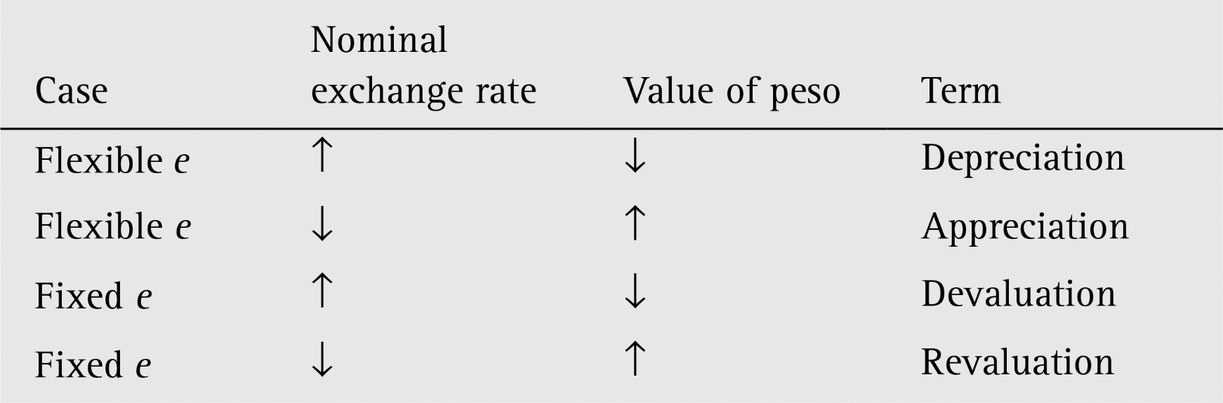
Table 18.3 Exchange rate terminology revisited

Slide 10
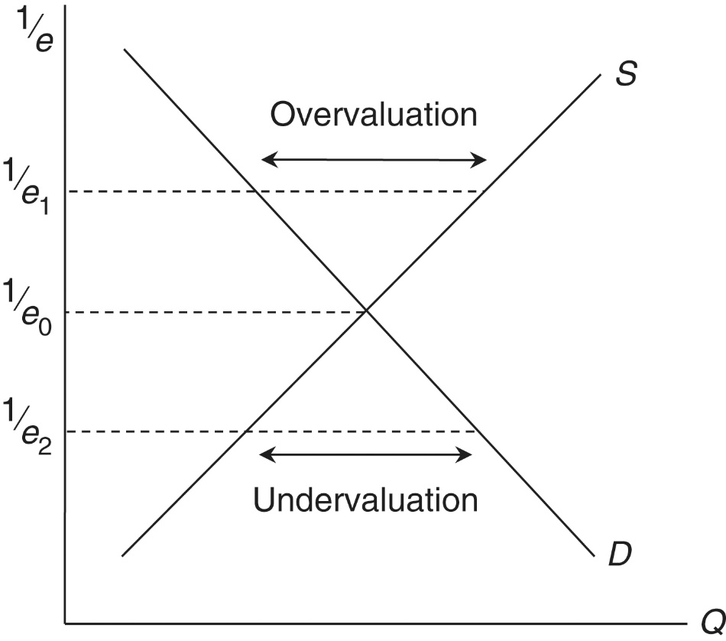
A Model of Fixed Exchange Rates
Suppose that the nominal exchange rate is fixed at e₁ and the value of peso is therefore fixed at 1/e_{1.}
  → excess supply of pesos: overvaluation
  Under a fixed exchange rate regime, adjustment could occur only if there were a government-instituted devaluation of the peso
Suppose that the nominal exchange rate is fixed at e₂ and the value of peso is therefore fixed at 1/e_{2.}
  → excess demand of pesos: undervaluation
  Under a fixed exchange rate regime, adjustment could occur only if there were a government-instituted revaluation of the peso
Figure 18.1 The peso market

Slide 11
A Model of Fixed Exchange Rates
If the exchange rate is fixed at e₀ and the value of peso is therefore fixed at 1/e_{0.}
  → neither overvaluation nor undervaluation
  The fixed nominal exchange rate and the equilibrium exchange rate are the same
Figure 18.1 The peso market

Slide 12
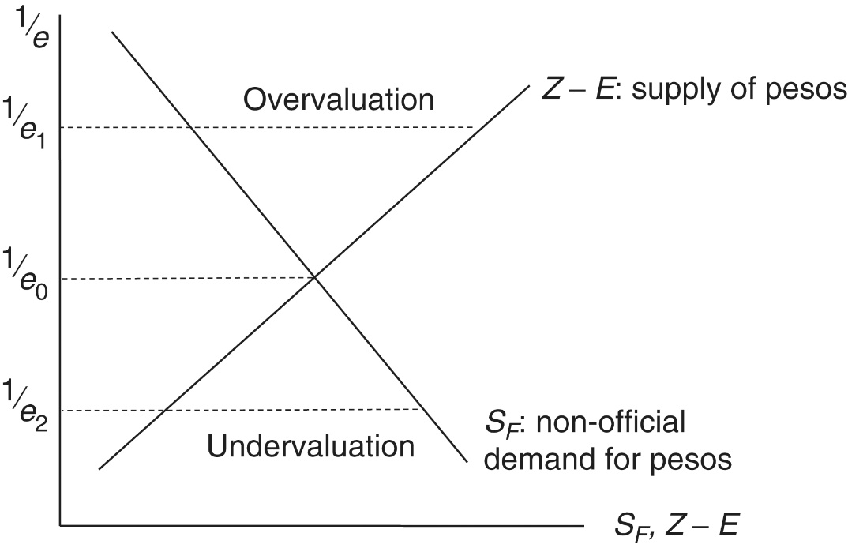
An Assets-Based Model of Fixed Exchange Rates
Suppose that e₀ represents the equilibrium exchange rate under a flexible exchange rate regime: supply of pesos given by the trade deficit Z-E equals the demand for pesos given by foreign savings, S_{F.}
Figure 18.2 The peso market in the assets-based model

Slide 13
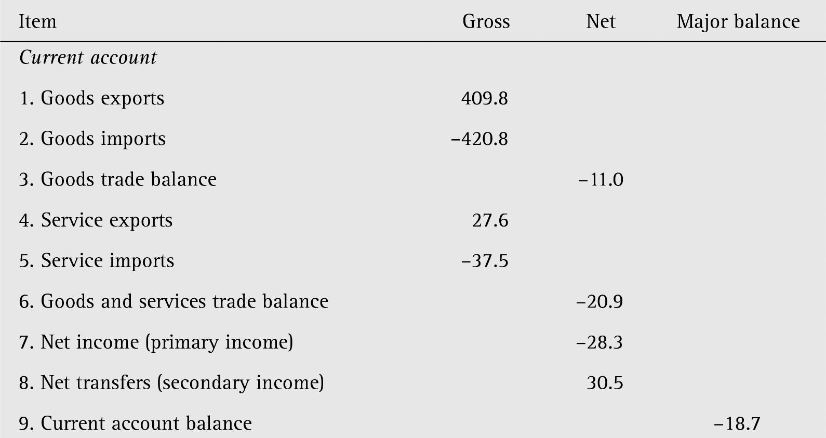
Table 18.4 Mexican simplified balance of payments, 2017 (US$ billions)
supply of peso

Slide 14

Table 18.4 Mexican simplified balance of payments, 2017 (US$ billions)
demand for peso

Slide 15
An Assets-Based Model of Fixed Exchange Rates
Suppose that the Mexican government chooses to fix the exchange rate at e₁
  The value of the peso, 1/e₁, is therefore above the equilibrium value of the peso, 1/e₀
  This situation is known as an overvaluation of the peso
An overvaluation of the peso implies an excess supply of pesos or an excess demand for dollars
The additional demand for pesos or supply of dollars can come from three sources (Table 18.4)
  positive net income (item 7)
  positive net transfers (item 8)
  positive net official reserve transactions (item 14) or drawing down foreign reserves

Slide 16
An Assets-Based Model of Fixed Exchange Rates
Suppose that the Mexican government chooses to fix the exchange rate at e₂
  The value of the peso, 1/e₂, is therefore below the equilibrium value of the peso, 1/e₀
  This situation is known as an undervaluation of the peso
An undervaluation of the peso implies an excess demand for pesos or an excess supply of dollars
The additional supply of pesos or demand for dollars can come from three sources (Table 18.4)
  negative net income (item 7)
  negative net transfers (item 8)
  negative net official reserve transactions (item 14) or building up foreign reserves

Slide 17
An Assets-Based Model of Fixed Exchange Rates
To summarize
Overvaluation ⇒ Excess supply of pesos (demand for dollars) ⇒ Central bank draws down foreign reserves
Undervaluation ⇒ Excess demand for pesos (supply of dollars) ⇒ Central bank builds up foreign reserves

Slide 18
Interest Rates and Exchange Rates
Another approach to maintaining a fixed exchange rate is to affect the equilibrium exchange rate
We can analyze this by using the interest rate parity condition
Suppose that the Mexican government successfully ensures that a fixed rate 1/e₃ is an equilibrium rate
  This implies that e₃ = e^{e}
  Therefore r_{m} = r_{US}

Slide 19
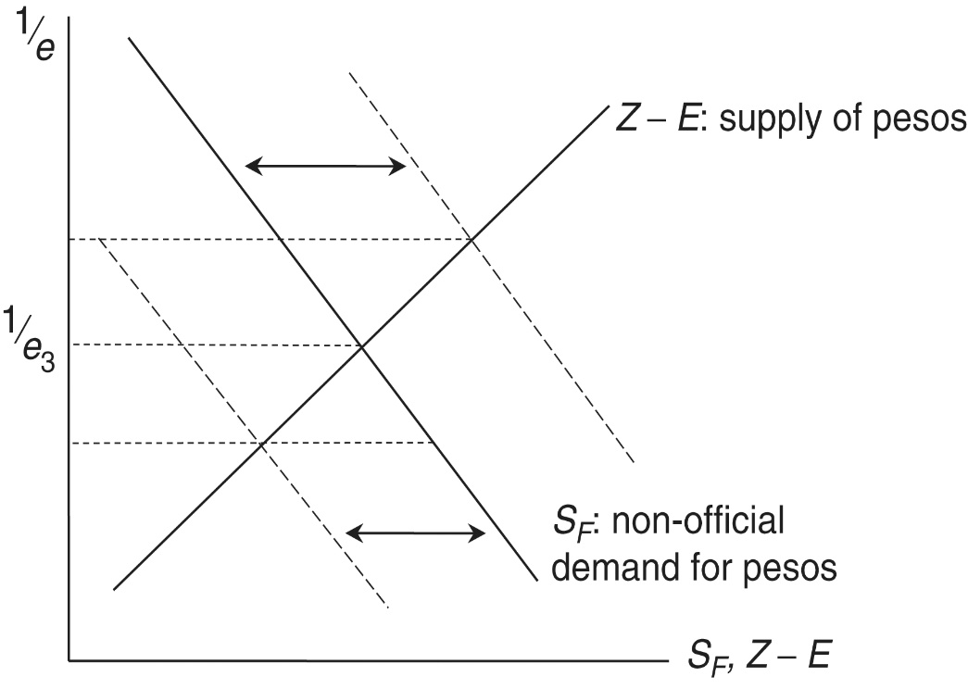
Interest Rates and Exchange Rates
  By increasing or decreasing r_{m} into equality with r_{US}, the Mexican government can move the S_{F} graph in Figure 18.3 to the left or right until the equilibrium e and e₃ are identical
Figure 18.3 An equilibrium fixed exchange rate

Slide 20
Interest Rates and Exchange Rates
  If a home country wants to maintain an equilibrium fixed exchange rate, it must set its interest rate equal to that prevailing in the foreign country whose currency serves as a peg for the home country currency
  In practice, fixed exchange rates are maintained with combinations of net income, net transfers, official reserve transactions, and interest rates. → Both figure 18.2 and 18.3 are relevant.
The farther a fixed exchange rate is from the equilibrium exchange rate, the more difficult it is to maintain for an extended period of time → the issue of the credibility of fixed exchange rates.

Slide 21
The Role of Credibility
Expectations regarding the future exchange rate can be volatile and subject to a host of economic and political events
If a fixed exchange rate comes under pressure from an incipient fall in demand (shift of S_{F} to the left), this pressure must be alleviated via an increase in the home-country interest rate
There are two difficulties here
  Increases in interest rates are recessionary in that they suppress domestic investment
  Increases in interest rates can potentially play havoc in fragile domestic financial systems, particularly when capital can leave the country in the form of capital flight

Slide 22
The Role of Credibility
Investors know what the potentially-negative impacts of an interest rate can be, and this information feeds back into expectations
If investors begin the question the willingness and ability of the home country government to defend the fixed peg with interest rate increases, the expected rate of depreciation again becomes positive and the peg is no longer credible

Slide 23
The Impossible Trinity
In the realm of international finance, countries would ideally like to pursue three desired objectives (the trinity)
  Monetary independence: the ability to conduct an independent monetary policy with an eye to stabilizing the domestic macroeconomic policy
  Exchange rate stability: the ability to avoid destabilizing volatility in the nominal exchange rate
  Capital mobility: the ability to take advantage of flows on the direct and portfolio capital accounts from foreign savings
As it turns out, countries must sacrifice one of the above desired objectives in order to achieve the other two
The impossible trinity is illustrated in Figure 18.4

Slide 24
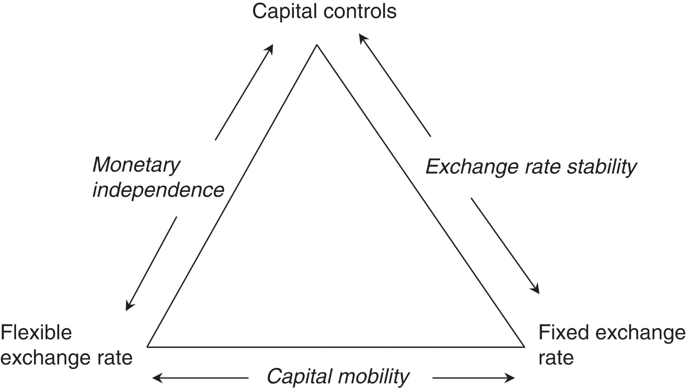
Figure 18.4: The Impossible Trinity

Slide 25
The Impossible Trinity
Suppose a country wants to maintain both capital mobility and exchange rate stability
  The country must sacrifice its independent monetary policy
Suppose a country wants to maintain both capital mobility and monetary independence
  The country must sacrifice exchange rate stability
Suppose a country wants to maintain both monetary independence and exchange rate stability
  The country must sacrifice capital mobility
Countries must give up one desired objective (monetary independence, exchange rate stability, or capital mobility) to attain the other two

Slide 26
Currency Boards
Currency boards are a fixed exchange rate regime with two characteristics
  The fixed rate is presented as an inviolable commitment with legal backing in domestic legislation
  The central bank serving as the currency board fully backs up it base money (cash and commercial bank reserves) with foreign reserves stands ready to exchange the domestic currency and the foreign currency in either direction to any such request

Slide 27
Currency Boards
Currency boards are effective ways to establish sound currencies and to limit excessive money creation that can fuel inflation.
It is not clear, however, how useful currency boards are in the long run.
The most well-known example of a currency board was the Convertibility Plan of Argentina in place between 1991 and 2001 and ending in a crisis
The usefulness of currency boards seems to be limited to certain small and very open economies

Slide 28
A Role for Fixed Rates?
Fixed exchange rates seem to run counter to most of the logic of basic economics, in which prices are supposed to move in response to changing conditions. Is there any reason to view fixed exchange rates as a potentially fruitful policy?
One potential reason is macroeconomic management. If countries experience high rates of inflation, perhaps even hyperinflation (e.g. Zimbabwe and Venezuela), it might be a good idea to take away their independent monetary policy and place them in a hard peg/currency board straitjacket.

Slide 29
A Role for Fixed Rates?
Floating exchange rates can facilitate balance of payments adjustment through real exchange rate flexibility, make countries less susceptible to crises, and help countries weather macroeconomic shocks that occur abroad.
Despite these advantages of flexible exchange rates, fixed exchange rates have been and continue to be a chosen regime for many countries. Some countries choose to band together into a monetary union, whereby the exchange rate is fixed by the adoption of a single currency (such as the euro).

Slide 30
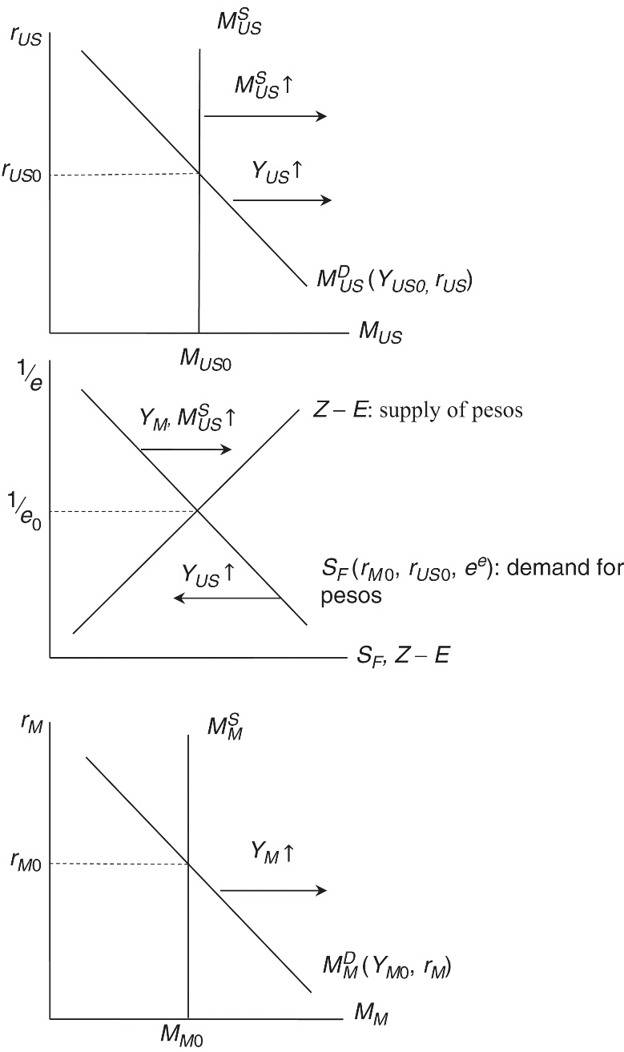
Appendix 18.1: Monetary Policies and Fixed Exchange Rates
Monetary polices in fixed exchange rate regimes can be understood with reference to Figure 18.5
The top diagram of this figure depicts equilibrium in the US money market and determines the interest rate on the dollar
The bottom diagram depicts equilibrium in the Mexican money market and determines the interest rate on the peso
The middle diagram depicts the peso market, being an equilibrium fixed exchange rate
Figure 18.5 Money markets and fixed exchange rates

Slide 31
Appendix 18.1: Monetary Policies and Fixed Exchange Rates
If income in Mexico (Y_{M}) increased
  This would increase r_{M} and the demand for pesos
  In order to prevent an appreciation of the peso, the Mexican central bank would need to increase the supply of pesos
If income in the United States (Y_{US}) increased
  This would increase r_{US} and decrease the demand for pesos
  In order to prevent a depreciation of the peso, the Mexican central bank would need to decrease the supply of pesos
If money supply (M^{S}_{US}) in the United States increased
  This would decrease r_{US} and increase the demand for pesos
  In order to prevent an appreciation of the peso, the Mexican central bank would need to increase the supply of pesos

Slide 32
Monetary Policies
In each of the above three cases, the Mexican government must stand ready to buy and sell pesos at to meet any excess supply or demand for pesos and, thereby, maintain the fixed exchange rate.
Under a fixed exchange rate regime, a country cannot pursue monetary policy independently of the rest of the world such as with an eye to stabilizing its own macro-economy
  Instead the monetary policy is committed to keeping the exchange rate fixed
A country with a fixed exchange rate can control its interest rate or its exchange rate, but not both

