Slide 1
Chapter 17: Flexible Exchange Rates
An Introduction to International Economics: New Perspectives on the World Economy

Slide 2
Analytical Elements
Countries
Currencies
Financial assets

Slide 3
Introduction
Forces of supply and demand in currency markets determine exchange rate
What makes a flexible exchange rate move one way or another?
This chapter develops a model of how the nominal exchange rate is determined in currency markets
Will first consider a trade-based model
Nominal exchange rate is determined by currency transactions arising from imports and exports
Will extend model to account for exchange of assets in an assets-based model

Slide 4
A Simple Model of Exchange Rate Determination
A simple supply-and-demand model
Any positive transaction or inflow on the balance of payments for Mexico generates a demand for pesos.
Any negative transaction or outflow generates a supply of pesos.
In this way, the balance of payments is linked to currency markets.
We consider the case of a flexible exchange rate regime
Table 17.1 Exchange rate terminology
Case | e | Value of Peso | Term
Flexible e | ↑ | ↓ | Depreciation
Flexible e | ↓ | ↑ | Appreciation

Slide 5
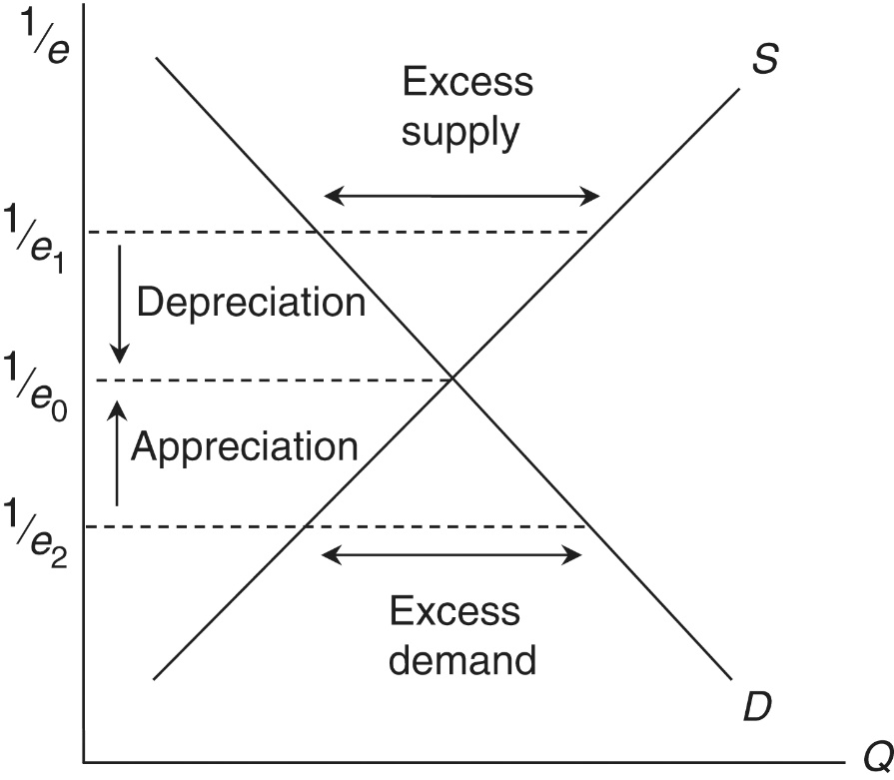
A Simple Model of Exchange Rate Determination
At $1/{e_{1}}$, there is an excess supply of pesos
→ depreciation of the peso
At $1/{e_{2}}$, there is an excess demand of pesos
→ appreciation of the peso
At $1/{e_{0}}$, the demand for and supply of pesos are the same
→ $1/{e_{0}}$ is the equilibrium value of the peso, and $e_{0}$ is the equilibrium nominal exchange rate.
Figure 17.1 The peso market

Slide 6
A Trade-Based Model
Begin with one form of the fundamental accounting equations
Foreign Savings = Trade Deficit
Rewrite this relationship using symbols
S_{F} (foreign savings) = Z (imports) - E (exports) or S_{F} = (Z - E)
Use Mexico as home country and United States as foreign country
S_{F} (foreign savings) ⇔ demand for pesos (supply of dollars)
Z − E (trade deficit) ⇔ supply of pesos (demand for dollars)

Slide 7
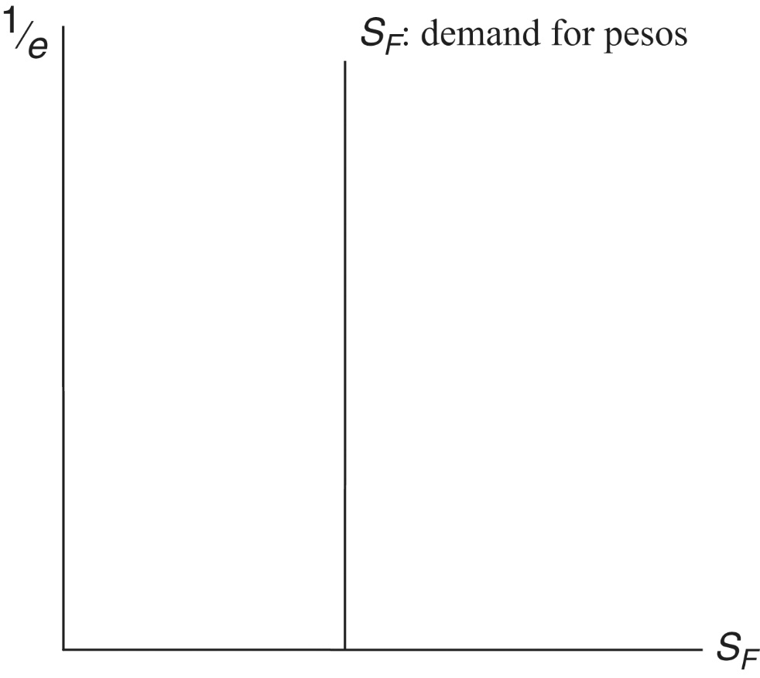
Figure 15.1: The Demand for Pesos
S_{F} is foreign savings
Savings supplied by US residents who buy Mexican assets
S_{F} is a demand for pesos (supply of dollars) by US
Assume that demand is invariant with respect to value of peso
Gives us the perfectly inelastic demand for pesos curve shown in Figure 17.2
Figure 17.2 The demand for pesos

Slide 8
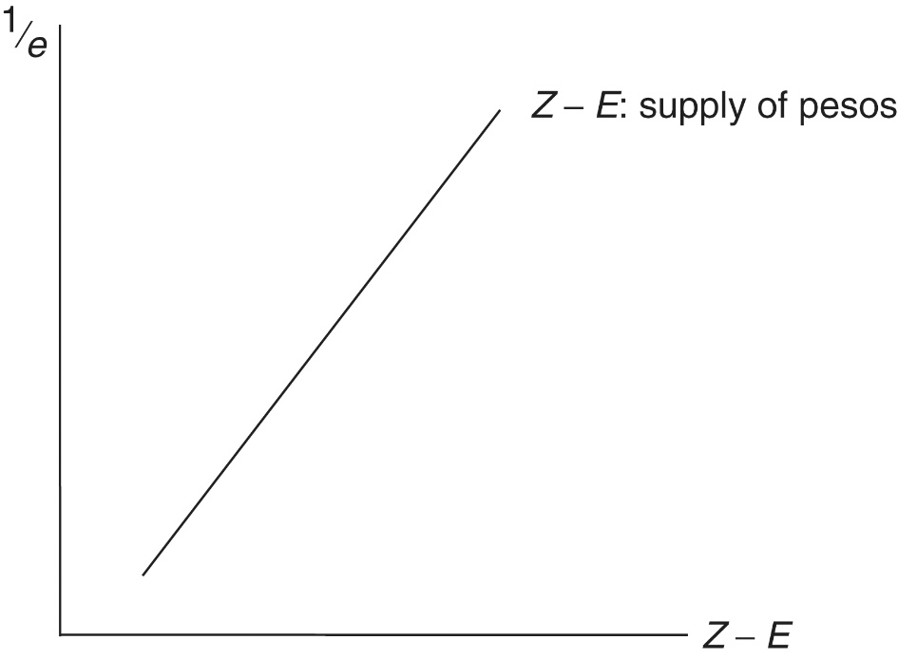
Trade-Based Model: Supply of Pesos
Z - E is the trade deficit
Net demand for US goods by Mexico
A supply of pesos (demand for dollars) by Mexico
Z has a positive relationship to value of peso
E has a negative relationship to value of peso
Thus Z-E has a positive relationship to value of peso
Shown in Figure 17.3
Figure 17.3 The supply of pesos

Slide 9
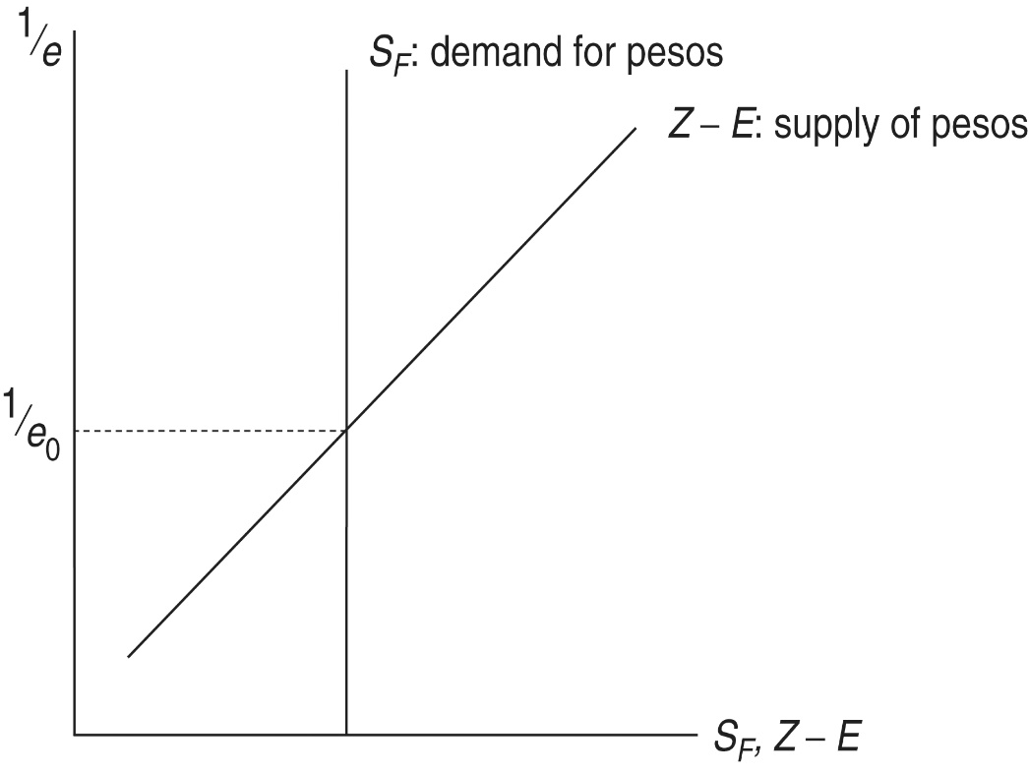
The Peso Market
Combining the demand for pesos and supply of pesos together gives Figure 17.4
$1/{e_{0}}$ is the equilibrium value of the peso, and $e_{0}$ is the equilibrium nominal exchange rate
Figure 17.4 The peso market

Slide 10
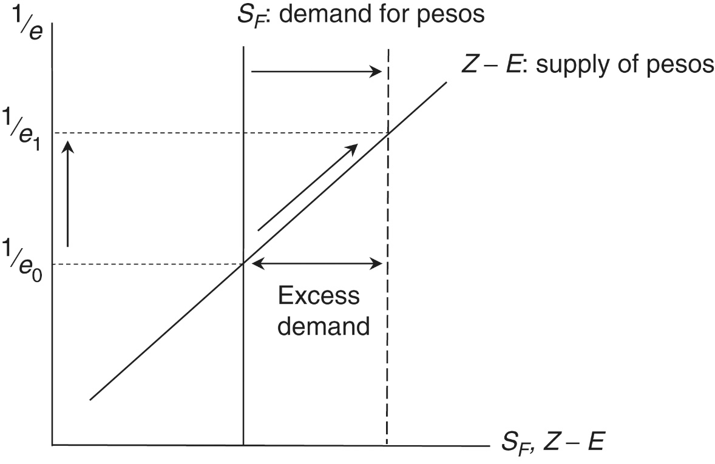
Capital Inflows and the Peso Market
We can use the trade-based model of Figure 17.4 to analyze capital inflows in Figure 15.4
An inflow of capital in the form of foreign savings shifts the S_{F} curve to the right
This causes an excess demand for pesos at 1/e₀
The value of the peso will begin to increase towards 1/e₁
That is, there will be an appreciation of the peso
The trade deficit will expand along the (Z - E) graph
Figure 17.5 Capital inflows and the peso market

Slide 11
An Assets-Based Model
Views foreign currency transactions as arising from the buying and selling of foreign-currency-denominated assets, rather than from trade flows
Focuses on foreign savings rather than on trade deficit in the S_{F} = Z - E relationship
Pretend you are a Mexican investor, deciding upon the allocation of your wealth portfolio between two assets
A peso-denominated asset
A dollar-denominated asset
Assume both assets to be open-ended mutual funds with fixed domestic-currency prices
You will allocate your portfolio with an eye to rates of return of alternative assets

Slide 12
An Assets-Based Model
In the case of peso-denominated assets, return you obtain is the interest rate, or r_{M}
Total expected return on the peso-denominated asset is
$R_{M}^{e}=r_{M}$
Since you are a Mexican investor, dollar-denominated assets are a bit more complicated—you must consider
The interest rate or $r_{US}$
The exchange rate

Slide 13
An Assets-Based Model
Suppose that the initial exchange rate is e₁ = 1.0
At this exchange rate, you purchase a dollar-denominated asset worth $1,000 and therefore 1,000 pesos
Suppose that the peso depreciates so that the new exchange rate is e₂= 1.1
The $1,000 asset has increased in value to 1,100 pesos
→ Depreciation of the peso causes a capital gain on the dollar-denominated asset in peso terms

Slide 14
An Assets-Based Model
At any point in time, you have your expectation of what exchange rate will be in the future, or e^{e}
Your expected rate of depreciation of the peso is
Your expected total rate of return on dollar-denominated assets is the sum of the interest rate and the expected rate of depreciation of the peso

Slide 15
An Assets-Based Model-Portfolio Allocation
Suppose the expected total rate of return on peso-denominated assets exceeds the expected total rate of return on dollar-denominated assets
You reallocate your portfolio towards peso-denominated assets, selling dollars and buying pesos
Suppose the expected total rate of return on dollar-denominated assets exceeds the expected total rate of return on peso-denominated assets
You reallocate your portfolio towards dollar-denominated assets, selling pesos and buying dollars
Suppose the expected total rate of return on peso- and dollar-denominated assets are the same
You keep your portfolio as it is

Slide 16
Interest Rate Parity Condition
Whenever $R_{M}^{e}$ and $R_{US}^{e}$ are not equal, there will be reason for you to reallocate your portfolio
Therefore, equilibrium in the foreign exchange market requires that $R_{M}^{e}$ = $R_{US}^{e}$
This gives us the interest rate parity condition
Equilibrium in the foreign exchange market requires that the interest rate on peso deposits equals the interest rate on dollar deposits plus the expected rate of peso depreciation

Slide 17
Interest Rate Parity Condition
We are going to consider the interest rate parity condition in terms of the peso market in Figure 17.4
Suppose that $R_{M}^{e}$ = $R_{US}^{e}$
Then the value of the peso increases or e falls
For a given expected future exchange rate e^{e}, as e falls, the expected future depreciation increases
Now $R_{US}^{e}$ > $R_{M}^{e}$ and investors switch into dollar-denominated assets
Foreign savings (S_{F} ) or the asset-based demand for pesos declines
This gives us the downward-sloping demand curve for pesos in Figure 17.6

Slide 18
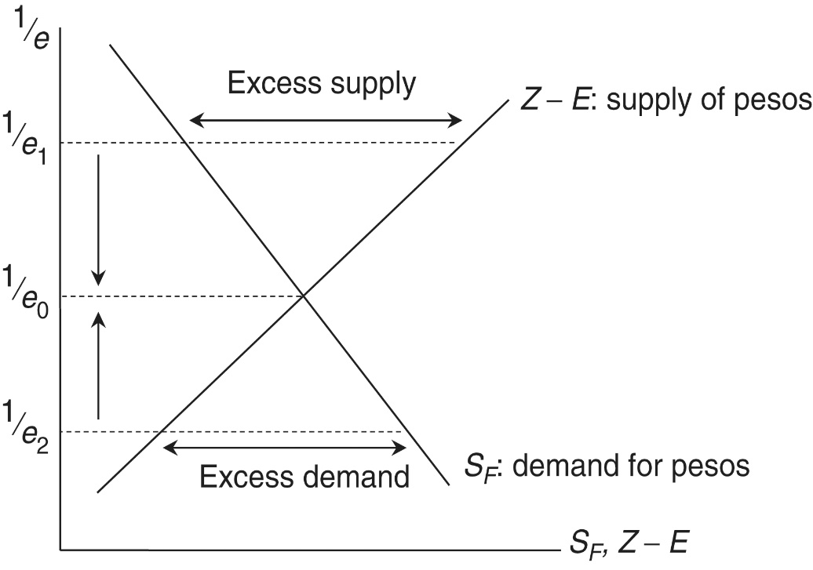
Adjustment in the Peso Market
At 1/e₁ in Figure 17.6, the supply of pesos exceeds the demand for pesos
The value of the peso falls
The trade deficit falls
Foreign savings increases as the expected rate of depreciation of the peso falls
At 1/e₂, the demand for pesos exceeds the supply of pesos
The value of the peso rises
The trade deficit increases
Foreign savings deceases as the expected rate of depreciation of the peso rises
At 1/e₀, the peso market is in equilibrium
Figure 17.6 An assets-based view of the peso market

Slide 19
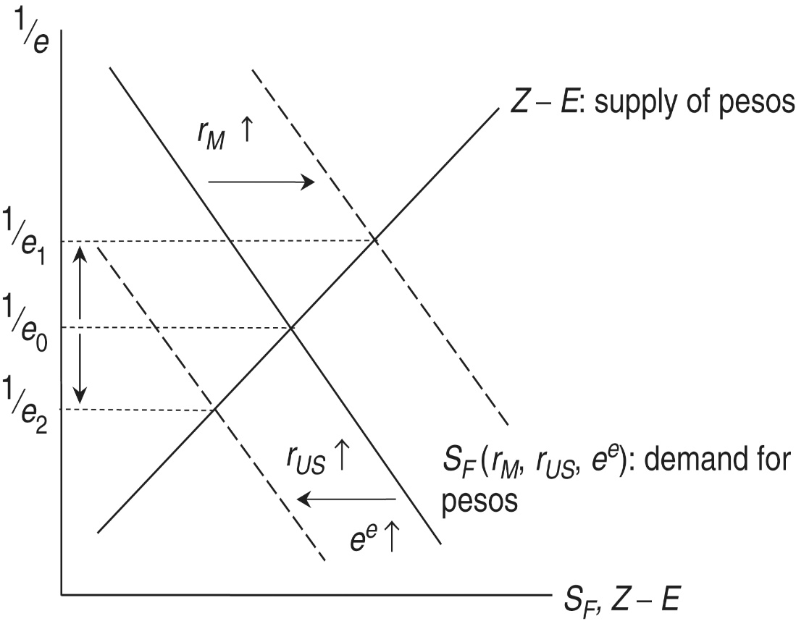
Interest Rates and Expectations
In the interest rate parity condition, changes in r_{m} and r_{US} shift the demand for peso graph
An increase in r_{M} increases the total expected rate of return on peso-denominated assets
The demand curve for pesos shifts to the right and the value of the peso increases
Figure 17.7 Interest rates and the peso market

Slide 20
Interest Rates and Expectations
An increase in r_{US} increases the total expected rate of return on dollar-denominated assets
The demand curve for pesos shifts to the left and the value of the peso decreases
An increase in e^{e} increases the total expected rate of return on dollar-denominated assets
The demand curve for pesos shifts to the left and the value of the peso decreases
Figure 17.7 Interest rates and the peso market

Slide 21
Table 17.2: Changes in Currency Markets
Change | Effect on S_{F} curve | Effect on value of home currency (1/e) | Term
Increase in home-country interest rate | Shifts to right | Increases | Appreciation
Increase in foreign-country interest rate | Shifts to left | Decreases | Depreciation
Increase in expected future home-country exchange rate | Shifts to left | Decreases | Depreciation

Slide 22
Covered vs. Uncovered Interest Rate Parity
The interest rate parity condition comes in two varieties, expressed here in terms of home (H) and foreign (F)
Uncovered interest rate parity (UIP)
$r_{H}=r_{F}+\frac{\left(e^{e}−e\right)}{e}$
Covered interest rate parity (CIP)
$r_{H}=r_{F}+\frac{\left(e^{f}−e\right)}{e}$
CIP is considered to hold more or less exactly, since traders make use of forward rates (e^{f})
The empirical question is whether UIP also holds or whether expected rates (e^{e}) are equal to forward rates (e^{f})

Slide 23
Appendix 17.1: Monetary Policies and the Nominal Rate
We can analyze the influence of monetary polices on short term nominal exchange rates using the Keynesian theory of money demand
The money demand function is
$M^{D}=L\left(Y,r\right)$
Money demand is positively related to income (Y)
The greater is Y, the greater the transactions demand for money
Money demand is negatively related to the interest rate (r)
The greater is r, the greater is the opportunity cost of holding money

Slide 24
Appendix 17.1: Monetary Policies and the Nominal Rate
We assume that money supply (M^{S}) is set by the central bank or treasury
Money demand and money supply are represented in Figure 17.8
An increase in money supply (an expansionary monetary policy) lowers the interest rate as in Figure 17.9
The interest rate falls to increase the demand for money and remove the initial excess supply of money

Slide 25
Figure 17.8: The Money Market

Slide 26
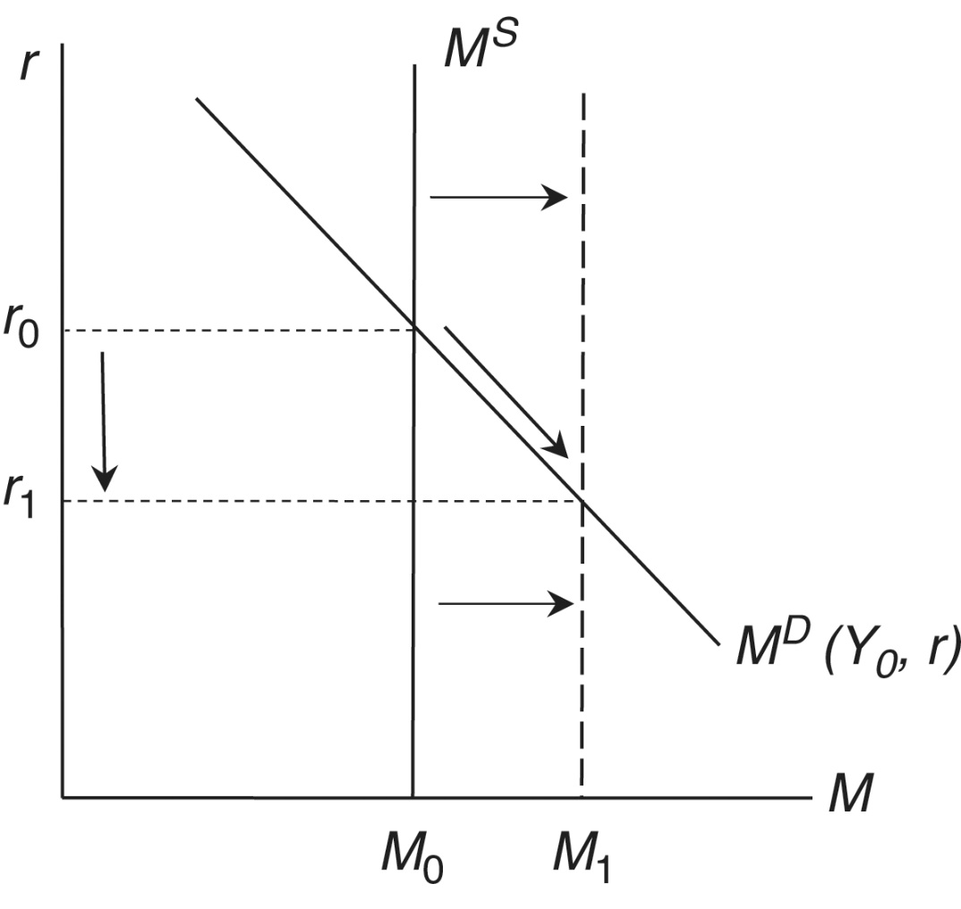
Figure 17.9: An Expansionary Monetary Policy

Slide 27
Appendix 17.1: Monetary Policies and the Nominal Rate
In order to analyze the effect of monetary policies on nominal exchange rates, we combine our assets-based diagram (Figure 17.6) with money market diagrams for Mexico and the United States
This is done in Figure 17.10

Slide 28
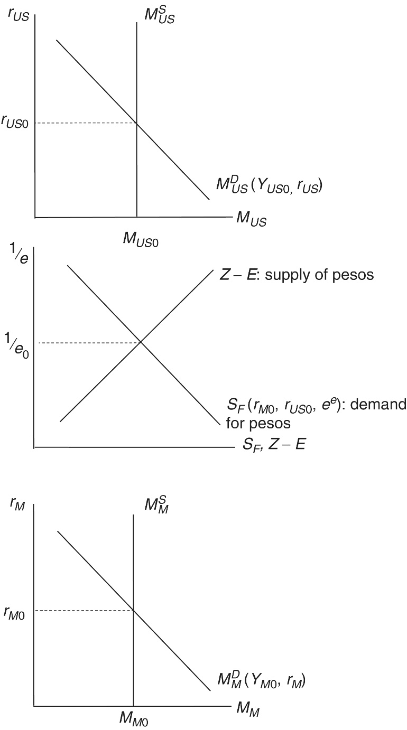
Figure 17.10: Money Markets and Exchange Rate Determination
The top diagram depicts the equilibrium in the US money market, which determines the interest rate on the dollar
The bottom diagram depicts the equilibrium in the Mexican money market, which determines the interest rate on the peso
The middle diagram determines the exchange rate

Slide 29
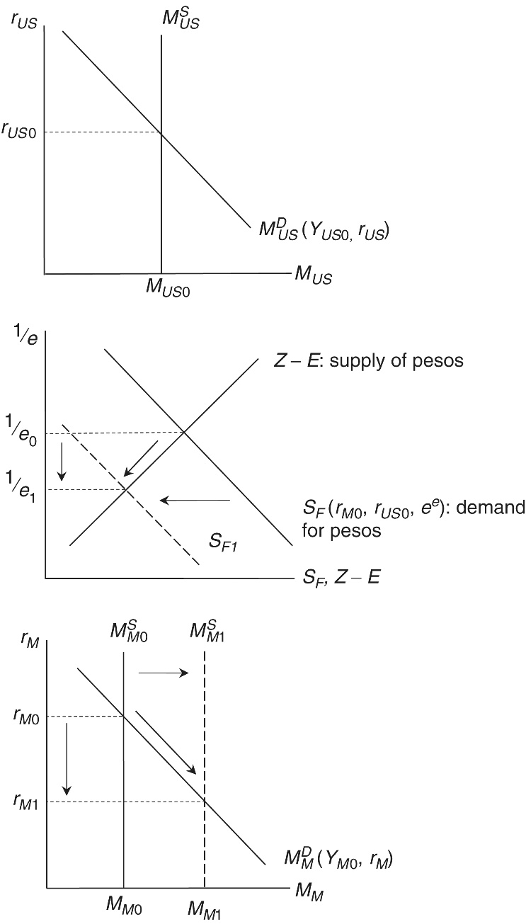
Expansionary Monetary Policy in Mexico (Home Country)
In the Mexican money market diagram, the increase in the money supply causes an excess supply of pesos and a fall of r_{M}
The lower r_{M} means that the expected total rate of return on peso-denominated assets is now less than the expected total rate of return on dollar-denominated assets
Investors sell pesos and buy dollars, which causes the demand for pesos graph to move to the left
As a result of this decrease in the demand for pesos, the value of the peso falls
In other words, there is a depreciation of the Mexican peso
Figure 17.11 Expansionary monetary policy in Mexico (the home country)

Slide 30
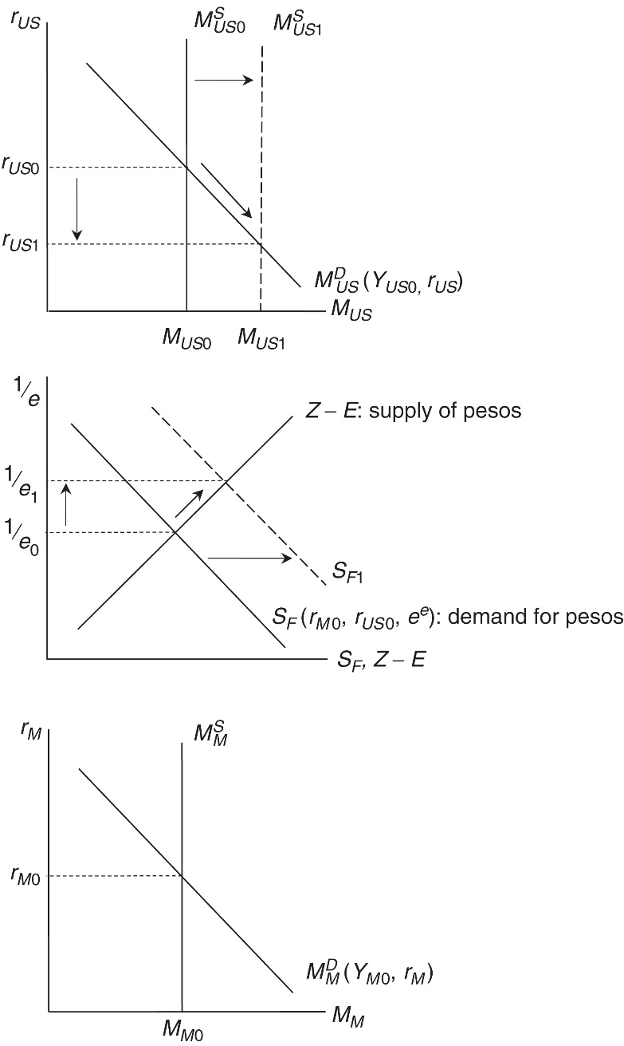
Expansionary Monetary Policy in the United States (Foreign Country)
In the US money market diagram, the increase in the money supply causes an excess supply of dollares and a fall of r_{US}
The lower r_{US} means that the expected total rate of return on dollar-denominated assets is now less than the expected total rate of return on peso-denominated assets
Investors sell dollars and buy pesos, which causes the demand for pesos graph to move to the right
As a result of this increase in the demand for pesos, the value of the peso rises
In other words, there is an appreciation of the Mexican peso
Figure 17.12 Expansionary monetary policy in the US (the foreign country)

