Slide 1
Chapter 16: Exchange Rates and Purchasing Power Parity
An Introduction to International Economics: New Perspectives on the World Economy

Slide 2
Analytical Elements
Countries
Currencies
Financial assets
© Kenneth A. Reinert,
Cambridge University Press 2021

Slide 3
Introduction
Exchange rates matter in many different ways to many different constituencies in the world economy
Much of this section on international finance will be directly or indirectly concerned with exchange rates
Two important exchange rate definitions:
Nominal exchange rate
Real exchange rate
A first model of exchange rate determination
The purchasing power parity model (PPP model)
Relationship of exchange rates and trade flows:
Spot rates vs forward rates
Exchange rate exposure
Price level
Monetary approach to exchanger rate determination

Slide 4
The Nominal Exchange Rate
Relative price of two currencies
Often expressed as number of units of local or home currency required to buy a unit of foreign currency
We will take Mexico (peso) as our home country and United States (dollar) as our foreign country
Nominal or currency exchange rate (e) is defined as
Or

Slide 5
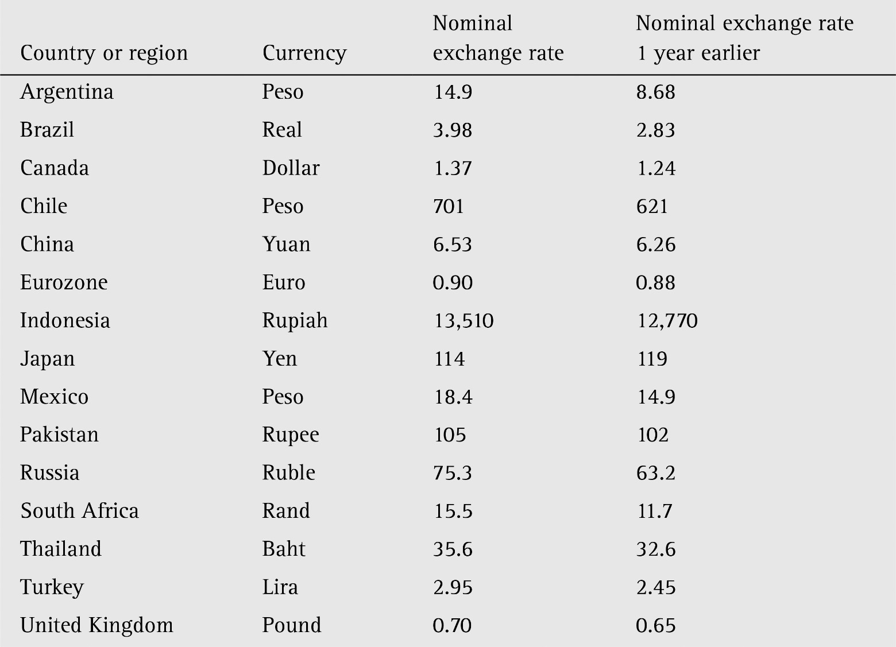
Table 16.1 Nominal exchange rates, February 17, 2016 (per US dollar)
Source:
www.economist.com

Slide 6
The Nominal Exchange Rate
If e increases the value of the peso (home currency) falls
If e decreases the value of the peso (home currency) rises
Since e and the value of the peso are inversely related, e is often graphed as its inverse which is equal to the value of the peso
This is done in Figure 16.1
It is important when looking at exchange rate data to be aware of which country is the home country
Figure 16.1 The value of the peso scale

Slide 7
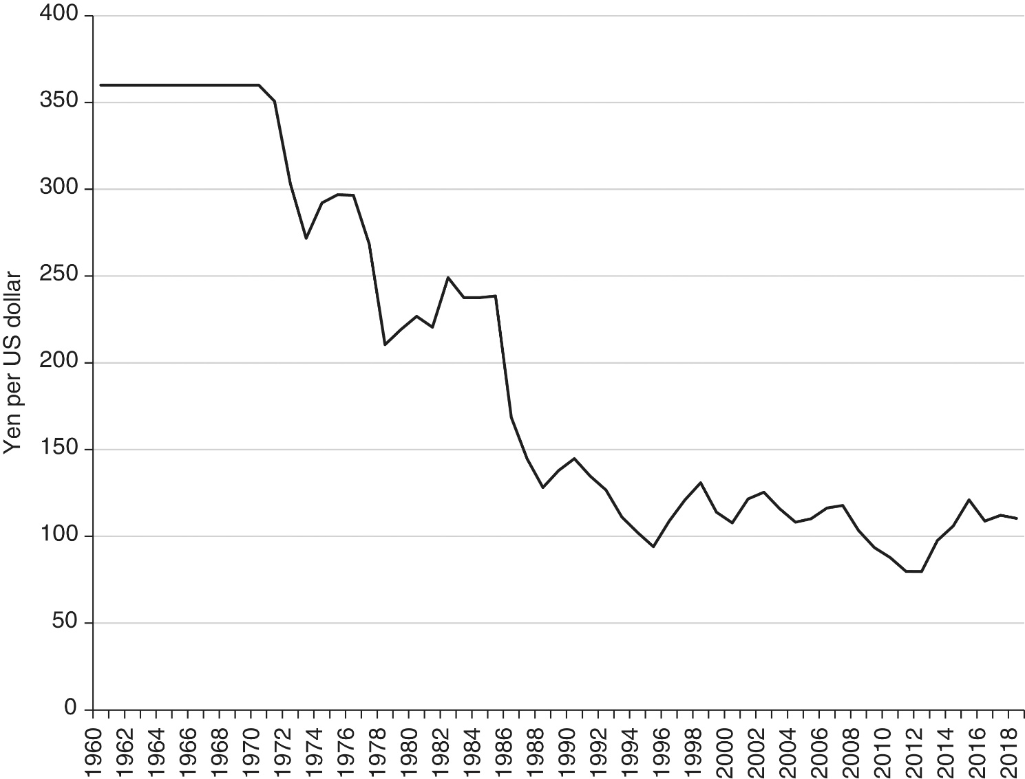
Figure 16.2 The yen/dollar nominal exchange rate, 1960–2016

Slide 8
The Real Exchange Rate
Nominal exchange rate: The rate at which two countries’ currencies trade against each other.
Real exchange rate: The rate at which two countries’ goods and services trade against each other.
The real exchange rate makes use of the price levels in the two countries under consideration

Slide 9
The Real Exchange Rate
Measures the rate at which two countries’ goods trade against each other
Makes use of the price levels in the two countries under consideration
P^{M}—overall price level in Mexico (the home country)
P^{US}—overall price level in the United States (the foreign country)

Slide 10
Table 16.2: Changes in the Real Exchange Rate
Change | Intuition | Effect in “re” equation
P^{US} increases | US goods increase in price. Therefore, it takes more Mexican goods to buy a unit of US goods. The real value of the peso has fallen. | Because it is in the numerator, the increase in P^{US} increases the value of re.
P^{M} increases | Mexican goods increase in price. Therefore, it takes fewer Mexican goods to buy a unit of US goods. The real value of the peso has risen. | Because it is in the denominator, the increase in P^{M} decreases the value of re.
e increases | It takes more Mexican pesos to buy US dollars. The real value of the peso has fallen. | The increase in increases the value of re.

Slide 11
Real Effective Exchange Rate
Just as there is an effective exchange rate for the nominal exchange rate, so is there a real effective exchange rate (REER) for the real exchange rate

Slide 12
Purchasing Power Parity
Begins with the hypothesis that the nominal exchange rate will adjust so that the purchasing power of a currency will be the same in every country
The purchasing power of a currency in a given country is inversely related to price level in that country
Therefore, the PPP hypothesis can be stated as

Slide 13
Purchasing Power Parity
The PPP equation can be rearranged as
It can also be arranged as
Here we see that the PPP model is a special case of the real exchange rate being fixed at unity
In reality, though, real exchange rates do change

Slide 14
Interpreting Purchasing Power Parity
The PPP assumes that all goods entering into country price levels are traded
In reality, many goods are non-traded
Currency trading is also dominated by financial asset considerations rather than trade considerations
The PPP is useful to get a sense of the long-term tendency towards which nominal exchange rates move absent other changes

Slide 15
Exchange Rates and Trade Flows
Changes in e have an impact on trade flows
Consider the case of Mexico’s imports and exports
World prices (P^{W}) are typically in US dollar terms
Mexican prices (P^{M}) are in peso terms
Relationship between the peso and world prices of Mexico’s import (Z) goods can be expressed as
Relationship between the peso and dollar prices of Mexico’s exported (E) goods can be expressed as

Slide 16
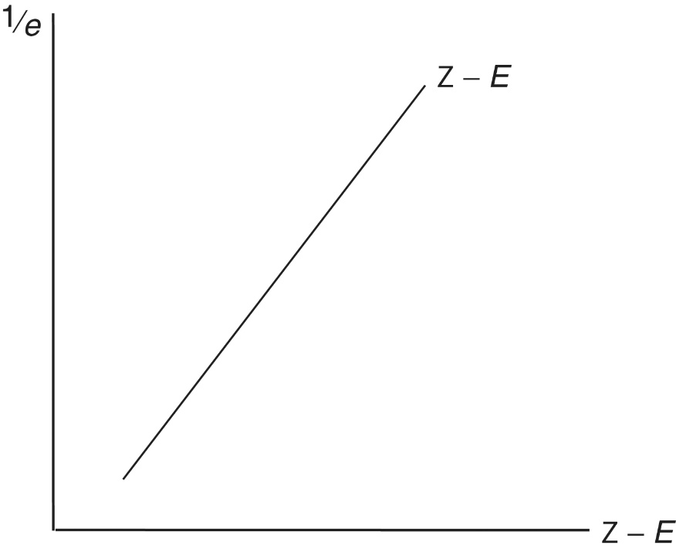
Exchange Rates and Trade Flows
Suppose e were to increase (the value of the peso falls)
Movement down the scale increases the peso price of the imported good in Mexico
Import demand consequently decreases
Suppose e were to decrease (the value of the peso rises)
Movement up the scale decreases the peso price of the imported good in Mexico
Import demand consequently increases
Figure 16.3: The Value of the Peso and Mexico’s Trade Deficit

Slide 17
Exchange Rates and Trade Flows
Suppose e were to increase (the value of the peso falls)
Movement down the increases the peso price of the export good in Mexico
Export supply in Mexico consequently increases
Suppose e were to decrease (the value of the peso rises)
Movement up the inverse scale decreases the peso price of exports in Mexico
Export supply consequently decreases
Figure 16.3: The Value of the Peso and Mexico’s Trade Deficit

Slide 18
Exchange Rates and Trade Flows
As seen in Figure 16.3, the relationship between exchange rates and trade flows is important in its own right as a link between the international trade and international finance windows of the world economy

Slide 19
Hedging and Foreign Exchange Derivatives
Firms enter foreign markets via contracting and foreign direct investment
If the sales from any of these market-entry strategies are not denominated in the currencies of the firms’ home-base countries, issues of exchange rate exposure arise

Slide 20
Hedging and Foreign Exchange Derivatives
Suppose that the €/US$ exchange rate is currently at a value of 1.00. Suppose also that a US firm is expecting euro revenues of €1.0 million.
Given the current exchange rate, known as a spot rate, the US firm might be expecting dollar revenues of US$1.0 million.
Suppose, however, that the euro weakens, and the spot rate moves to = 1.25 (a dollar value of the euro of $0.80).
It now takes more euros to purchase a dollar, and the dollar revenues shrink to $800,000

Slide 21
Foreign Exchange Derivatives
Table 16.3 distinguishes among four types of foreign exchange derivatives
Forward contracts
Foreign exchange swaps
Currency swaps
Options
Figure 16.4 plots these types of derivatives using data from the Bank of International Settlements

Slide 22
Table 16.3: Foreign Exchange Derivatives
Derivative type | Explanation
Forward contracts | Two parties agree on a foreign exchange transaction to take place at a specified, future date.
Foreign exchange swaps | Two parties exchange currencies for a specified length of time after which the currency exchange is reversed.
Currency swaps | Two parties exchange interest payments in different currencies for a specified period of time and then exchange principals at a specified maturity date.
Options | A party purchases the right to exchange one currency for another at a specified, future date and at a specified rate.

Slide 23
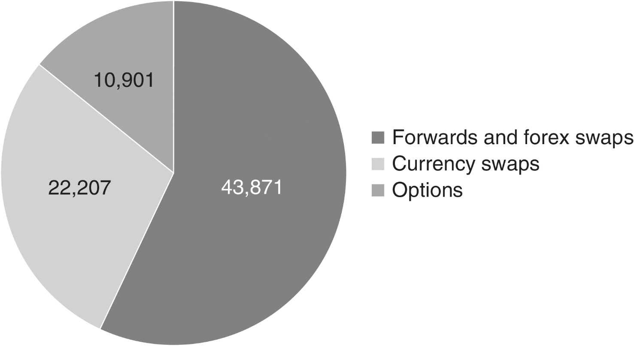
Figure 16.4: Foreign Exchange Derivatives
Source: Bank for International Settlements

Slide 24
Hedging
Foreign exchange derivates are financial instruments that have the effect of “locking in” a forward exchange rate
How can they play a role in hedging exchange rate exposure?
Consider this using the forward rate
If the forward rate of the euro (€/US$) is the same as the spot rate, the euro is said to be “flat”
If the forward rate of the euro is above the spot rate, the euro is said to be at a “forward discount”
Finally, if the forward rate of the euro is below the spot rate, the euro is said to be at a “forward premium”

Slide 25
Hedging
Suppose that we begin with the exchange rate (€/US$) being 1.00 and that a US firm is expecting euro revenues of €1.0 million in six month’s time
Suppose that the euro is at a six-month forward discount of 1.11.
The US firm could take out a forward contract and, at that future time, convert the euro revenue into $900,900 of dollar revenue.

Slide 26
Hedging
Would this be a smart move?
If the firm knew with certainty that the future spot rate were to be 1.25, it would be.
With the forward contract, the firm would earn $900,900 rather than $800,000.
If the future spot rate were actually to be below 1.11, though, it would not be.
The firm could have earned more than $900,900 without the forward contract
Thus hedging exchange rate exposure requires that firms have expectations or forecasts of future spot rates

Slide 27
Appendix 16.1: Price Levels and the PPP Model
Price level
Assumption: Income Y is equal to both the nominal gross domestic product and the nominal gross national income
Any change in Y can be separated into the part due to a change in the number of goods and services (y) and the part due to a change in the prices of goods and services (P)
This measure of the price level is known as the GDP price deflator.
This is the price level measure used in this chapter.

Slide 28
Appendix 16.1: Price Levels and the PPP Model
The real exchange rate equation, involving price levels from two countries, is
$re=e×\frac{P^{US}}{P^{M}}$

Slide 29
Appendix 16.2: The Monetary Approach to Exchange Rate Determination
There is an approach to monetary theory known as monetarism
This concerns the quantity theory of money based on the equation of exchange
Here, M is the money stock, V is the velocity of money, P is the overall price level and y is real GDP
Monetarists add two assumptions to this equation
V is stable (slowly changing)
y is determined by the supply side (slowly changing)

Slide 30
Appendix 16.2: The Monetary Approach to Exchange Rate Determination
This long-run monetarist relationship can be combined with the long-run purchasing power parity (PPP) relationship
This represents the monetary approach to exchange rate determination
e is determined primarily by the money stock ratio, secondarily real output and velocity ratios

