Slide 1
Chapter 15: Global Capital Flows
An Introduction to International Economics: New Perspectives on the World Economy

Slide 2
Analytical Elements
Countries
Currencies
Financial assets

Slide 3
Introduction
Four main types of capital flows:
foreign direct investment,
equity investment,
bond finance,
commercial bank lending
The broad determinants of global capital flows.
Arguments for capital account liberalization, as well as arguments for capital controls

Slide 4
Table 15.1 Types of capital flows

Slide 5
Figure 15.1 Nominal FDI inflows

Slide 6
Foreign Direct Investment
FDI is a critical capital flow that has implications in the realms of international trade, international production, international finance, and international development.
In general, it is considered the “safest” type of capital flow.

Slide 7
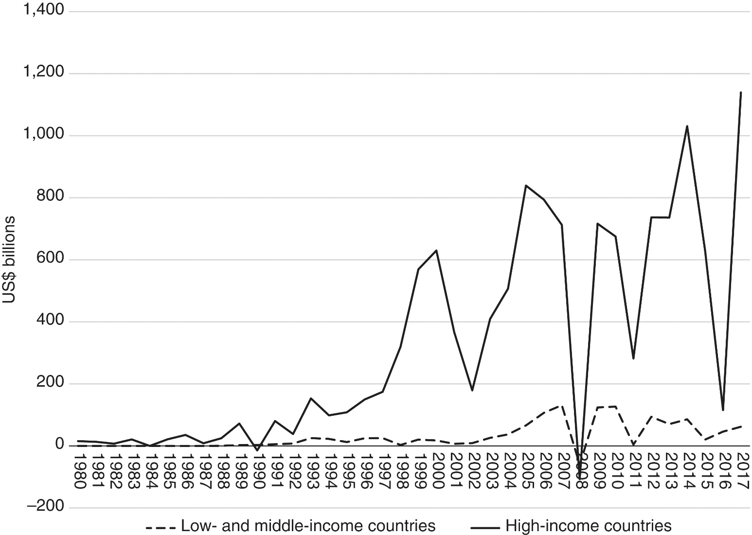
Figure 15.2 Net equity inflows (US$ billions)

Slide 8
Equity Portfolio Investment
Inflows into high-income countries tend to be much larger than into LMICs.
The series also tend to be “spikey,” indicating a certain degree of volatility → known as equity market volatility
Why equity inflows could be useful:
Can supplement domestic savings as a source of capital and be part of a movement away from short-term finance (e.g. bank lending) to long-term finance
Can help provide both an informational mechanism on the performance of firms and an incentive mechanism for firm managers.
However, there is evidence that, when equity markets exist in LMICs, their market capitalization (percentage of GDP) tends to be significantly lower than in high-income countries, limiting these positive effects

Slide 9
Bond Finance
Bond finance involves the international exchange of debt instruments.
There is an important difference, however, between bond finance and the alternative form of debt, commercial bank lending, namely transferability.
Bank loans and bonds can be connected through a process known as “securitization,” which can be an effective means of distributing risks across financial institutions and countries, but in practice, it can increase or concentrate some types of risk.
In the case of firm bankruptcies, debt is usually given priority over equity.
There is an expressed concern that this shifts priority away from equity sales to corporate bond financing.

Slide 10
Bond Finance
There is ample evidence that bond finance is relatively volatile and potentially destabilizing.
Figure 15.3 provides data on inflows of bond finance (along with commercial bank lending) into LMICs.
This tends to be relatively “spikey,” especially during but even after the GFC.
There is also evidence that debt flows (both bond finance and commercial bank lending) are potentially more destabilizing than equity flows, despite that they are often grouped as portfolio investment.
Within bond finance, there is also a need to distinguish between private or corporate bond finance and government bond finance.
There is also an issue in terms of the currency in which bonds are issued.

Slide 11
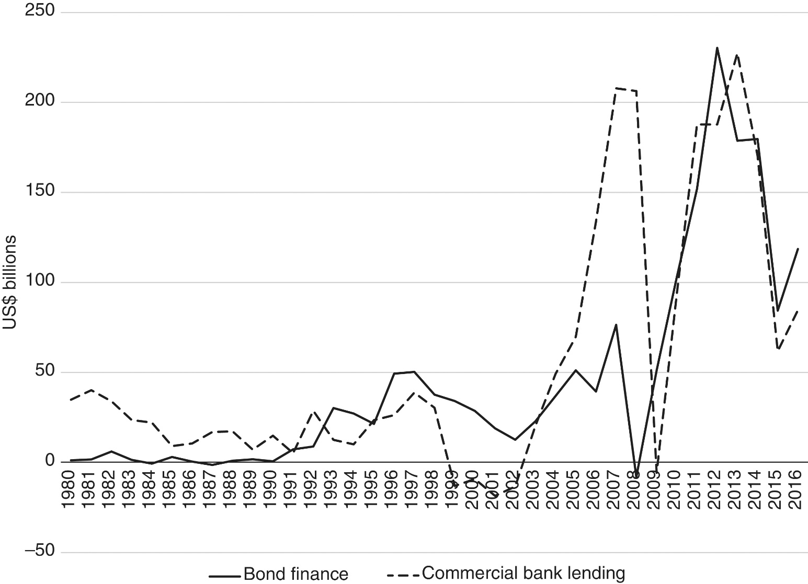
Figure 15.3 Net bond finance and commercial bank lending inflows to low- and middle-income countries, 1980–2016 (US$ billions)

Slide 12
Commercial Bank Lending
Commercial bank lending is a form of debt that does not involve a tradable asset such as bond finance.
It appears as “other investment” in the balance of payments, a label that tends to hide its connection to the banking sector.
Inflows of commercial bank lending into LMICs were illustrated in Figure 15.3, along with bond finance.
Commercial bank lending is even more “spikey” than bond finance.

Slide 13
Net versus Gross Flows
Since the GFC of 2008 researchers have become attuned to an important distinction between net and gross capital flows.
Even with small net balances, there can be large gross flows.

Slide 14
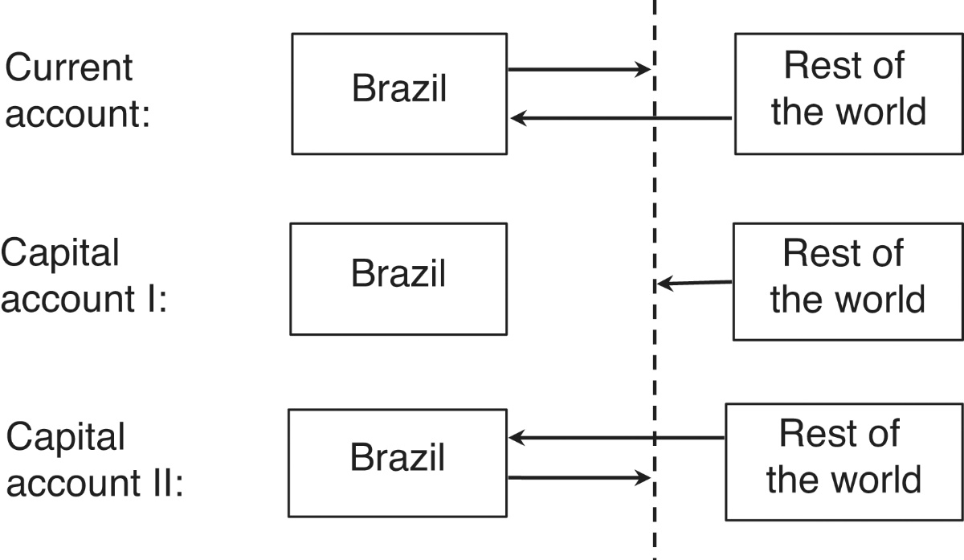
Figure 15.4 Net versus gross flows
In the current account, Brazil has a deficit in its relationship with the rest of the world.
This deficit is equal to the distance from the “Rest of the world” box to the vertical dotted line.
This requires net inflows on the capital account
Possibility 1 (Capital account I): Brazil has capital inflows but no capital outflows.
Possibility 2 (Capital account II): Brazil has much larger capital inflows and also small outflows

Slide 15
Net versus Gross Flows
There is ample evidence that the distinction made in Figure 15.4 is a relevant one.
The “Capital account II” case can be riskier.
Therefore, simply focusing on current account imbalances as a device to assess emerging risks is incomplete.
Monitoring of current accounts needs to be complemented by a monitoring of gross international financial flows and positions.
One focus area here is gross flows in the form of commercial bank lending.
The distinction between net and gross capital flows is related to the concept of intra-industry trade.
Large gross asset flows can be considered as potentially a form of “intra-industry” trade, but in differentiated assets rather than differentiated goods and services.

Slide 16
Determinants of Capital Flows
The literature on global capital flows generally groups flow determinants into “push factors” and “pull factors” that operate at the country level.
Push factors are reasons for capital to leave origin countries
Pull factors are reasons for capital to enter destination countries.
A simplified summary of the two sets of factors are presented in Table 15.2

Slide 17
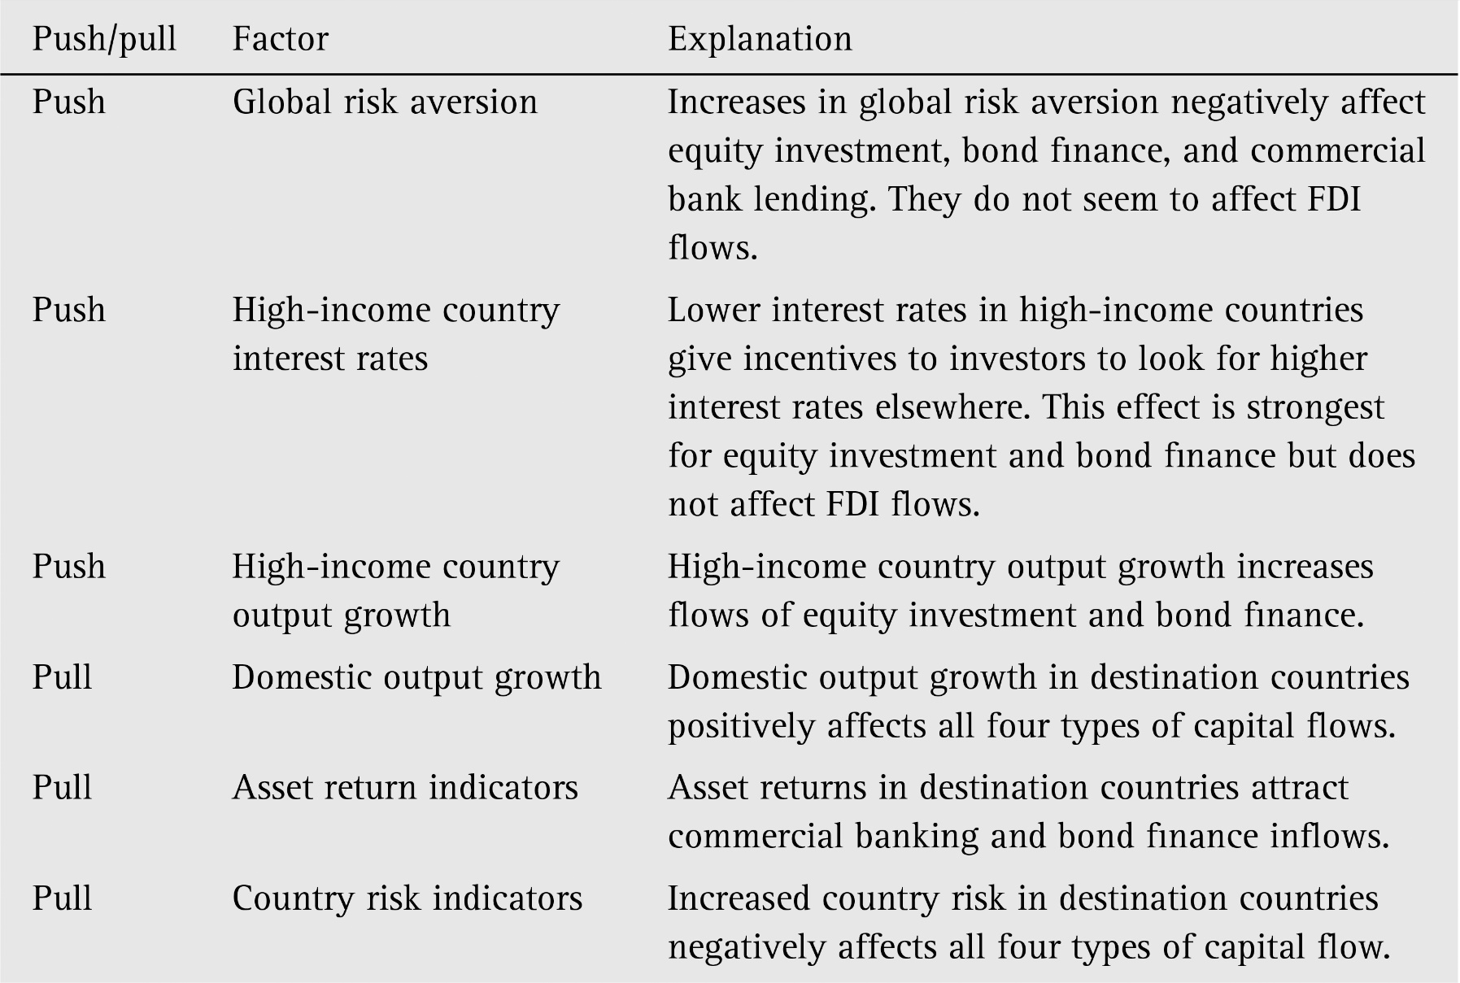
Table 15.2 Factors affecting global capital flows

Slide 18
Capital Account Liberalization
There is a standard “free-market” argument for the increased liberalization or opening of capital accounts.
The argument goes: Economic liberalization → Growth → Poverty reduction
In 1997, when a committee of the IMF recommended that the full liberalization or “convertibility” of capital/financial accounts be made an explicit objective of the IMF, to be enshrined in an amended Articles of Agreement.
Months after this proposal was made, a financial crisis in Asia developed. Some prominent international economists also began to argue against the proposal.
The proposed amendment to the IMF Articles of Agreement was dropped.
After the 2008 GFC, the IMF revisited capital controls and gave them an endorsement.

Slide 19
Capital Controls
Capital controls: policy measures to restrict capital mobility, a.k.a. capital account regulations (CARs) and capital flow (management) measures (CFMs).
Capital controls can take many forms:
Inflows versus outflows; Different asset classes; Residents versus non-residents; Quantitative versus qualitative
The purpose of capital controls is to address the volatile nature of gross capital flows, the pattern of large inflows of short-term, portfolio capital that is later followed by a reversal in the form of capital flight.
potential negative macroeconomic effects of global capital flows can be viewed as a type of negative externality
standard microeconomic theory suggests that taxing activities with significant negative externalities can be an appropriate policy response.

Slide 20
Capital Controls
Can capital controls be effective?
Yes, but not always and everywhere.
Magud, Reihart, and Rogoff (2018): capital controls were by and large effective in altering the composition of capital flows towards more long-term flows
Ostry et al (2011): capital controls may be useful not so much to reduce the volume of inflows as to make them less risky
Take-away from the discussion of capital control:
Policy instrument varies. Some are less intrusive and more market-friendly than others.
Different policies can be designed for different types of capital flows.

Slide 21
Balance of Payments Revisited
If domestic savings are too small to finance domestic investment, a country requires an inflow of foreign savings to make up the difference.
This inflow of foreign savings finances the trade deficit and shows up as positive entries (asset sales) in the capital/financial account.
We now see that these positive entries include net inflows of foreign direct investment, equity investment, bond finance, and commercial bank lending.
They do not all have to be positive net inflows, but the sum of them needs to be.

Slide 22
Balance of Payments Revisited
If domestic savings exceed the requirements of domestic investment, the country lends the difference to the rest of the world.
This outflow of foreign investment generates a trade surplus and shows up as negative entries (asset purchases) in the capital/financial account.
We now see that these negative entries include net outflows of FDI, equity investment, bond finance, and commercial bank lending.
They do not all have to be negative net inflows, but the sum of them needs to be.

