Slide 1
Chapter 14: Accounting Frameworks
An Introduction to International Economics: New Perspectives on the World Economy

Slide 2
Analytical Elements
Countries
Currencies
Financial assets

Slide 3
Things Add Up
From this chapter, we will enter the third realm of the world economy, international finance: the exchange of assets between countries.
In this chapter, we consider the implications of a basic economics principle that “things add up”
We apply it to open-economy accounts and to balance of payments accounts
These provide us with powerful tools to analyze aspects of open economies in their interactions with the world economy

Slide 4
Open-Economy Accounts
To begin our discussion of open-economy accounts, we are going to consider a circular flow diagram
We are going to view the Mexican economy as being aggregated into one, giant sector composed of two accounts
Firm
Household
Figure 13.1 represents a simple, closed economy
Simple refers to the absence of capital (savings/investment) and government consideration
Closed refers to the absence of transactions with the world economy

Slide 5
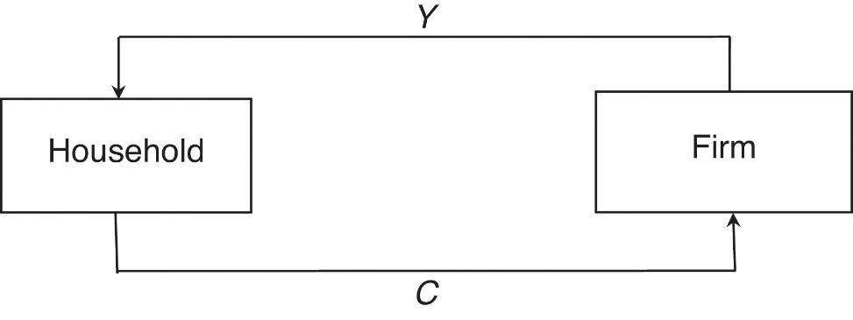
A Simple Closed Economy
Two macroeconomics flows:
Y is income that accrues to the household from the firm and with simplifying assumptions represents Mexico’s gross domestic product (GDP) and gross national income (GNI)
C is consumption of the household that accrues to the firm
Figure 14.1 A circular flow diagram for a simple closed economy

Slide 6
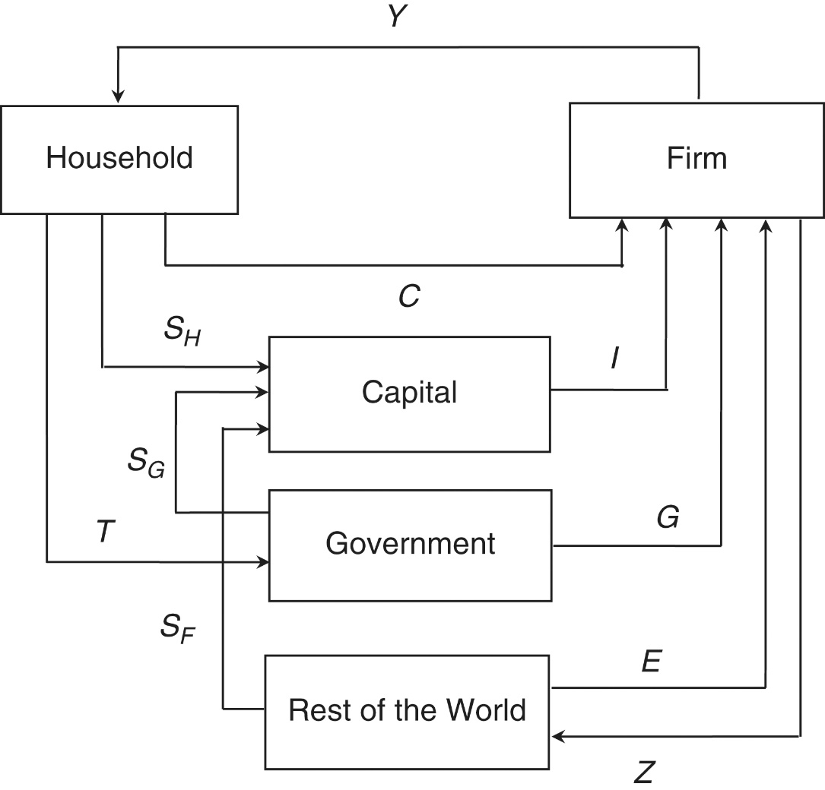
Open-Economy Accounts
We need to complicate Figure 14.1 as in Figure 14.2 with three more accounts
Capital: financial intermediary in savings-investment process
Government
Rest of the world (ROW)
Figure 14.2 An open economy with government, savings, and investment

Slide 7
Open-Economy Accounts
The firm makes two expenditures
Y or income of the household
Z or Mexico’s imports
Household has three kinds of expenditures
C or consumption
S_{H} or household savings
T or taxes
Government has two kinds of expenditures
G or government spending
S_{G} or government savings
Figure 14.2 An open economy with government, savings, and investment

Slide 8
Open-Economy Accounts
Capital has one expenditure
I or investment
The rest of the world has two expenditures
E or Mexico’s exports
S_{F} or foreign savings
We are going to apply the “things add up” principle to the capital and ROW accounts
Applying it to the capital account gives us
I = (S_{H} + S_{G}) + S_{F}
I - (S_{H} + S_{G}) = S_{F}
Figure 14.2 An open economy with government, savings, and investment

Slide 9
Open-Economy Accounts
Applying the “things add up” principle to the ROW account gives us
E + S_{F} = Z
S_{F} = Z - E
If we combine the capital account equations with the ROW equations, we get the two fundamental account equations
I - (S_{H} + S_{G}) = S_{F} = Z – E
(S_{H} + S_{G}) –I = S_{F} = E - Z
The insights that can be gleaned from equations presented in Table 14.1
Figure 14.2 An open economy with government, savings, and investment

Slide 10
Table 14.1: Domestic Savings, Domestic Investment, Foreign Savings, and the Trade Balance
Domestic Investment and Domestic Savings | Foreign Savings | Trade Balance | Explanation
Domestic investment exceeds domestic savings | Foreign savings is positive | Trade deficit | Domestic savings is too small to finance domestic investment. Therefore, the country requires an inflow of foreign savings to make up the difference This inflow of foreign savings finances the trade deficit.
Domestic savings exceeds domestic investment | Foreign savings is negative or foreign investment is positive | Trade surplus | Domestic savings exceeds the requirements of domestic investment. Therefore, the country lends the difference to the Rest of the World. This outflow of foreign investment generates a trade surplus.

Slide 11
Fundamental Accounting Equation Intuition
Domestic investment exceeds domestic savings (trade deficit)
The Mexican economy is importing more goods and services in value terms than it is exporting.
Therefore, Mexico must sell something else other than goods and services to the ROW to make up the difference.
This “something else” turns out to be assets: government and corporate bonds, corporate equities, and even real estate.
The purchase of Mexican assets by the ROW is the very thing that generates the inflow of foreign savings into Mexico.

Slide 12
Fundamental Accounting Equation Intuition
Domestic savings exceeds domestic investment (trade surplus)
The Mexican economy is exporting more goods and services in value terms than it is importing.
Therefore, Mexico must buy something else other than goods and services from the ROW to make up the difference.
That “something else” again is assets.
The purchase of foreign assets by Mexico generates the outflow of foreign investment to the ROW.

Slide 13
Balance of Payments Accounts
The balance of payments accounts of any country focus exclusively on the relationship of the country with the Rest of the World
We consider summary accounts for Mexico in 2017 presented in Table 14.2
The balance of payments has five parts
Current account
Capital/financial account
Official reserve transactions
Errors and omissions
Overall balance

Slide 14
Balance of Payments Accounts
The current account records transactions with the rest of the world that do not involve the exchange of assets
The capital account records transactions with the rest of the world that do not involve the exchange of assets
The official reserve transactions record governmental (central bank and treasure) transactions involving the exchange of assets

Slide 15
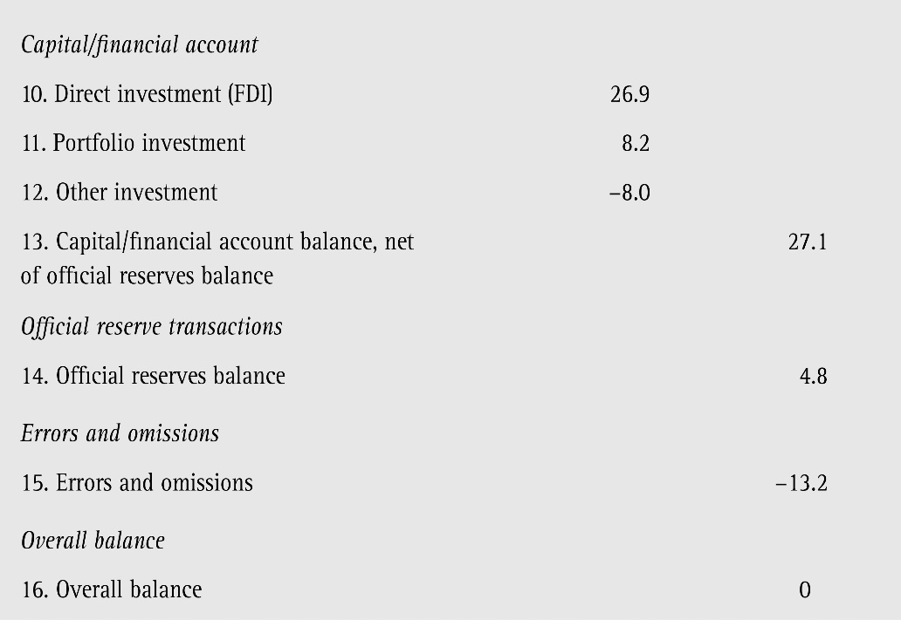
Table 14.2: Mexican Balance of Payments, 2017 (billions of US dollars) Current Account
The overall balance must be zero: things add up
Current Account + Capital/Financial Account + Official Reserves Transactions + Errors and Omissions = 0

Slide 16
Balance of Payments: Overall Balance
The overall balance must be zero: things add up
Current Account
+ Capital/Financial Account
+ Official Reserves Transactions
+ Errors and Omissions
= 0
This can be seen in item 16 in Table 14.2

Slide 17
Table 14.2: Mexican Balance of Payments, 2017 (billions of US dollars) Current Account
Item | Gross | Net | Major Balance
Current Account
1. Goods exports | 409.8
2. Goods imports | -420.8
3. Goods trade balance |  | -11.0
4. Service exports | 27.6
5. Service imports | -37.5
6. Goods and services trade balance |  | -20.9
7. Net income |  | -28.3
8. Net transfers |  | 30.5
9. Current account balance |  |  | -18.7
=item1+item2
=item3+item4+item5
a.k.a. primary income. Net of income receipts and income payments
=item6+
item7+
item8
a.k.a. secondary income. Includes foreign aid, foreign remittances, and international pension flows.

Slide 18
Table 14.2: Mexican Balance of Payments, 2017 (billions of US dollars) Other Accounts
Item | Gross | Net | Major Balance
Capital/Financial Account
10. Direct investment |  | 26.9
11. Portfolio investment |  | 8.2
12.Other investment |  | -8.0
13. Capital/financial account balance |  |  | 27.1
Official Reserve Transactions
14. Official reserves balance |  |  | 4.8
Errors and Omissions
15. Errors and omissions |  |  | -13.2
Overall Balance
16. Overall balance |  |  | 0
FDI
Equities and bonds
Commercial bank lending
=item10+
item11+item12
Reflects the actions of treasuries and central banks

Slide 19
Official Reserve Balance
When Mexico’s central bank sells foreign exchange holdings, this generates an inward flow of funds and income or receipts on Mexico’s official reserve balance (positive entries)
When Mexico’s central bank buys foreign exchange holdings, this generates outlays or expenditures on the official reserve balance (negative entries)
When foreign central banks sell their reserves of Mexico’s currency, this generates an outward flow of funds and an outlay or expenditure on Mexico’s official reserves balance (negative entries)
Finally, when foreign central banks buy reserves of Mexico’s currency, this generates an income or receipts on Mexico’s official reserve balance (positive entries)

Slide 20
Analyzing the Balance of Payments Accounts
For ease of analysis, we remove the errors and omissions major balance
Current Account + Capital/Financial Account + Official Reserves Transactions = 0. (14.7a)
If two of the items in this equation have the same sign (positive or negative), then the third must have the opposite sign (negative or positive)

Slide 21
Analyzing the Balance of Payments Accounts
Current Account + Capital/Financial Account + Official Reserves Transactions = 0 (14.7a)
If the current and capital/financial accounts are both positive (negative), then official reserve transactions must be negative (positive)
If the current and official reserve transaction accounts are both positive (negative), then the capital/financial account must by negative (positive)
If the capital/financial and official reserve transaction accounts are both positive (negative), then the current account must be negative (positive)
Current account + Capital/financial account = Change in official reserves (14.7b)

Slide 22
Global Imbalances
A basic proposition in international economics is that capital will flow from developed to developing economies
Developed economies will therefore have capital/financial account deficits/outflows
Developing economies with therefore have capital/financial account surpluses/outflows
This is not the current pattern in the world economy
Figure 14.3 shows the United States with a significant capital/financial account surplus/inflow
Figure 14.4 shows China with a significant official reserves deficit
Global imbalances can appear at the regional level as well. Figure 14.5 considers the case of Europe.

Slide 23
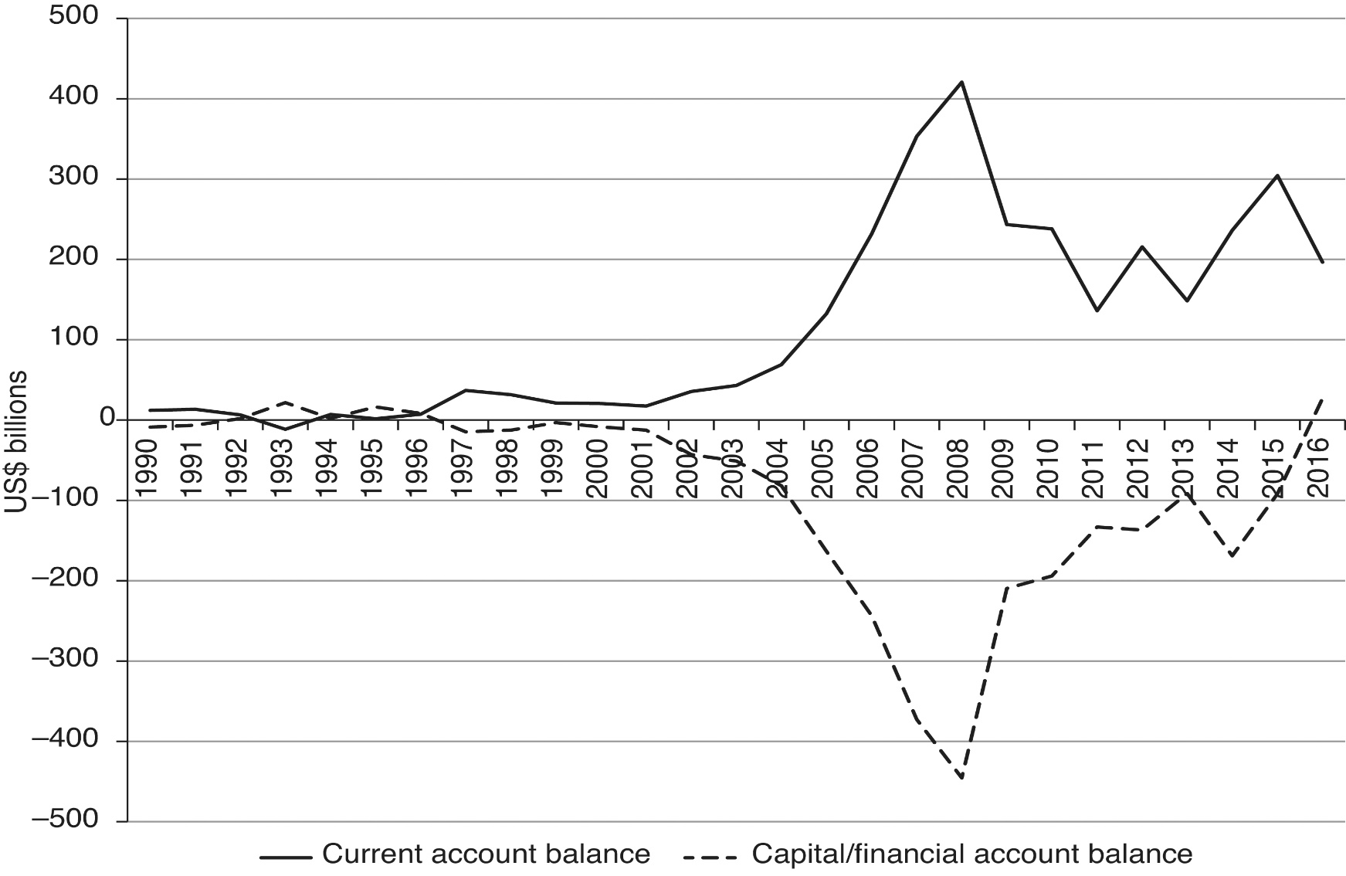
Figure 14.3: United States Current Account and Capital/Financial Account Transactions (billions of US $)

Slide 24
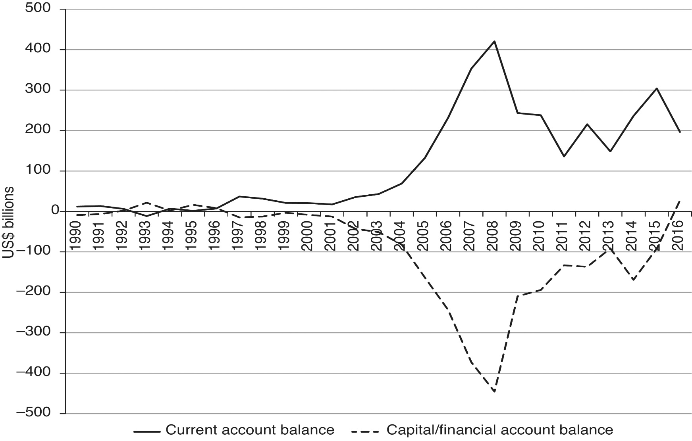
Figure 14.4: China Capital/Financial and Official Reserves Account Transactions (billions of US $)

Slide 25
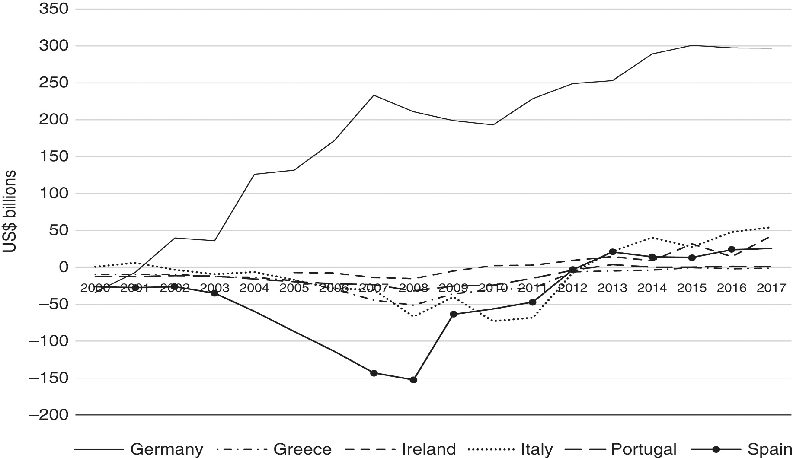
Figure 14.5 Current account balances for selected European countries (US$ billions)

Slide 26
Appendix 14.1: Accounting Matrices
Open economy accounting matrices abide by four rules
The number of accounts composes the dimensions of the square matrix
Expenditures are recorded down the columns
Receipts are recorded across the rows
The row and column sums must be equal
A general, open economy accounting matrix is presented in Table 14.1

Slide 27
Table 14.3: An Open-Economy Accounting Matrix
 | Firm | Household | Capital | Government | ROW
Firm |  | C | I | G | E
Household | Y
Capital |  | S_{H} |  | S_{G} | S_{F}
Government |  | T
ROW | Z

Slide 28
Accounting Matrices
Applying the fourth rule to Table 13.3, we see
Firm: Y + Z = C + I + G + E
Household: C + S_{H} + T = Y
Capital: I = S_{H} + S_{G} + S_{F}
Government: G + S_{G} = T
ROW: E + S_{F} = Z
Combining the firm, government and ROW identities, we can get
S_{H} + T – G – I = E – Z
This can be used in a basic, open economy model

Slide 29
Appendix 14.2: An Open-Economy Model
Keynesian thinking in macroeconomics suggests
S_{G} is a positive function of Y
Z is a positive function of Y
These considerations modify our equation above to
S_{H}(Y) + T – G – I = E – Z(Y)
Figure 14.6 depicts this equation for an increase in export demand
Y increases to restore macroeconomic balance
Figure 14.7 depicts this equation for an increase in government spending or investment
Y increases to restore macroeconomic balance

Slide 30
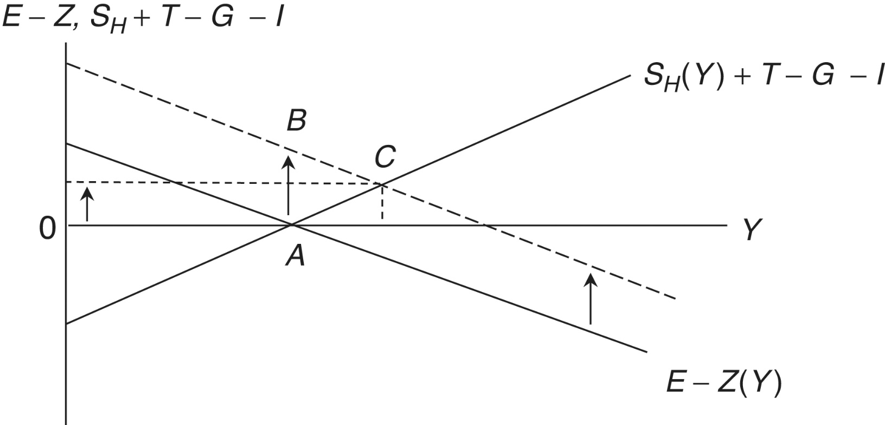
Figure 14.6 An open-economy macroeconomic model and an increase in export demand

Slide 31
Figure 14.7: An Increase in Government Spending or Investment

