Slide 1
Chapter 13: Migration
An Introduction to International Economics: New Perspectives on the World Economy

Slide 2
Analytical Elements
Countries
Firms
Factors of production

Slide 3
Introduction
A third means by which international production can take place, namely the movement of people across national borders in the form of temporary or permanent migration.
According to UN (2017), this mode of international production involves approximately 260 million migrants, or 3.5% of the world’s population.

Slide 4
Types of Migration
Beath, Goldin and Reinert (2009) distinguished different types of international migration
Permanent high-skilled migration
Involves permanent residence and is sometimes granted to high-skilled migrants often at the urging of hiring corporations such as the multinational enterprises (MNEs)
Temporary high-skilled migration
Similar in motivation to permanent high-skilled migration but can be more politically palatable in some cases where there is political resistance to granting permanent residence
Temporary low-skilled migration
Includes migrant workers in the areas of manual labor, construction, domestic service and nursing
Family migration
A large flow that allows permanent residence to the families of those who have already gained this residence

Slide 5
Types of Migration
Asylum seekers
Granted certain rights by the 1951 Geneva Convention addressing persons with well-founded fears of persecution
Irregular/undocumented migration
Involves both voluntary and non-voluntary (trafficked) illegal migrants.
Visa-free migration
Relates to common markets (Chapter 9) in that it involves the free movement of both labor and capital.
While all of these types of migration are important, in this chapter, we will focus on high-skilled and low-skilled migration

Slide 6
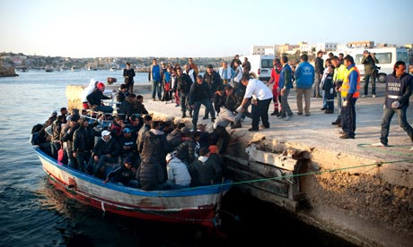
Migration into the European Union
Source: www.guardian.co.uk

Slide 7
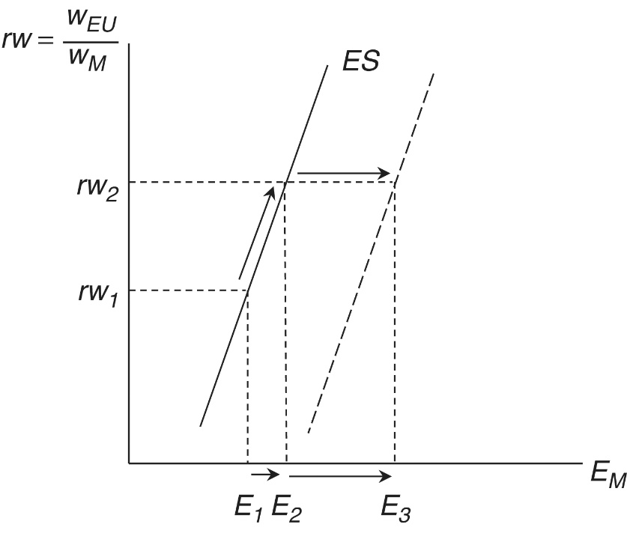
The Migration Decision
We focus on the economic decision-making of potential migrants, knowing that non-economic issues might be more potent in some cases.
5 factors may influence the migration decisions of potential migrants from Morocco (M) to the EU:
- Relative wages
The relative wage is given by $rw={w_{EU}}/{w_{M}}$
The larger is rw, the more Moroccans would like to emigrate to the EU, a movement up the emigration supply curve of Fig. 13.1
Figure 13.1: The Migration Decision

Slide 8
The Migration Decision
Youth population growth
Youth population grown in Morocco will increase the number of risk-taking individuals who are considering emigrating to the EU
This is a shift of the supply curve in Fig. 13.1 to the right
Financial resources
Given the direct and opportunity costs of migration, as GDP per capita rises, the supply curve in Figure 13.1 shift to the right
Figure 13.1: The Migration Decision

Slide 9
The Migration Decision
Education levels
Increasing education levels increases the information and aspiration of Moroccans to migrate, shifting the supply curve in Figure 13.1 to the right
Migration networks
Networks of migrants in the EU are conduits of information back to potential migrants in Morocco
As these networks develop, the supply curve in Figure 13.1 shifts to the right
Figure 13.1: The Migration Decision

Slide 10
The Emigration Supply Curve
Historical evidence suggests that shifts of the ES curve in Figure 13.1 can be more significant than movements along the curve
Additionally, the four shift factors can work together as origin countries develop
The approximate correlation of all four shift factors in time can lead to a phenomenon known as the migration hump shown in Figure 13.2

Slide 11
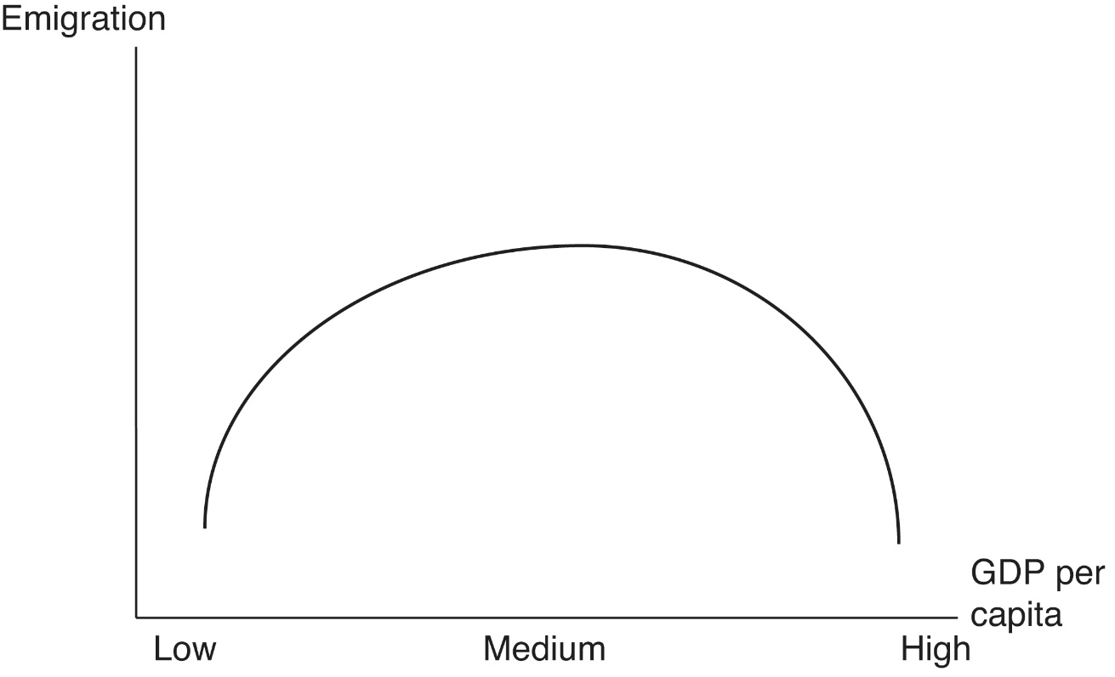
Figure 13.2: A Highly-Stylized “Migration Hump”
The migration hump indicates that
Barring political or ecological impetus, most international migration is from middle-income countries
The migration flows that occur near the peak of the migration hump can persist for some time

Slide 12
High-Skilled Migration
Data on high-skilled migration (HSM) are both scarce and unreliable, but nevertheless some patterns are discernible
The most important destination of HSM is the OECD countries
HSM is increasing over time (increased demand due to the information and communication technology (ICT) advances)
Origin countries are widely dispersed
The types of firms who hire HSM tend to be larger firms that are more internationalized via foreign ownership and exports

Slide 13
High-Skilled Migration
Firms active in HSM face volatile policy regimes in terms of visa requirements and quotas
HSM can contribute to what is known as brain drain: the loss of human capital in low-income source countries due to the migration of citizens to foreign destination countries
The positive externality associated with human capital evaporated in the origin countries
The destination countries did not make the public expenditure investment in human capital: a public finance issue
The origin countries also lose future tax payments
The presence of emigration opportunities may increase the incentive for human capital accumulation in origin countries and thereby contribute to an increase in total human capital

Slide 14
High-Skilled Migration
Medical brain drain: when doctors and nurses emigrate. A significant development issue.
Brain waste: a.k.a. “occupational downgrading”--when a high-skilled immigrant ends up in a job that requires less skill
Return migration: high-skilled workers bring newly acquired know-how and entrepreneurial skills back to their countries of origin

Slide 15
High-Skilled Migration
Brain drain can evolve into brain circulation
Expatriates from developing countries return either temporarily or permanently to contribute to what might be called intellectual remittances
These return migrants can even have a subsequent, positive effect on inflows of FDI
The return migration and subsequent enterprise development act as a signal to foreign MNEs that conditions are ripe for FDI by enhancing the location advantages

Slide 16
Low-Skilled Migration
The supply-side of low-skilled migration (LSM) can be roughly described using our discussion of Figure 13.1
There is also the demand side to consider
A number of key destination countries are experiencing a “birth dearth” or a decline in populations due to low fertility rates
The persistence of low-skilled, non-tradable services in destination countries
These two demand-side factors cause the demand curve for LSM to shift to the right as in Figure 13.3

Slide 17
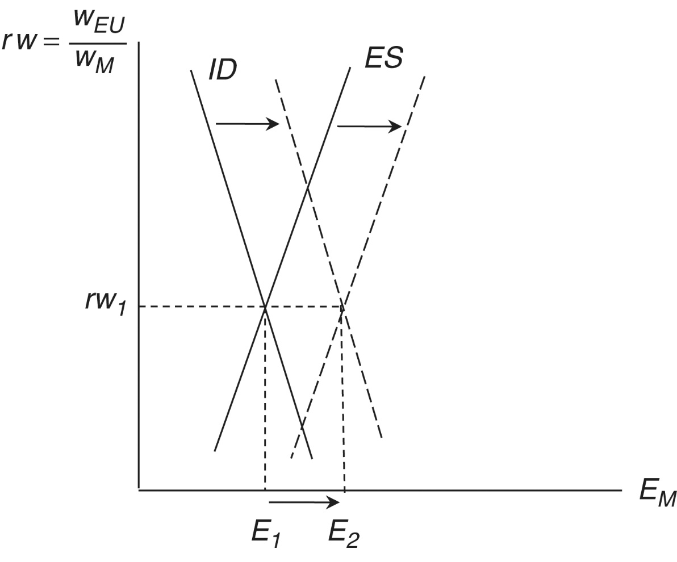
Figure 13.3: The Market for Low-Skilled Migration
As this graph is drawn, the relative unskilled wage remains the same, but it could either increase or decrease

Slide 18
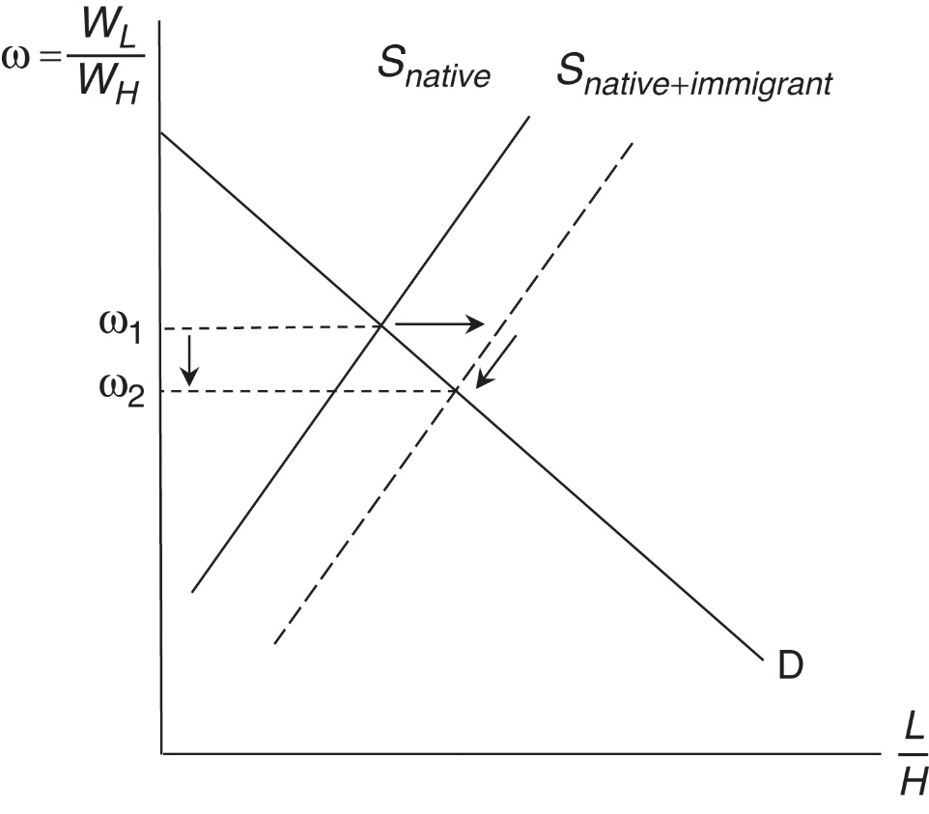
Low-Skilled Migration
Low-skilled migration is subject to a great deal of political opposition, which often focuses on three alleged problems:
Identity
Increasingly manifested itself in a rise in ethno-nationalism
Wage pressure (Figure 13.4)
low-skilled immigrants can suppress local wages but do so by small amounts:
immigrants are imperfect substitutes for native workers
Native workers reduce their supply by moving to different labor markets
Fiscal burden
Estimated net fiscal impact was zero
Figure 13.4 The impact of low-skilled migration on the destination labor market

Slide 19
Remittances
Remittances are flows of money from emigrants to their countries of origin
Data on remittance flows going back to 1970 are presented in Figure 13.5
Remittance flows have increased dramatically since the mid-1990s
Most of the increase in remittances has been to middle income countries
Remittances can have significant and positive impacts in developing countries by directly transferring income more efficiently than foreign aid

Slide 20
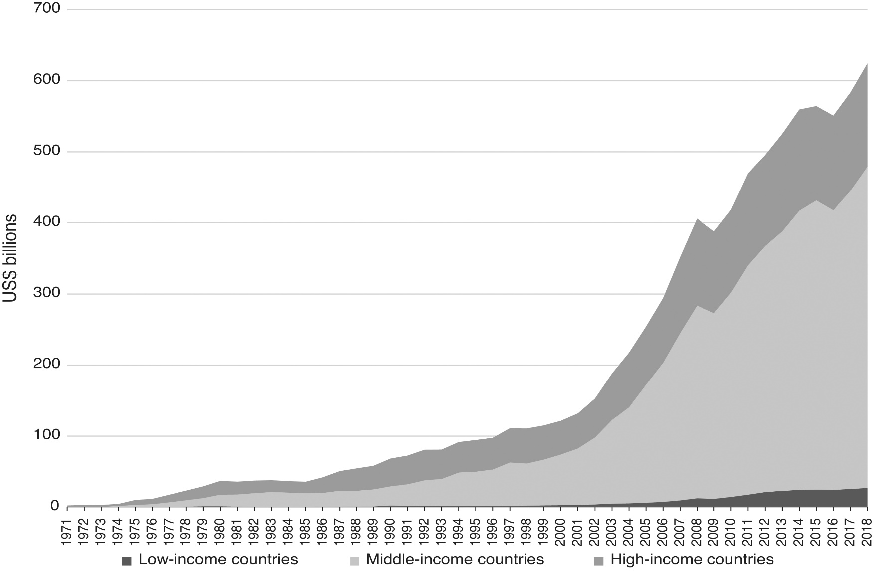
Figure 13.5: Remittance inflows, 1971–2018 (Source: World Bank, World Development Indicators)

Slide 21
Migration Policy
Migration poses a policy dilemma:
Increases in migration potentially provide a large increase in economic welfare
But the costs of migration are concentrated
Governments and international organizations need to consider how to promote the benefits of increased migration while mitigating the unevenly distributed costs.
Unlike in the realms of international trade (the World Trade Organization), international finance (the International Monetary Fund), and international development (the World Bank), there is no multilateral organization for migration policy.
In most cases, the policy locus of international migration policy is the nation state based on the principle of sovereignty
In contrast to the “pro-market” orientations of policy regimes in trade, finance and development policy, intervention and coercion are the order of the day in migration policy

Slide 22
Migration Policy
Global Commission on International Migration (GCIM): established in 2003 by the UN secretary-general
In 2005 the GCIM suggested that greater multilateral coordination of migration policies would be a good idea.
The GCIM was followed by the United Nations High-Level Dialogue (HLD) on International Migration and Development, in 2006.
The HLD was quickly followed later the year by the International Labour’s Organization’s Multilateral Framework
Some observers have suggested that such a multilateral organization would be a good idea
One area for renewed multilateral cooperation in trade-related migration policy is Mode 4 of the WTO’s General Agreement on Trade in Services (GATS Mode 4)

