Slide 1
Chapter 10: Foreign Direct Investment and Intra-Firm Trade
An Introduction to International Economics: New Perspectives on the World Economy

Slide 2
Analytical Elements
Countries
Sectors
Tasks
Firms

Slide 3
Tasks and Value Chains
The “action” of the global production and trading system has dropped down to a lower, more detailed level of economic activity. These are tasks.
A value chain is a series of value-added processes (tasks) required for the production of any good or service. It proceeds in steps, from beginning or upstream tasks to subsequent downstream tasks.
Consider a semiconductor value chain
Research, development and design leading up to details of the physical circuitry of the chip to be placed on the silicon
Fabrication (or just fab in semiconductor jargon) in an advanced manufacturing process in which circuitry layouts are etched onto silicon wafers containing many die
Assembly and testing in which the die are cut from wafers and mounted or packaged into a functioning device with wire contacts and insulation
Final incorporation in which the semiconductor is incorporated into the final piece of equipment such as a personal computer or mobile phone

Slide 4
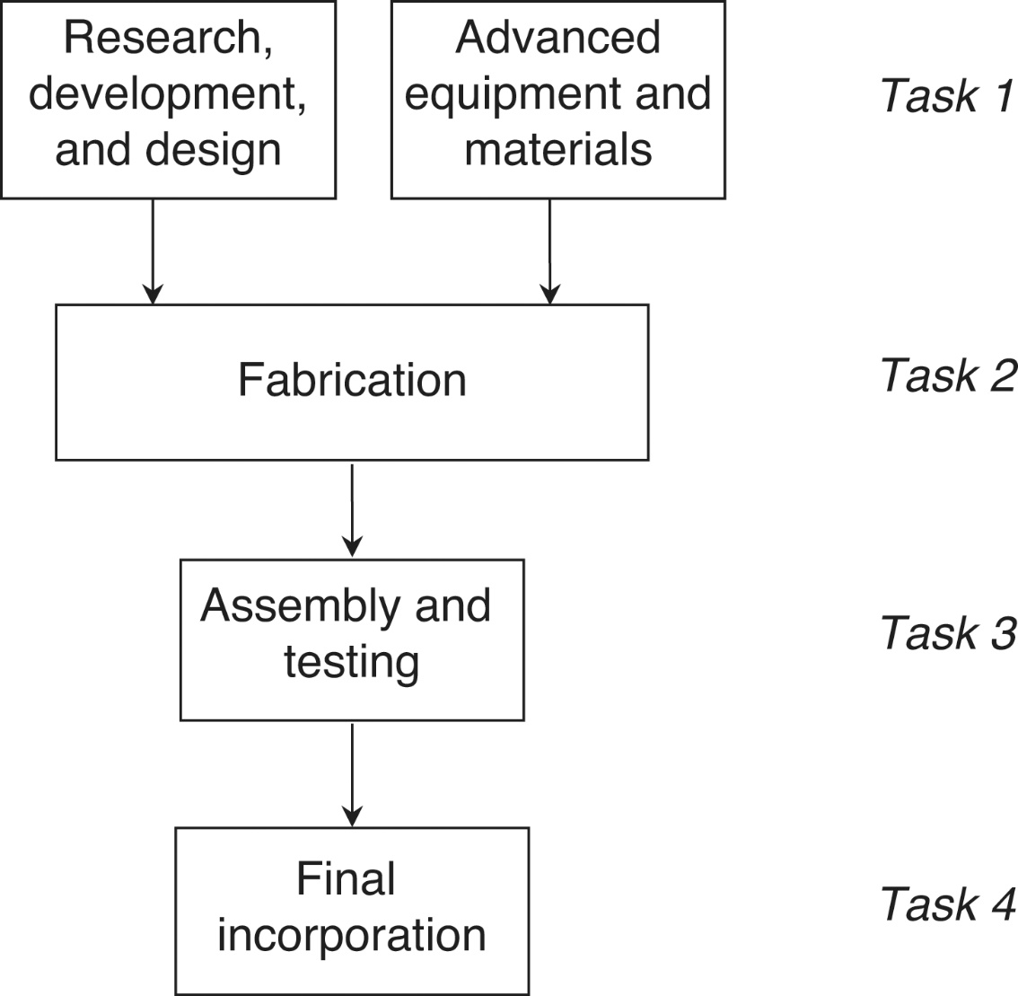
Figure 11.1: A Value Chain for Semiconductors

Slide 5
Semiconductor Value Chain
The semiconductor value chain is shown in Figure 11.1
Omitted from Figure 11.1 are numerous supporting producer services.
It is not necessary for a firm to be active across all stages of semiconductor manufacturing
The task scope of a firm in the industry is the result of a firm’s decision-making with regard to what tasks to perform along the value chain
Intel is involved in the first three stages of the value chain: research, development and design; fabrication; and assembly and testing

Slide 6
From Value Chains to Global Value Chains
Value chains are potentially distributed across countries.
This brings to the firm a location decision related to foreign market entry.
When value chains are linked together across countries in potential buyer-supplier or ownership relationships, they become known as global value chains.
An example of this is given in Figure 11.2:
The semiconductor production decision is multiple, including the decisions as to what part of the value chain to take on and in which countries to do so.
There are both task and location decisions to consider

Slide 7
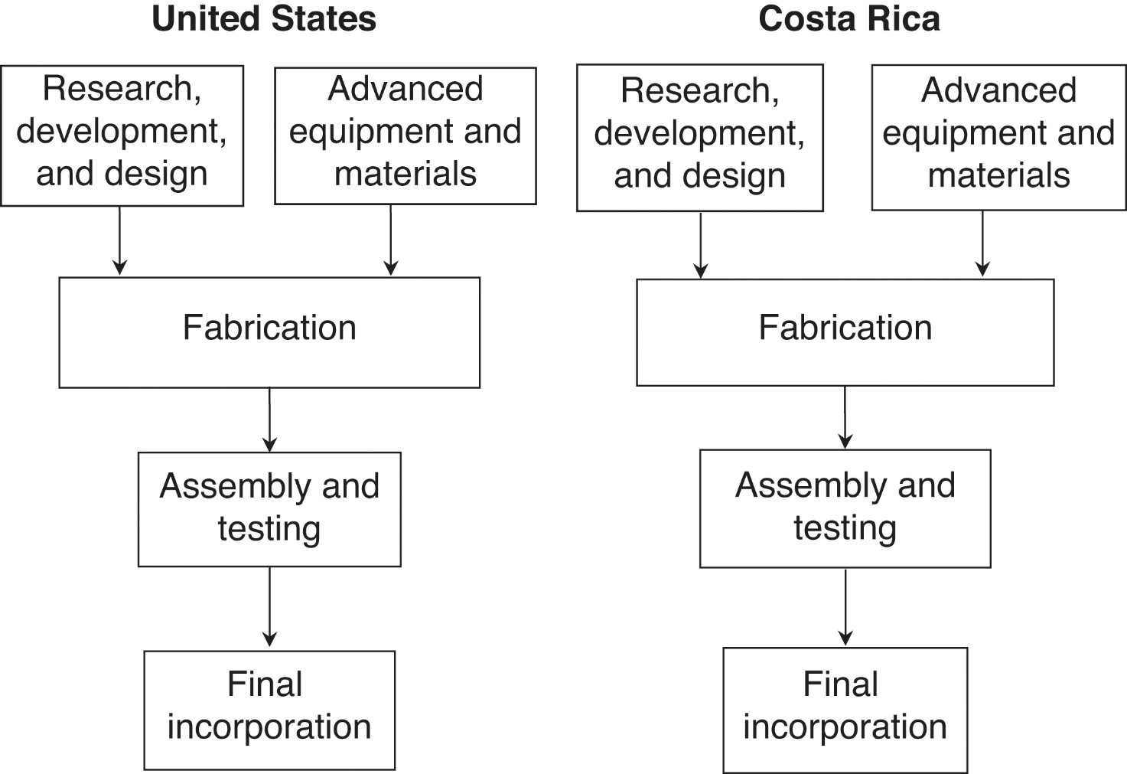
Figure 11.2: A Global Production Network for Semiconductors

Slide 8
From Value Chains to Global Value Chains
There is another way to look at the GVC decision-making process: the horizontal and vertical dimensions
Movements up and down the value chains of Figure 11.2, whether in the United States or Costa Rica, are vertical movements
Movements up a value chain, from subsequent to previous tasks are backward vertical movements
Movements down a value chain from previous to subsequent tasks are forward vertical movements
Movements from one country to another, from the United States to Costa Rica, for example, are horizontal movements

Slide 9
Firm-Specific Assets and Internationalization
Firms can and do take more than one approach to the semiconductor value chain or GVC
A simplified version of Intel’s semiconductor GVC is presented in Figure 11.3
The dashed lines indicate potential areas where Intel has chosen not to operate
The ability of Intel to operate where it does in its GVC reflects its competiveness
International business researchers explain competitiveness with reference to firm-specific assets

Slide 10
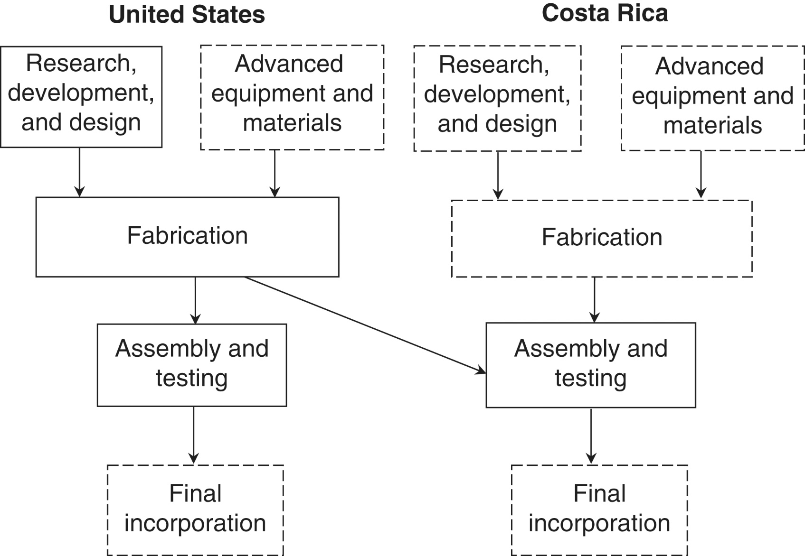
Figure 11.3: Intel’s global value chain for semiconductors

Slide 11
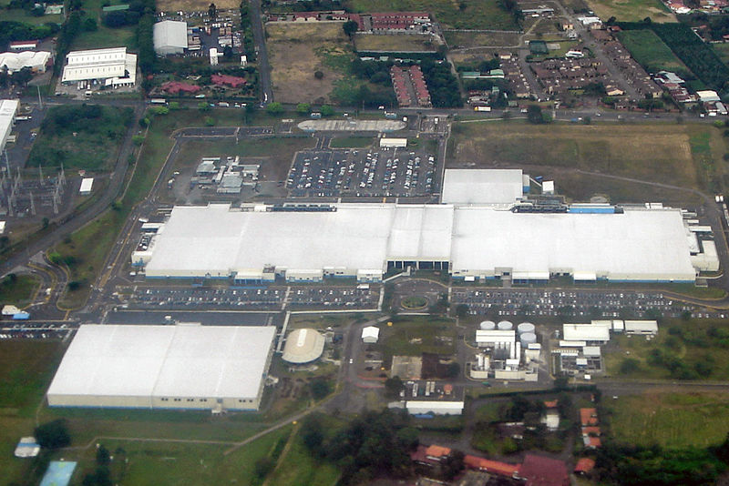
Intel’s Plant in Costa Rica (Source: Wikipedia)

Slide 12
Firm-Specific Assets
Firm-specific assets can be tangible
Access to silicon and other advanced materials,
Firm specific assets can also be intangible
Specialized knowledge, patented products or processes, organizational abilities, or brand distinctiveness and loyalty
When a firm such as Intel takes on new tasks along the vertical dimension of a GVC, it can experience an efficiency gain by spreading the costs incurred in acquiring its firm-specific assets (both tangible and intangible) over more value chain stages
These efficiency gains are known as firm-level economies

Slide 13
Firm-Level Economies
The concept of firm-level economies is not, in general, sufficient to explain the integration process along GVCs
→ Because firms always have the option (discussed in Chapter 10) of licensing its firm-specific assets to other firms
Corporate strategists suggest that a firm’s decision to internalize the firm-specific asset market reflects market failure -- difficulty in selling its firm-specific assets in a contractual arrangement (particularly relevant for intangible assets)

Slide 14
Intra-Firm Trade
We can observe a pattern of intra-firm trade in Figure 11.3
Intel exports fabricated die from its home base to its subsidiary in Costa Rica
This is not an arm’s-length, market-based transaction that takes place at world prices
It is a trade transaction within Intel itself at a price set by it
We now have two distinctions of trade (Table 11.1)
Inter-industry vs. intra-industry
Inter-firm vs. intra-firm

Slide 15
Table 11.1: Industry and Firm Dimensions of Trade
 | Firm Dimension
Industry Dimension | Inter-firm | Intra-firm
Inter-industry | Trade that takes place between two different industries and two different firms | Trade that takes place between two different industries and within a single firm
Intra-industry | Trade that takes place within a single industry and between two different firms | Trade that takes place within a single industry and within a single firm

Slide 16
A Cost View of Internalization
Suppose:
a home-country firm faces a fixed cost of setting up a production facility in country of FP_{j}
the firm faces a smaller fixed cost of establishing a contractual relationship with a firm from country of FC_{j}.
variable costs associated with these two options of VP_{j} and VC_{j}
variable costs of international production are smaller than the variable costs of international contracting due to the firm-specific assets that give it an advantage over the potential contracting partner.

Slide 17
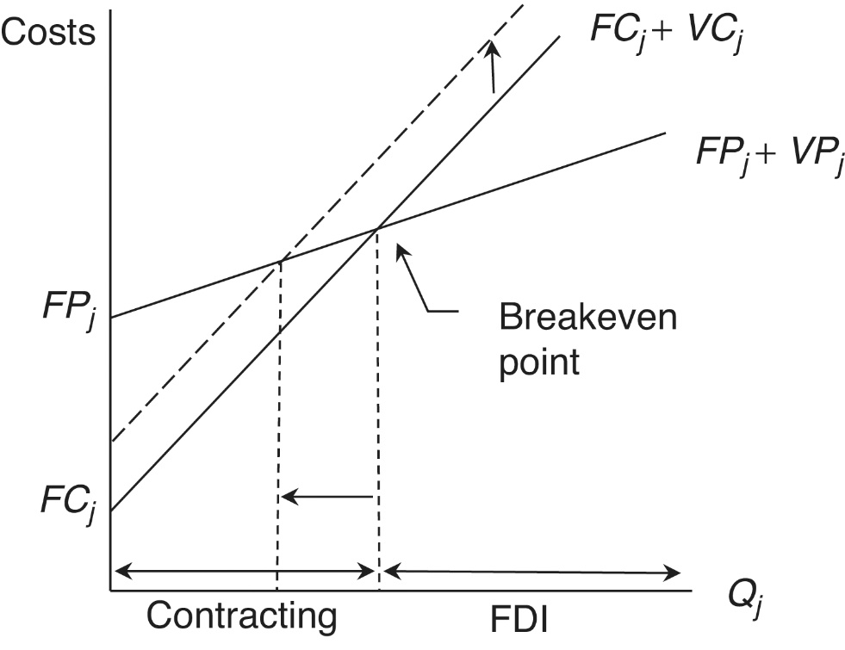
Figure 11.4: A Cost Analysis of Production and Contracting
In Figure 11.4, the solid FP_{j}+VP_{j} graph begins at the vertical axis intercept equal to the fixed cost of production and increases from there with a slope equal to the variable costs of production.
The solid FC_{j}+VC_{j} graph begins at a lower vertical axis intercept equal to the lower fixed cost of contracting and increases from there with a slope equal to the variable costs of contracting
The two solid lines intersect at a “breakeven point” that establishes a boundary between quantities where it would be better for the firm to engage in contracting and quantities where it would be better for the firm to engage in production

Slide 18
Inter-Firm Relationships
When firms choose the mode of contracting for foreign market entry, the issue of inter-firm relationships arises.
An important consideration within this issue is that of vertical connections to supplying firms.
Contractual-plus arrangements: consist of “repeated transactions, reputation, and social norms that are embedded in particular geographic locations or social groups” (Gereffi, Humphrey, and Sturgeon 2005: 81)
→ can help overcome the difficulties of the contractual mode in the presence of intangible assets and dissemination risk

Slide 19
Inter-Firm Relationships
Four types of relationships between an MNE and its suppliers:
Market: standard contractual relationships (can be augmented by trust and normality developed through repeated transaction)
Modular: occurs when the product and production process in question are standard and generic, and the suppliers are coalesced around specific breakpoints in GVCs.
Relational: MNE-supplier interactions are more complex, “mutual dependence”. Associated with ethnic ties or geographic proximity
Captive: an asymmetric relationship in which the MNE is dominant over its suppliers.

Slide 20
Tying Things Together: The TLM Framework
An informal framework of task, location, and mode (TLM)
task: what part of the value chain to engage in
Decision involves deciding how to deploy its tangible and intangible firm-specific assets
location: in which countries to do so
The firm weighs location advantages of countries and cities
mode: how to engage
The key decision is contracting versus FDI
Firms can choose different modes in different locations.
Each possible GVC design is a combination of task, location, and mode. Firms need to assess and compare a large number of possible TLM combinations.

Slide 21
Value Added in GVCs
“value capture—the ultimate variable of interest for both business and countries—is considerably less dispersed than tasks within a supply chain” (Ali-Yrkkö et al. 2011: 264).
value added was concentrated in less tangible aspects of the value chain, such as technology and software licenses, design, advertising and marketing, and distribution (wholesale and retail).
E.g. Apple and its semiconductor chip suppliers captures over 90% of the profits in its extensive GVC

Slide 22
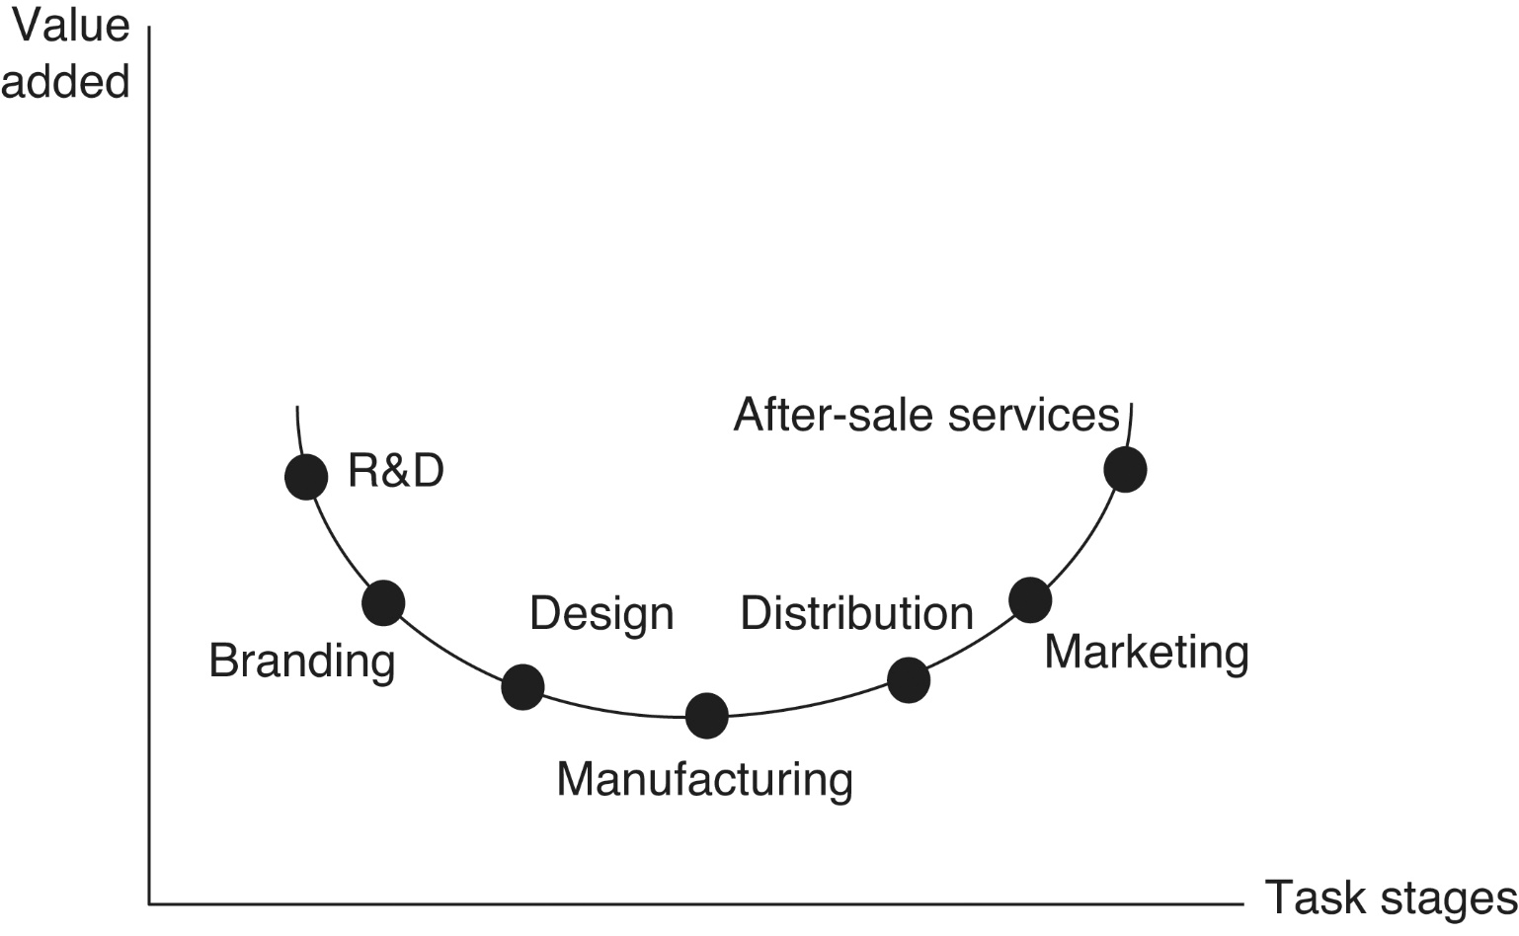
Figure 11.5 The smile curve of GVCs

Slide 23
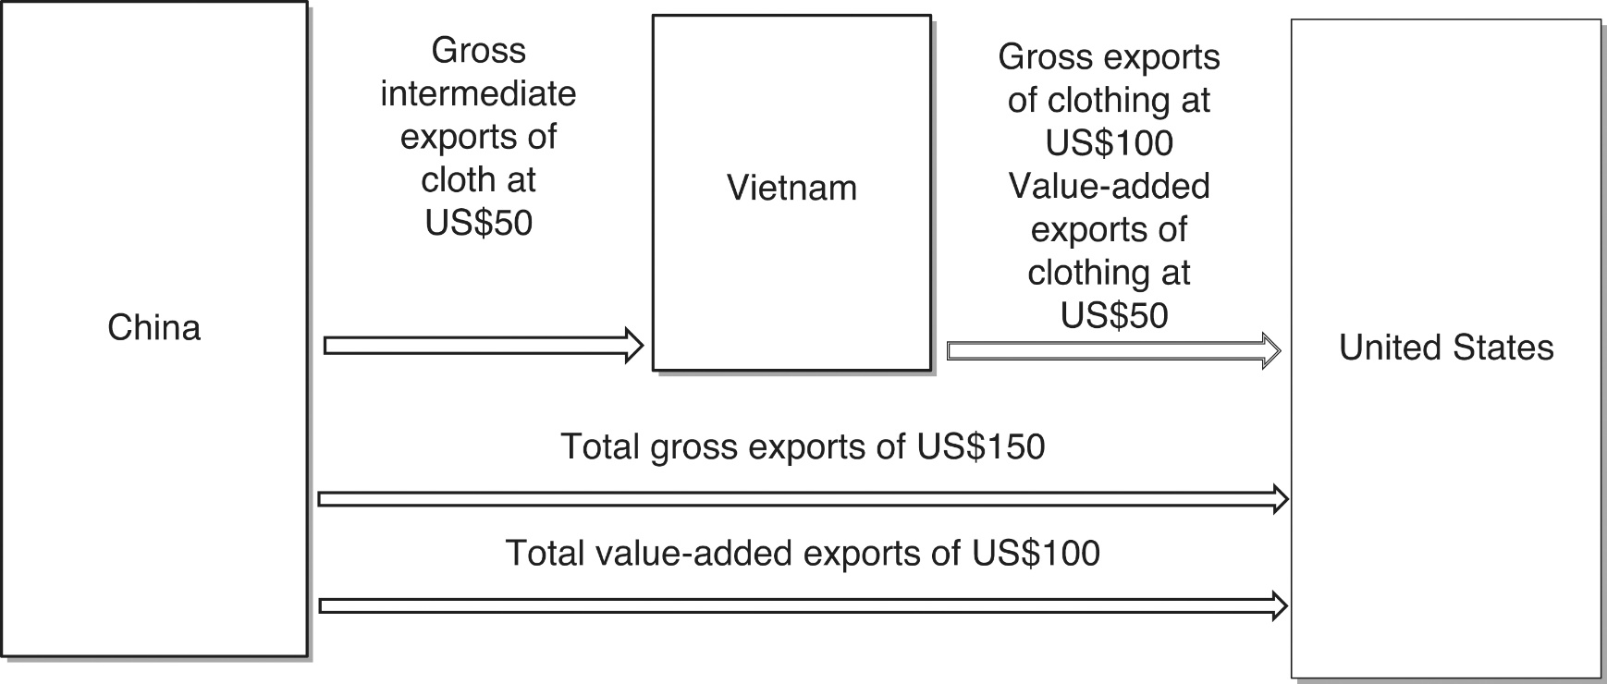
Trade in Value Added
Figure 11.6 A simple example of trade in value added

Slide 24
Trade in Value Added
Policy-makers and politicians often focus on gross bilateral trade imbalances (deficits) as signs of “unfair” trade. → misleading because a significant portion of the “unfairness” is actually attributable to the foreign exporter’s intermediate imports.
From a net value-added trade perspective, trade in services is somewhere around two-fifths of the total (one-fifth of global gross trade)
Ahmad (2013: 87): “Better understanding how much domestic value-added is generated by the export of a good or service in a country is crucial for development strategies and industrial policies.”

Slide 25
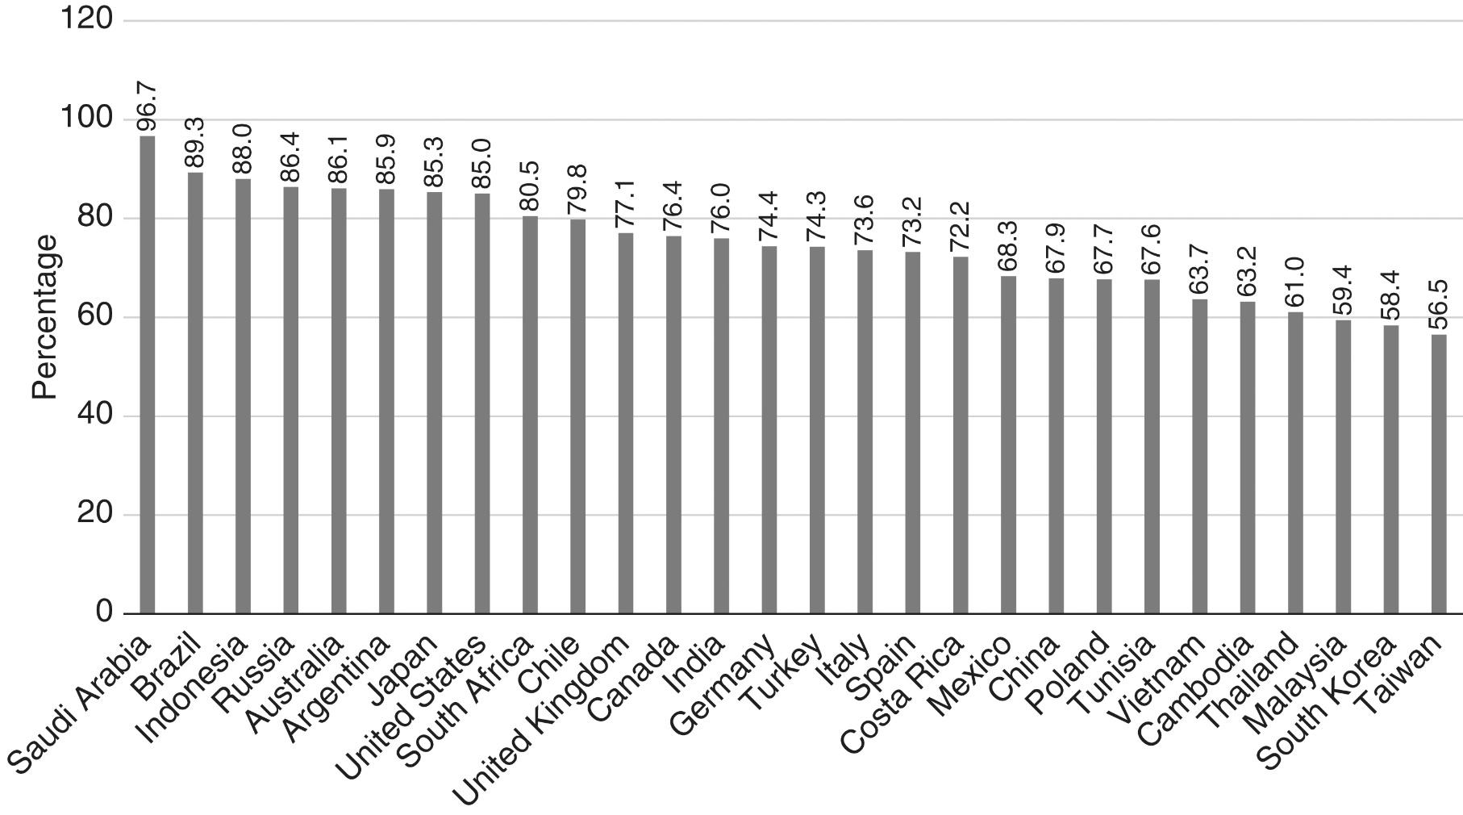
Figure 11.7 Domestic value added in total exports as a percentage of total exports, 2011
Source: Organisation for Economic Co-operation and Development.

Slide 26
Trade Policy and Global Value Chains
The evolution of GVCs has some significant implications for trade policy.
Protection in a world of GVCs can look very different from protection in a world of pure final goods.
Officials with responsibilities for international trade policies need to keep GVCs firmly in mind
E.g.: US-China ”trade war”

