Slide 1
Chapter 10: Multinational Enterprises and Foreign Direct Investment
An Introduction to International Economics: New Perspectives on the World Economy

Slide 2
Analytical Elements
Countries
Sectors
Tasks
Firms
Factors of production

Slide 3
Introduction
Exports are just one way that firms can place their products in foreign markets; there is also international production
Shifting our analytical focus from countries to firms
Three types of foreign market entry:
Export
Contracting
Foreign direct investment (FDI)
international production

Slide 4
Table 10.1: The Foreign Market Entry Menu
Category | Mode | Characteristics
Domestic | None | Purely domestic firm supplying home market
Exporting | Indirect Exporting | Another firm acts as sales agent
 | Direct Exporting | Firm undertakes export transaction itself
Contractual | Subcontracting | Contract with materials and specifications (a.k.a. outsourcing and contract manufacturing)
 | Licensing | License to foreign firm to produce abroad
 | Franchising | License with conditions to ensure consistency
Investment | Joint venture (JV) | Establish a separate firm jointly owned with a foreign-country firm
 | Mergers and Acquisitions | Purchase of part or whole of foreign firm
 | Greenfield | Brand-new production facility

Slide 5
Exporting
Indirect exporting
The home-country firm relies on another firm known as a sales agent or trading company to complete the export transaction
Direct exporting
The home-country firm takes on the export transaction itself
This can include the research, marketing, finance, and logistics requirements of the trade transaction

Slide 6
Contractual
Arm’s-length market-based relationships, not ones of ownership
Subcontracting/foreign outsourcing/contract manufacturing
The home-country firm contracts with a foreign firm to produce a product to certain specifications
E.g. of Uniqlo
Licensing
The home-country firm licenses a foreign firm to allow it to use the home-country firm’s production process in the foreign country
Danger of losing aspects of the licensed technology to the foreign firm
Franchising
The home-country firm licenses a foreign firm to allow it to use the home-country firm’s production process in the foreign country but exerts more control over production and marketing to ensure consistency across foreign markets
More common in service and retail firms than in manufacturing

Slide 7
Investment
Joint venture (JV)
The home-country firm establishes a separate firm in the foreign country that is jointly-owned with a foreign-country firm
Mergers and acquisitions (M&A)
The home-country firm buys part (merger) or all (acquisition) of the shares of an already-existing production facility in the foreign country
Greenfield investment
The home-country firm establishes a brand-new production facility in the foreign country that it fully owns

Slide 8
Foreign Market Entry
Foreign market entry is not free: involving transaction costs
Flexible manufacturing: sophisticated information and communication technology “permits rapid switching from one part of a production process to another and allows…the tailoring of production to the requirements of individual customers”

Slide 9
Motivation for International Production
Resource seeking
Gaining access to natural resources or human resources
Market seeking
Locating near expected market growth, to better adapt a product to local needs, and to supply intermediate inputs to another firm
Efficiency seeking
Rationalize the established structure of international production for economies of scale and scope
Strategic asset seeking
Part of a strategic game among global competitors in oligopolistic sectors

Slide 10
Strategic Asset Seeking
Insights from Dunning and Lundan (2008)
Acquiring or collaborating with another to thwart a competitor from doing so
Merging with a foreign rivals to strengthen joint capabilities
Acquiring a group of suppliers to corner the market for a particular raw material
Gaining access over distribution outlets to better promote its own brand of products
Buying out a firm producing a complementary range of goods or services so it can offer its customers a more diversified range of products
Joining forces with a local firm in the belief that it is in a better position to secure contracts from the host government

Slide 11
Entry Mode Choice
Economic view
A firm will choose the entry mode that will provide it with the greatest risk-adjusted or expected return on the entry investment
Sequential approach:
firms develop understanding of foreign market by slowing moving down Table 10.2.
Firm-specific asset approach:
Firm-specific assets: tangible and intangible resources that the firm owns and that contribute to its competitiveness over time
Knowledge capital is a particularly important type of firm-specific asset.
→ issue of dissemination risk: the possibility of a foreign partner firm obtaining technology or other know-how from the home-country firm and exploiting it for its own commercial advantage

Slide 12
Table 10.2: Factors Influencing Choice of Foreign Market Entry Mode
Source: Hill, Hwang and Kim (1990)
Mode | Degree of Control | Level of resource commitment | Degree of dissemination risk
Trade | Low | Low | Low
Contractual | Low | Low | High
Investment- Joint Venture | Medium | Medium | Medium
Investment- M&A or greenfield | High | High | Low

Slide 13
Entry Mode Choice
If a firm’s most important concern was
Degree of control over the production and marketing process
Lead the firm towards an investment mode of foreign market entry based on a subsidiary obtained either through greenfield or acquisition investment
Limiting resource commitment to low levels
Consider either trade or contractual modes of foreign market entry
Low degree of dissemination risk
Either trade or investment via a subsidiary would be the preferred mode of entry
In most instances, firms have more than one primary concern

Slide 14
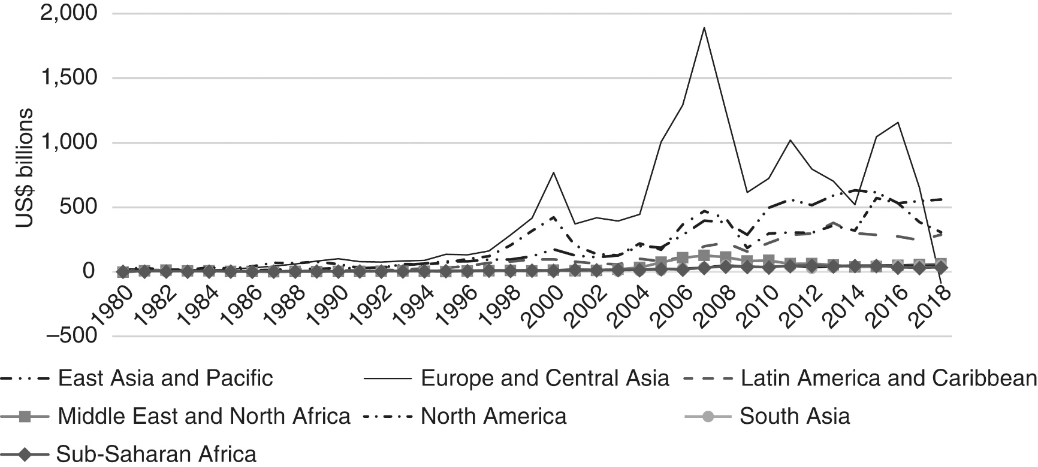
Patterns of FDI
Figure 10.1 Nominal inflows of FDI by region, 1980-2018 (US $ billions)

Slide 15
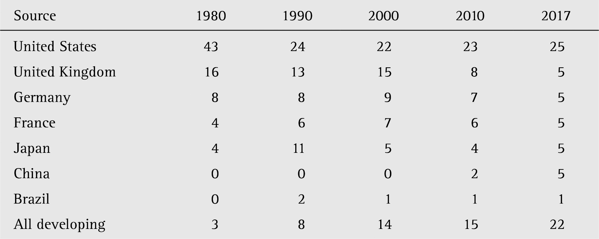
Patterns of FDI
Table 10.3 Leading sources of world FDI, 1980–2017 (percentage of global outward stocks)

Slide 16
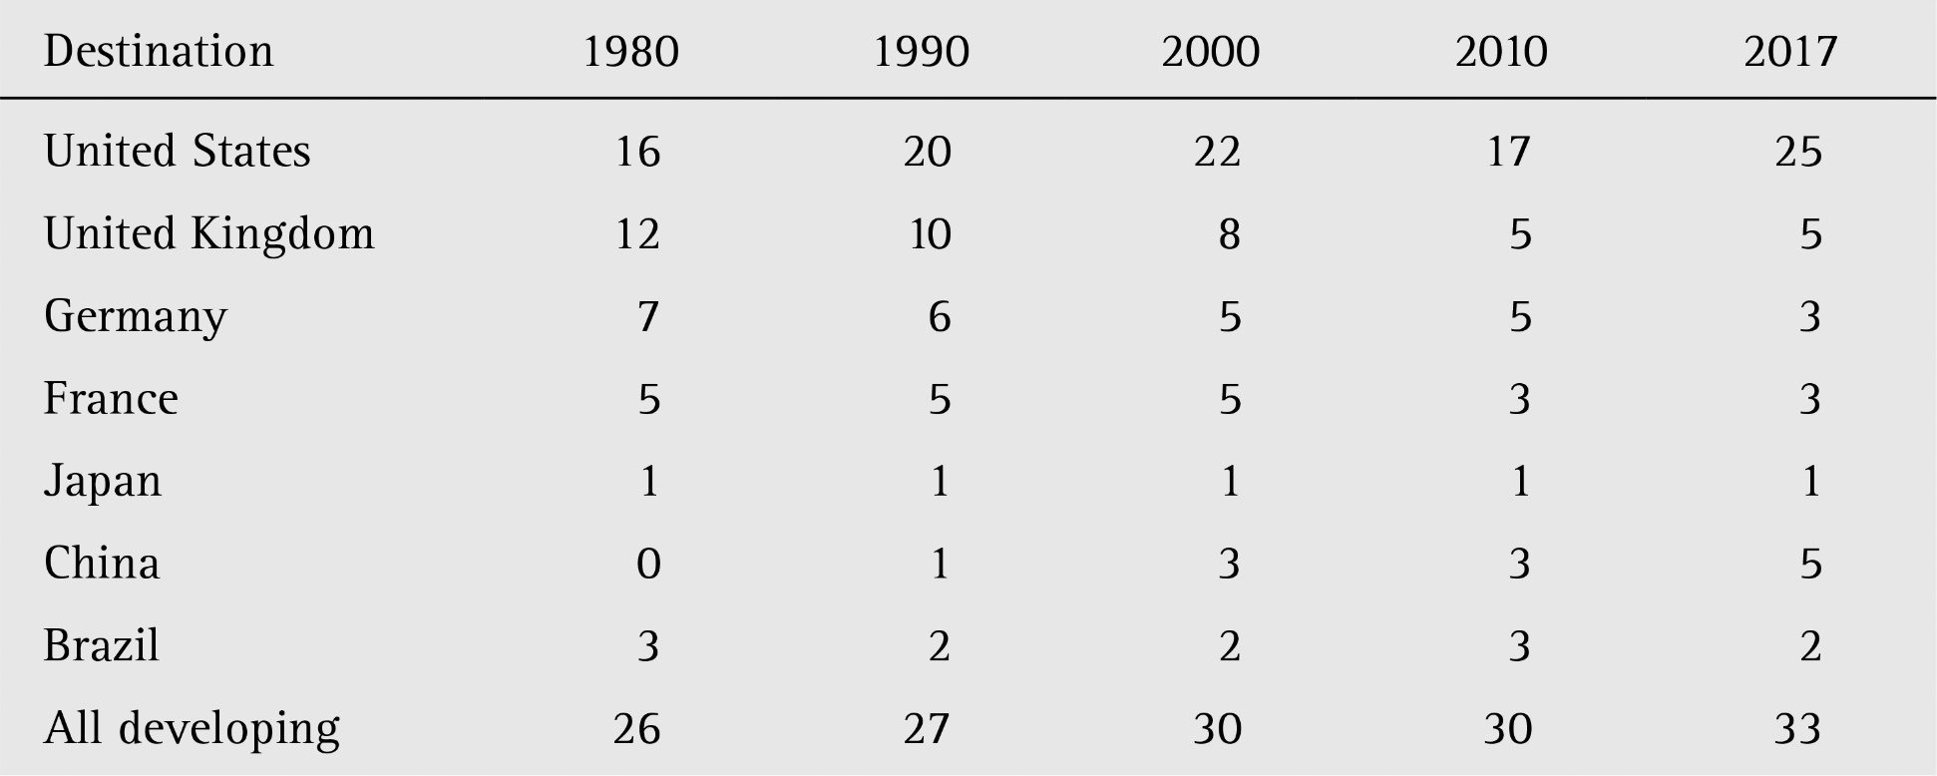
Patterns of FDI
Table 10.4 Leading destinations of world FDI, 1980–2017 (percentage of global inward stocks)

Slide 17
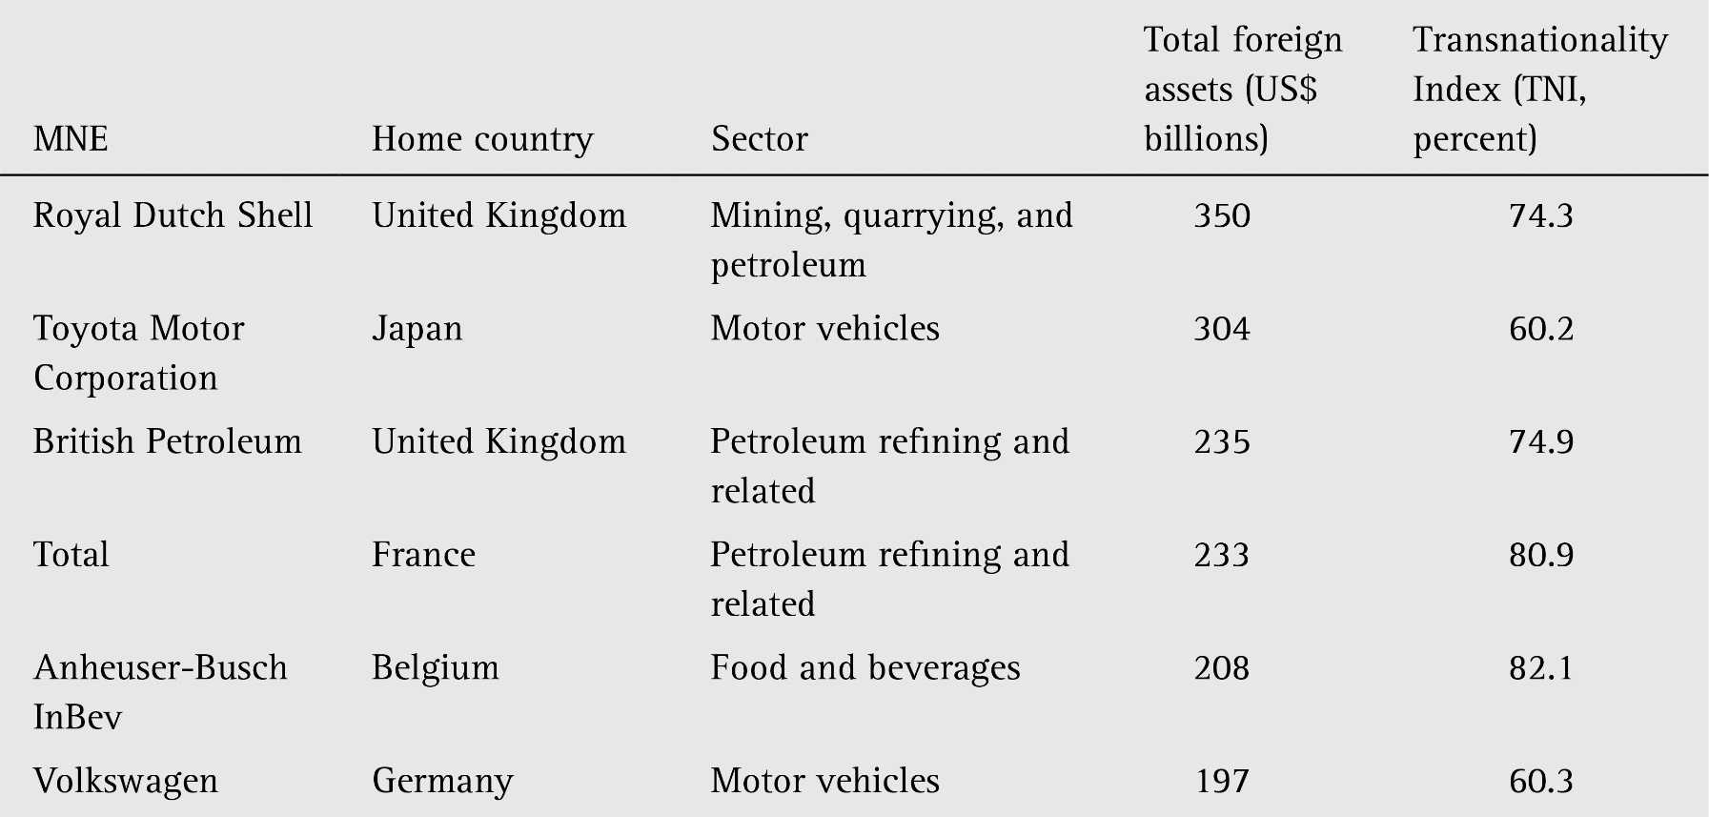
Patterns of FDI
Table 10.5 The world’s 25 largest non-financial MNEs, 2016

Slide 18
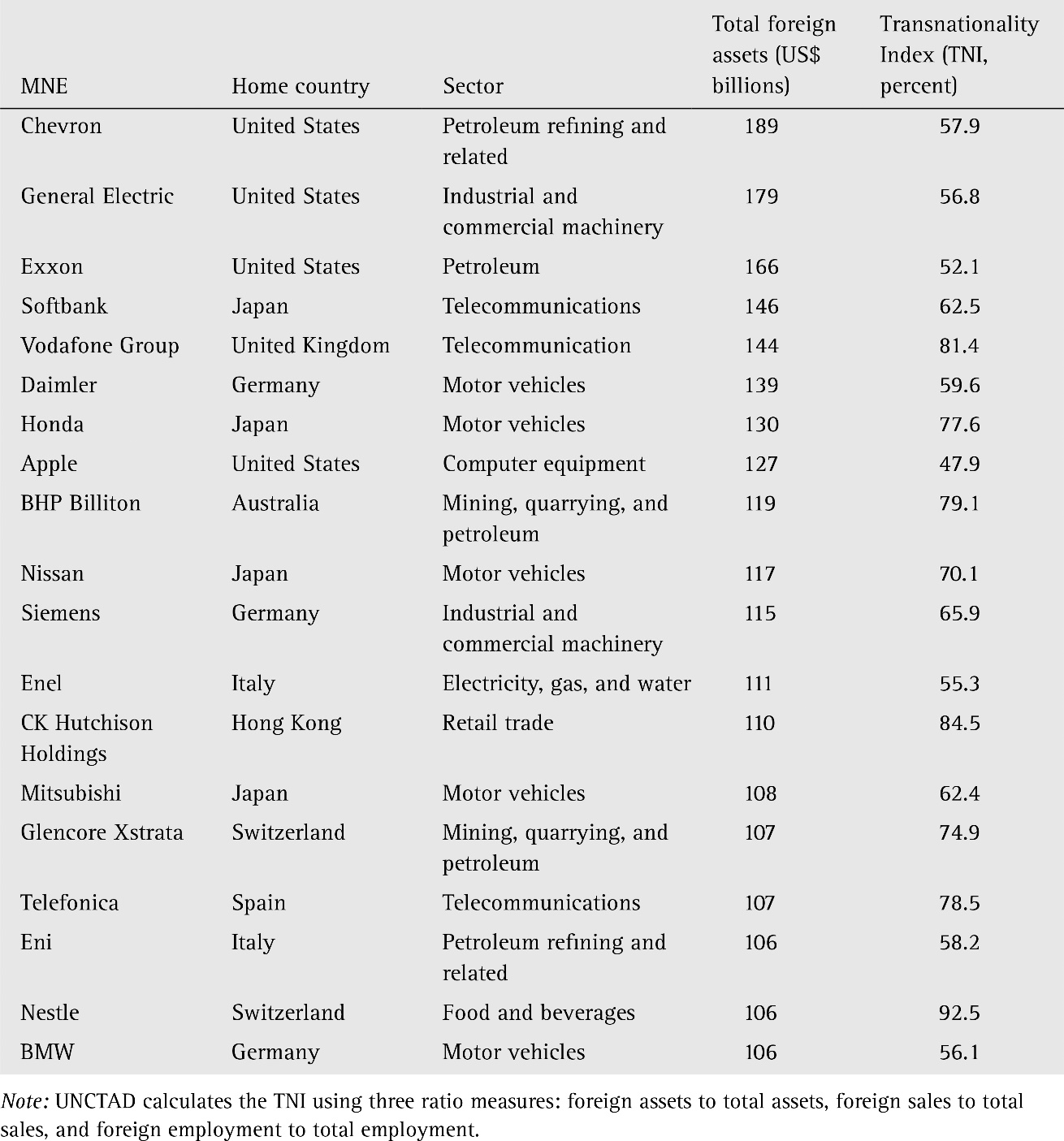
Table 10.5 The world’s 25 largest non-financial MNEs, 2016 (cont’d)

Slide 19
MNE Organizational Design
Table 10.6 Generic types of MNE organizational design

Slide 20
MNE Organizational Design
Two general tendencies:
The narrower the range of its products, the more likely the MNE is to adopt a country/region divisional structure.
The wider the range of its products, the more likely the MNE is to adopt a product divisional structure.
Heterarchy:
involves information sharing and informal ways of circumventing the limitations of formal organizational design (subsidiary differentiation, the use of multiple methods of coordination, including intra-firm social networks, and the creative use of human resource development)

Slide 21
The Home Base
Home base: where the MNE started
Almost always the location of its corporate headquarters
Tendency for certain functions (including finance, corporate control, and R&D) to be centralized within the HQ.
Role of the home base in supporting MNE competitiveness:
To support the firm-specific assets
Cluster of firms to draw from certain resources or factors
These considerations can cause an MNE to change its home bases

Slide 22
Joint Ventures
JV: the home-country firm establishes a separate firm in the foreign country that is jointly owned with a foreign-country firm
JVs are notoriously unstable and relatively short-lived, due to the difficulty of managing two firms together, clashes of organizational culture, and clashes of national culture.

Slide 23
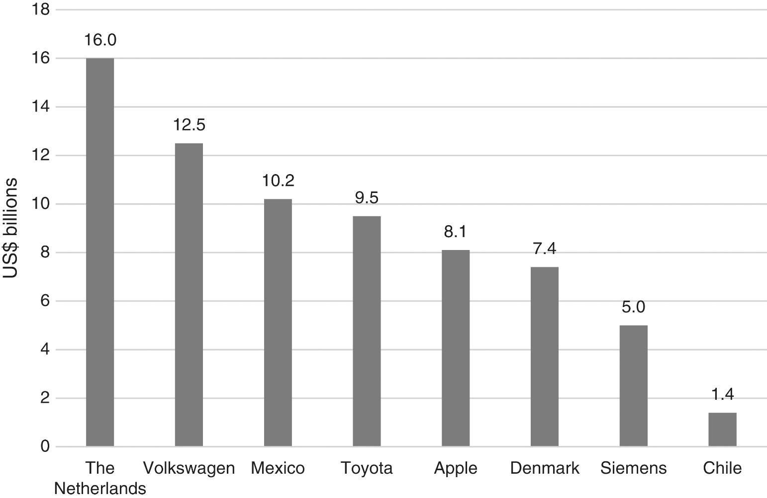
Research and Development
Figure 10.2 R&D expenditures of selected MNEs and countries, 2016 (US$ billions)

Slide 24
Research and Development
The way in which MNEs configure R&D within their GVCs matters enormously to global technological capabilities.
There is a tendency to centralize R&D functions in the home-base country, or even in the corporate headquarters.
There is also movement towards locating particular aspects of R&D outside the home base.
the improvement in ICT
the rise of emerging markets and the need to better tailor products to these markets.
talent and creativity for effective R&D is no longer confined to Western Europe, the United States and Japan
Emerging concern about the role of increased nationalism on the trajectory of R&D among MNEs

