Slide 1
Chapter 8: World Trade Organization
An Introduction to International Economics: New Perspectives on the World Economy

Slide 2
Introduction
This chapter covers key aspects of the World Trade Organization (WTO)
Covers the General Agreement on Tariffs and Trade (GATT) and trade in goods
Addresses trade in services and intellectual property
Discusses dispute settlement, the environment and the Doha Round

Slide 3
The General Agreement on Tariffs and Trade
In 1944, the United States and Britain held a conference (Bretton Woods) that established:
International Bank for Reconstruction and Development (World Bank)
International Monetary Fund
In 1945, the United States attempted to launch idea of an International Trade Organization (ITO)
London—twenty-three founding members were present and signed General Agreement on Tariffs and Trade (GATT)
In 1948 ITO charter was agreed to at a United Nations Conference
In 1950 US announced it would not seek US Congressional ratification of Havana Charter, effectively terminating ITO plan
Vehicle for post-war trade negotiations became GATT

Slide 4
The General Agreement on Tariffs and Trade
Between 1946 and 1994, the GATT provided a framework multilateral trade negotiations
Rounds reduced tariffs among member countries in many (but not all) sectors
Weighted average tariff on manufactured products imposed by industrial countries fell from 20% to 5%
However GATT suffered from what some defects that limited its effectiveness
A number of these defects were addressed in the Marrakesh Agreement at the end of the Uruguay Round of multilateral trade negotiations

Slide 5
Table 8.1 GATT/WTO rounds of multilateral trade negotiations

Slide 6
Non-Discrimination Principle
Non-discrimination has two elements
Most-favored nation (MFN) applying to border measures
Each member must grant treatment to all other members as favorable as it extend to any individual member country
National Treatment (NT) applying to behind-the-border measures
Foreign goods within a country should be treated no less favorably than domestic good with regard to tax policies and other regulations

Slide 7
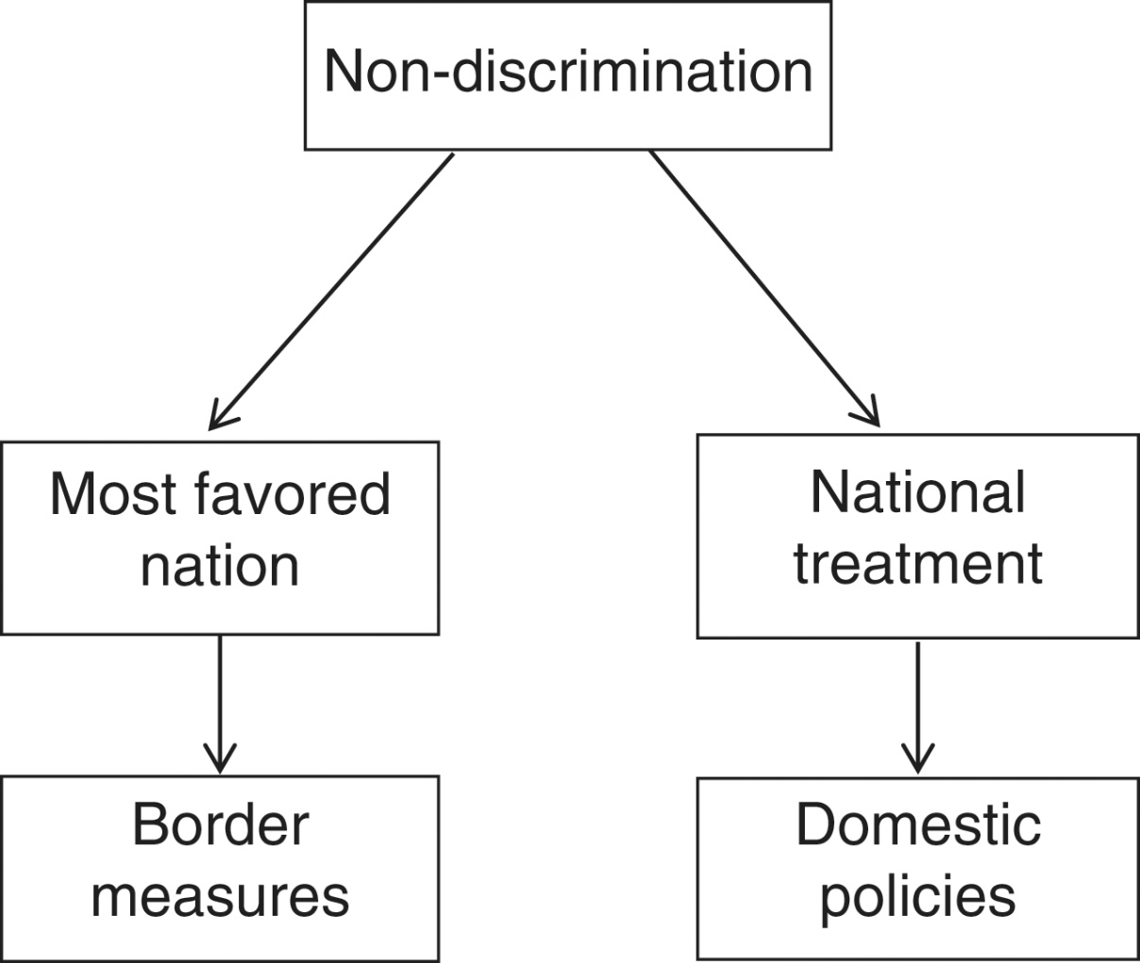
Figure 8.1: Non-Discrimination Principle

Slide 8
General Prohibition of Quotas
A second important GATT principle
General prohibition of quotas or quantitative restrictions on trade
Reflects a longstanding view that price distortions (tariffs) are preferred to quantity distortions in international markets
Quantitative restrictions were one of the most significant impediments to trade prior to GATT
Exceptions are allowed: agricultural products, textile and clothing…→unfair for LMICs?

Slide 9
Tariff Bindings and Fair Trade
Tariffs are bound at an agreed-upon level often above applied levels
Levels may not be increased in the future
Applied rates below bound rates may be increased

Slide 10
The World Trade Organization
The Marrakesh Agreement created the WTO and included the WTO “tripod”
General Agreement on Tariffs and Trade (GATT 94) on trade in goods
General Agreement on Trade in Services (GATS)
Agreement on Trade-Related Aspects of Intellectual Property Rights (TRIPS)
Included a WTO charter
Established WTO as a legal international organization
Stipulated that “WTO shall provide the common institutional framework for the conduct of trade relations among its members”
Defined the functions of WTO

Slide 11
Table 8.2: Administrative Structure of the WTO

Slide 12
Trade in Goods
The Marrakesh Agreement contains GATT 1994, an Agreement on Agriculture, and an Agreement on Textiles and Clothing (expired in 2005)
Agreement on Agriculture addressed three issues
Market access
Replaced quotas with a system of bound tariffs (tariffication) and tariff-reduction commitments
Domestic support
Distinction was made between
“Green box” measures—are exempt from any reduction commitments
“Amber box” measures—are not exempt
Export subsidies
Use was not eliminated but limited to specified situations
Represented a change in rules with little actual liberalization

Slide 13
Trade in Services
General Agreement on Trade in Services (GATS)—significant outcome of Uruguay Round
Represented first time services were brought into a multilateral trade agreement
Negotiations were difficult due to fact that trade in services is less tangible than trade in goods
Defined trade in services as occurring in one of four modes
Mode 1: Cross-border trade
Mode 2: Movement of consumers
Mode 3: Foreign direct investment or FDI
Mode 4: Movement of natural persons

Slide 14
Trade in Services
Cross-border trade
Mode of supply that does not require physical movement of producers or consumers
For example, Indian firms provide medical transcription services to US hospitals via satellite technology
Movement of consumers
Consumer travels to the country of producer
For example, tourism services
Foreign direct investment
Services that require a commercial presence by producers in country of the consumers
For example, financial services
Temporary movement of natural persons
Non-commercial presence by producers
For example, consulting, construction, and instructional services

Slide 15
GATS Protocols
Second GATS Protocol: Revised Schedules of Commitments on Financial Services, 1995
Third GATS Protocol: Schedules of Specific Commitments Relating to Movement of Natural Persons, 1995
Fourth GATS Protocol: Schedules of Specific Commitments Concerning Basic Telecommunications, 1997
Fifth GATS Protocol: Schedules of Specific Commitments and Lists of Exemptions from Article II Concerning Financial Services, 1998

Slide 16
Intellectual Property
Definition: An asset in the form of rights conferred upon a product of invention or creation by a country’s legal system
Agreement on Trade-Related Aspects of Intellectual Property Rights
Most contentious aspect of Marrakesh Agreement
Defined intellectual property as belonging to one of six categories
Copyrights
Trademarks
Geographical indications
Industrial designs
Patents
Layout designs of integrated circuits
Applied the principle of nondiscrimination to intellectual property

Slide 17
TRIPS Agreement
Sets out obligations for members
Copyrights
Members must comply with 1971 Berne Convention on copyrights
Trademarks
Goods and services are to be protected for a term of no less than seven years
Provisions for the registration of trademarks must be made and are renewable indefinitely
Geographical indications
Members must provide legal means to prevent false use of geographical indications
Industrial designs
Members must protect “independently created industrial designs that are new or original”
Patents
Exceptions exist and include protection of public order, human, animal, and plant life
Layout designs of integrated circuits
Distribution of protected layout designs is forbidden

Slide 18
TRIPS Agreement: controversies
Citizens and firms in developed countries own most of the world’s IP
Developing countries currently often have less IP protection than developed countries
Especially in the case of patents
Raises cost of many goods and services to developing countries
Represents a transfer from developing country consumers to developed country producers
Issues have also been raised about the impact of new pharmaceutical patents on access to medicines

Slide 19
Dispute Settlement
Marrakesh Agreement included an Understanding on Rules and Procedures Governing the Settlement of Disputes
Original GATT was unclear about resolution of disputes—Marrakesh Agreement attempted to clarify dispute settlement procedures
WTO includes councils on trade in goods and services as well as a council on TRIPs
Should help minimize occurrence of disputes

Slide 20
Figure 8.2: Dispute Settlement

Slide 21
Dispute Settlement
If the consultation process fails to settle a dispute within 60 days, the complaining member may request the establishment of a panel
Composed of three or five “well-qualified governmental or non-governmental individuals”
Function is to assist DSB in dispute settlement process
Consults the parties involved and provides DSB with a written report of its findings
DSB has 60 days to adopt report by consensus unless a party to dispute decides to appeal
The appeal of a panel report is referred to an appellate body
Reviews the appeal and submits its report to the DSB
Any DSB member can effectively insist on the adoption of the appellate body report

Slide 22
Dispute Settlement
Dispute settlement procedure applies to all aspects of the Marrakesh Agreement
Improves procedures of old GATT
Effectiveness of procedures depends on members’ commitment to it
A country has option of ignoring outcome of the dispute settlement process
Complaining member has right to impose retaliatory tariffs on a volume of imports from the other country determined by the DSB
Table 8.3 WTO dispute settlement complaints, 1995–2016

Slide 23
The Environment
In 1991, the GATT reactivated a long-dormant Working Group on Environmental Measures and International Trade (EMIT)
GATT dispute resolution panel issued its controversial opinion in the now-famous tuna-dolphin case
Ruled against US law banning imports of Mexican tuna that involved dolphin-unsafe fishing practices
Argued import ban violated general prohibition against quotas and United States had not attempted to negotiate cooperative agreements on dolphin-safe tuna fishing
US environmental community reacted strongly against the GATT panel ruling, casting the GATT as anti-environment

Slide 24
Committee on Trade and the Environment
EMIT was replaced by Committee on Trade and the Environment
Most developing country members of WTO have taken a dim view of the work of CTE
Fear the possibility of further protection against their exports in the form of “green protection”
Often view environmental matters having no place in the WTO
Many trade economists support the developing-country view that environmental issues represent an “intrusion” into WTO trade agenda
They do, however, support the use of multilateral environmental agreements and perhaps even a World Environmental Organization

Slide 25
Committee on Trade and the Environment
In 1999, WTO formally took up trade and environment issue
Report argued increased trade can have both positive and negative impacts on the environment
Emphasized trade-driven growth cannot always be counted upon to deliver improvements in environmental quality through increased incomes
Consequently, these higher incomes must be “translated into higher environmental quality” through mechanism of international cooperation
Also emphasized that government subsidies to polluting and resource-depleting sectors can exacerbate the environmental consequences of trade

Slide 26
The Doha Round
Launched in Doha, Qatar in 2001
Progress has been very uneven, with a noted failure at the 2003 Cancun Ministerial Meeting
July 2004, October 2005 and July 2008 negotiations made some progress on contentious agricultural issues
A “final countdown” to conclude the Round by the end of 2011 was missed
Significant issues remain in agriculture and in “non-agricultural market access” (NAMA)

Slide 27
Appendix 8.1: Tariff Rate Reduction Formulas
Tariff formulas can be used to determine tariff reductions in rounds of trade negotiations
The Kennedy Round introduced linear or proportional tariff reduction:
The Tokyo Round of MTNs introduced tariff reduction via the “Swiss formula”:
where b is the ceiling tariff.

Slide 28
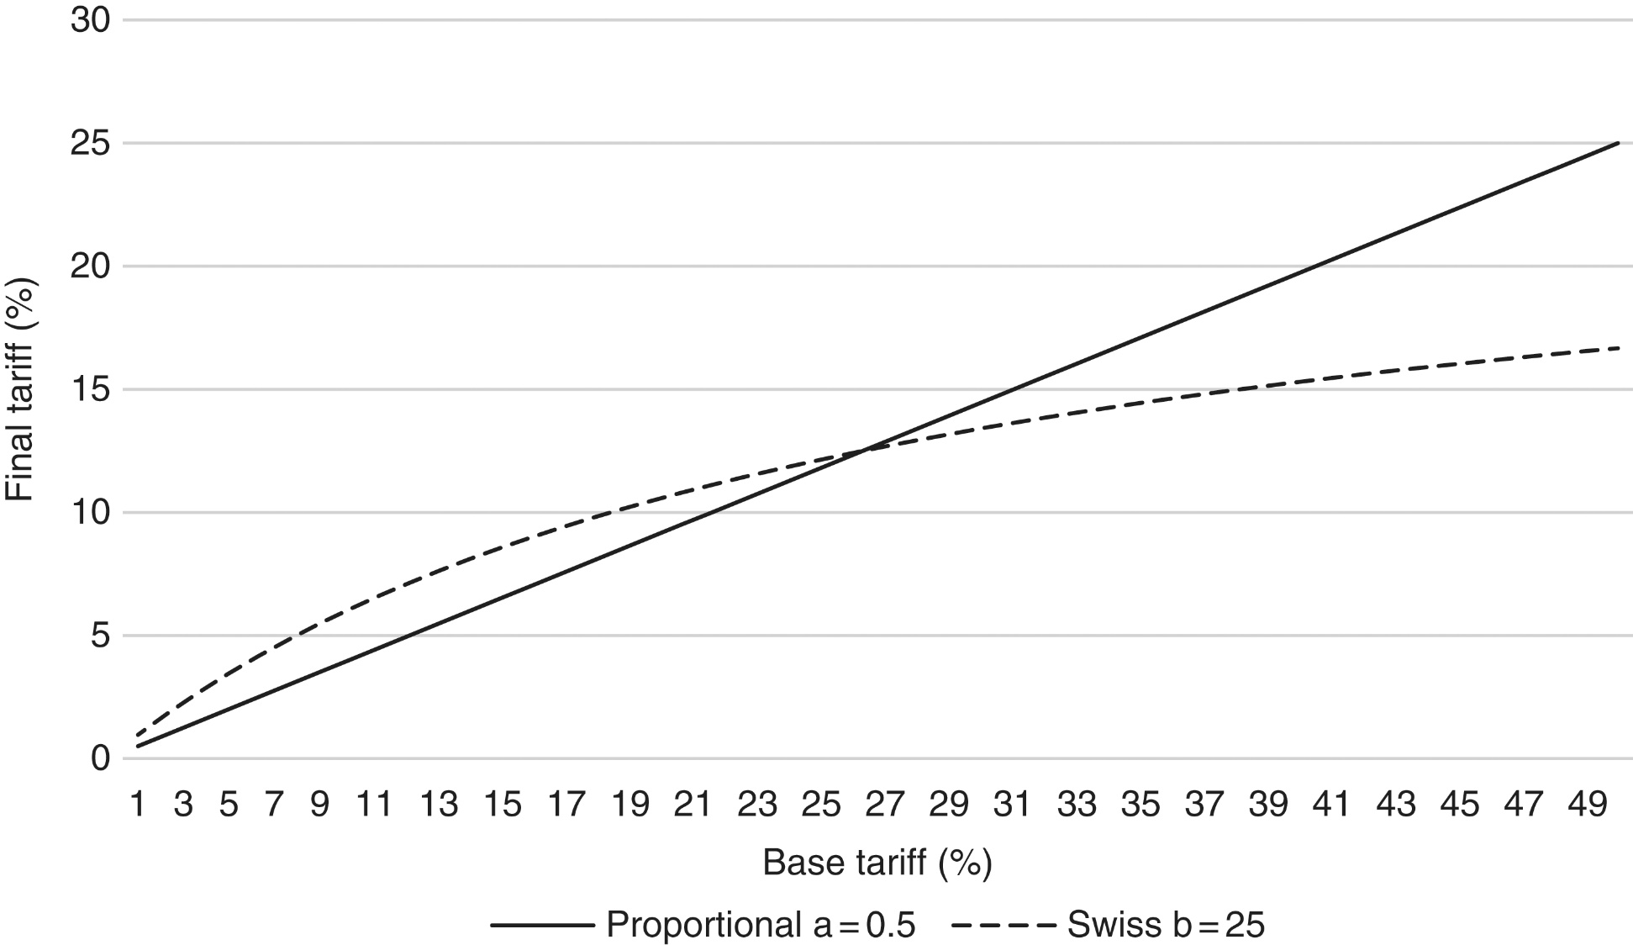
Figure 8.3: Tariff Formulas

