Slide 1
Chapter 7: Trade Policy Analysis
An Introduction to International Economics: New Perspectives on the World Economy

Slide 2
Analytical Elements
Countries
Sectors
Factors of production

Slide 3
Introduction
Reasons to expect landowners in Japan might oppose the import of rice from another country
Opposition to imports exists despite overall gains to Japan from these imports
Trade policy analysts and international affairs professionals are often called upon to assess impacts of government interventions in international trade
Purpose of chapter is to understand how the assessments are made

Slide 4
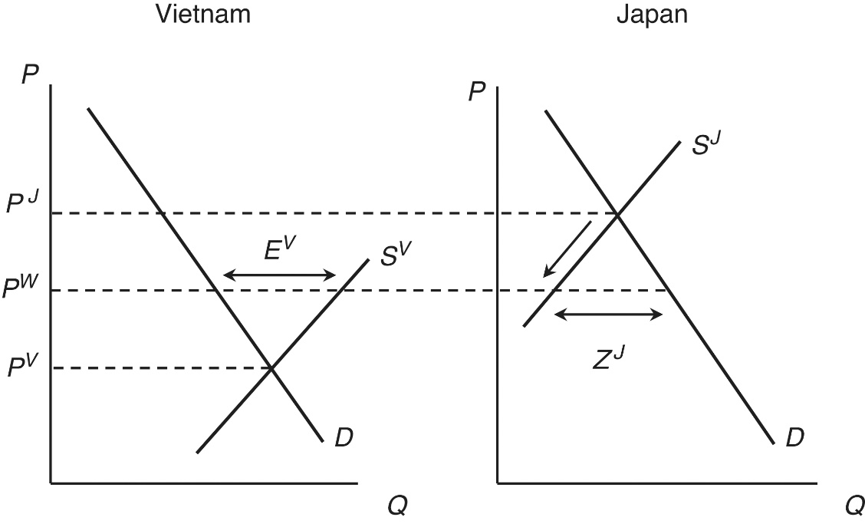
Absolute Advantage Revisited
In moving from autarky to trade in Figure 7.1, there is a reduction in domestic quantity supplied in Japan
Japanese rice-producing firms would lobby Japanese government to oppose decrease in domestic quantity supplied
Demand protection from Vietnam exports
Protective policies are widespread in world economy
Figure 7.1: Absolute Advantage and Trade in the Rice Market

Slide 5
Trade Policy Measures
A country can grant import protection to a sector of its economy in form of either
Tariffs: a tax on imports
Specific tariff is a fixed tax per physical unit of the import
Ad valorem tariff is a percentage tax applied to the value of the import
Non-tariff measures (see Table 7.1)
Governments employ both types of measures

Slide 6
Table 7.1 Non-tariff measures: Tax-like measures

Slide 7
Table 7.1 Non-tariff measures: Cost-increasing measures

Slide 8
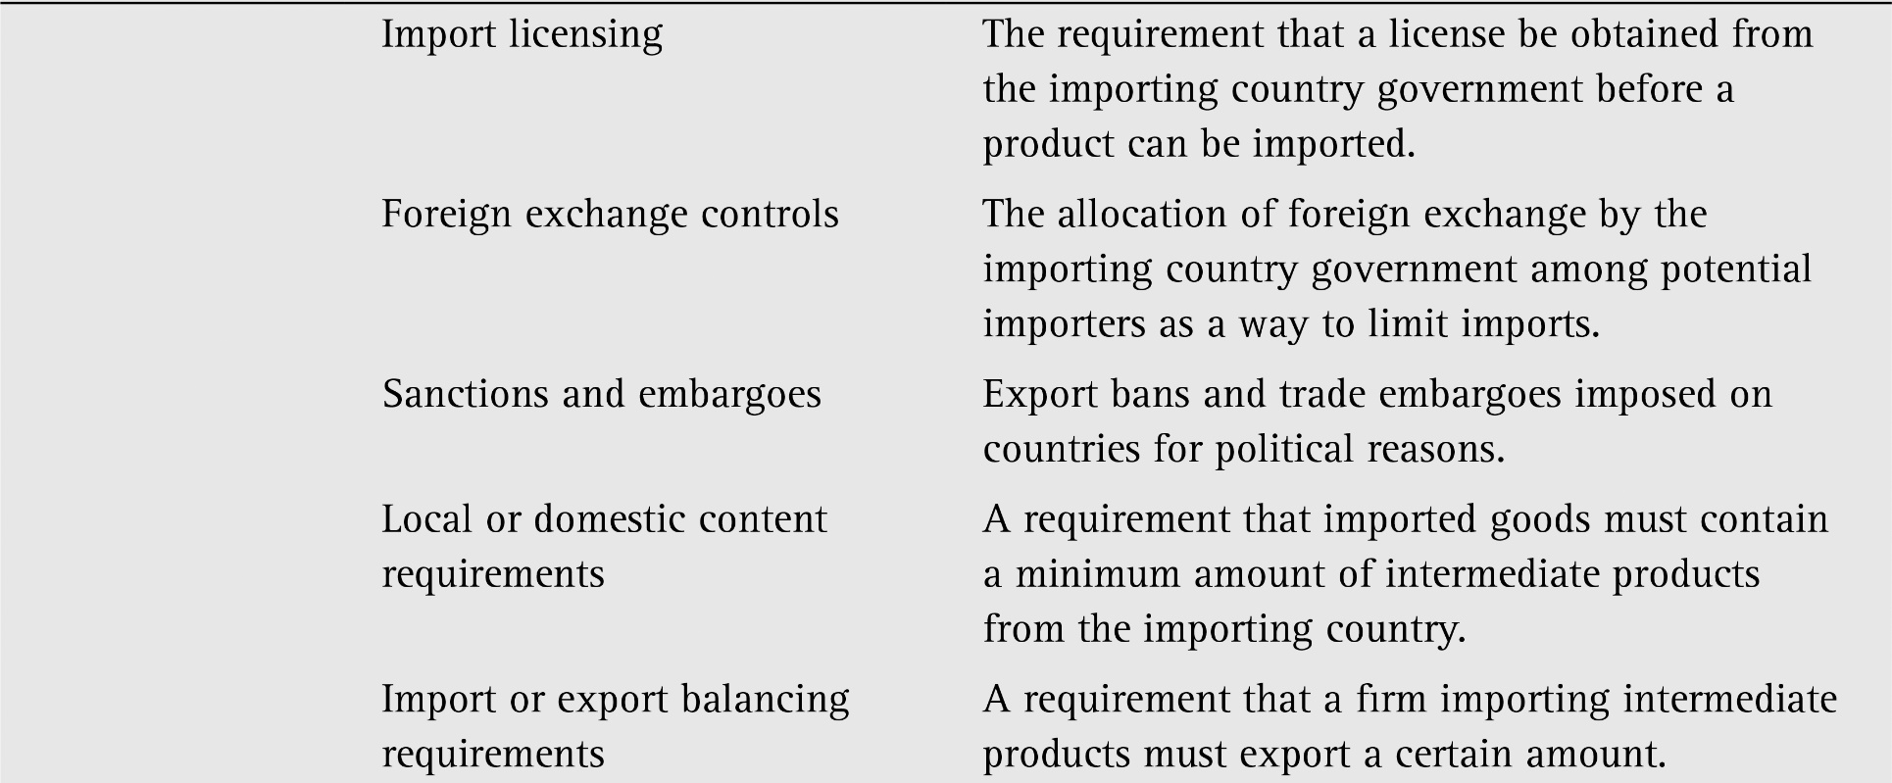
Table 7.1 Non-tariff measures: Quantitative measures

Slide 9
Table 7.1 Non-tariff measures Government procurement measures

Slide 10
A Tariff
Two kinds of tariffs:
A specific tariff
An ad valorem tariff
For our graphical analysis in this chapter, it is much simpler to consider a specific tariff. Basic results also apply to an ad valorem tariff

Slide 11
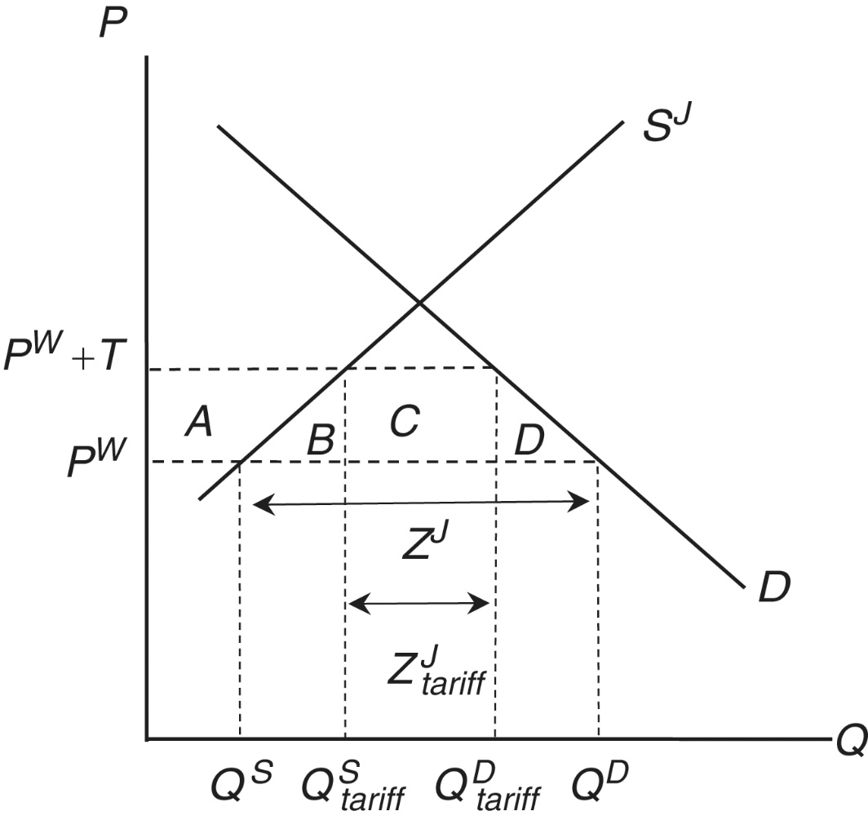
Figure 7.2: A Tariff on Japan’s Imports of Rice
A tariff increases domestic price of imported product above world price
In the case of Japanese rice, domestic price is many times larger than world price
Causes an increase in Japan’s production of rice which is desired effect from Japanese rice farmers
Domestic consumption of rice falls
Imports fall

Slide 12
Tariff Effects
Welfare and revenue effects also occur from the tariff
Consumer surplus of Japanese households fell
Japanese rice consumers are paying more and consuming less
Producer surplus of Japanese firms has increased
Japanese rice producers are receiving more for their product and producing more
Japanese government is receiving revenue from import tax

Slide 13
Net Welfare Effects
Summarizes welfare impact of policy for the country as a whole
N = A + C − (A + B + C + D) = −(B + D)
From an economic standpoint, tariff hurts Japanese society as a whole
Although it benefits producers and government, losses imposed on consumers outweigh benefits
Figure 7.2: A Tariff on Japan’s Imports of Rice

Slide 14
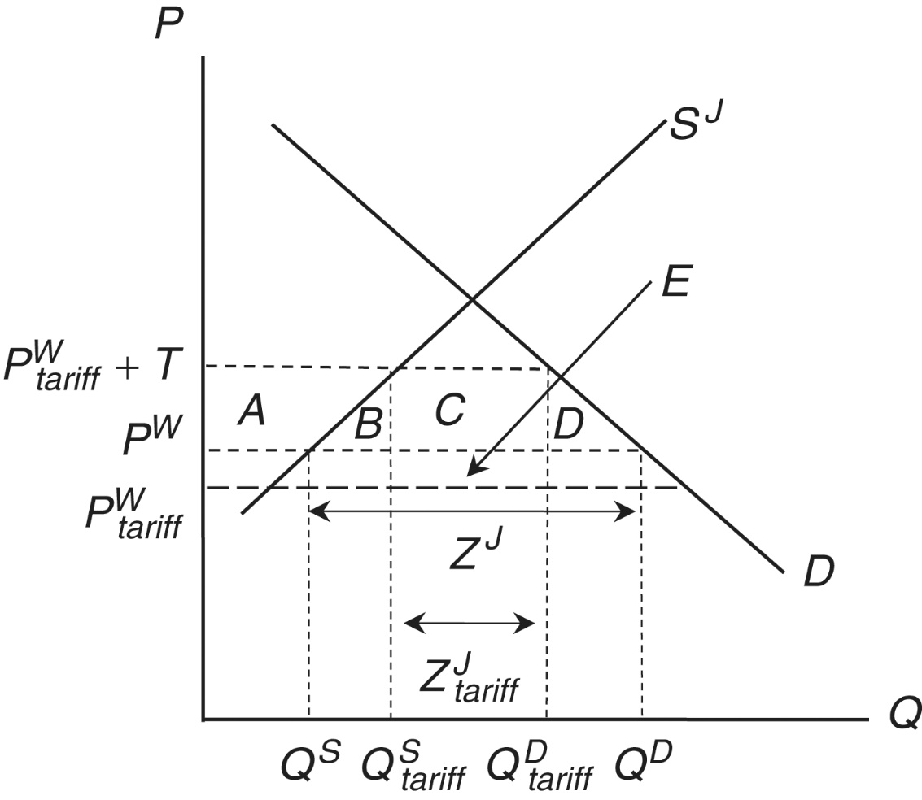
Terms of Trade Effects
When Japan imposes a tariff on its imports from Vietnam, amount of these imports decreases
As Japan’s imports of rice decrease, there will be excess supply in the world market for rice
Will cause the world price to fall
Since Japan is importing rice, this is a good thing for this country
Figure 7.3: The Terms-of-Trade Effects of Japan’s Tariffs

Slide 15
A Quota
Import quota—a quantitative restriction on imports
Type of non-tariff measure
A quota results in a shortage of a good relative to initial situation without quota, causing price of good to rise
Known as quota premium
Consumer surplus falls and producer surplus increases

Slide 16
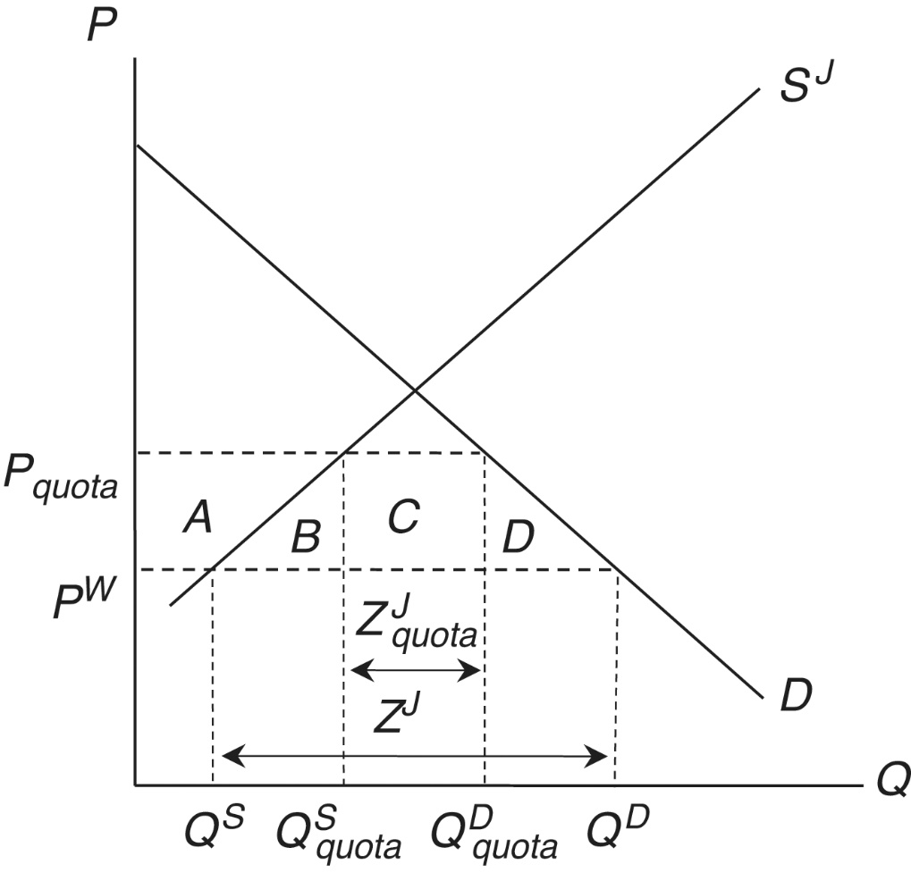
A Quota
Policy usually administered via a system of import licenses
Quota has restricted supply of import licenses
Extra value of the right to import an amount of a good is known as quota rents (area C)
Who receives rents depends on how the quota licenses are allocated
Allocated to domestic importers
Quota rents accrue to importers and remain in Japan as a gain
Allocated to foreign exporters
Quota rents accrue to exporters and leave Japan as a loss
Figure 7.4: A Quota on Japan’s Rice Imports

Slide 17
Summary of Trade Policies
Tariff
Unambiguous net welfare loss due to consumer surplus loss outweighing gains in producer surplus and government revenue
Tariff with terms of trade effects
Ambiguous net welfare effect due to terms of trade gain (fall in world price) potentially outweighing efficiency loss
Domestic-allocated quota
Unambiguous net welfare loss due to consumer surplus loss outweighing gains in producer surplus and quota rents
Foreign-allocated quota
Unambiguous net welfare loss that exceeds that of domestic-allocated quota case

Slide 18
Anti-Dumping and Countervailing Measures
Anti-dumping: a product has been sold at less than “normal” value
Tariff can be applied against “dumped” goods if the dumping causes “material injury” to the domestic competing sector producing a “like product.”
Anti-dumping is consistent with obligations under the WTO
Determination of dumping:
Price-based dumping: determined with evidence that an exporter is selling a good in the importing country at a price below what it charges in its own country.
Cost-based dumping: determined with evidence that an exporter is selling a good in the importing country below its costs of production

Slide 19
Anti-Dumping and Countervailing Measures
Calculating the dumping margins can be complicated, particularly when market systems in exporting countries are not completely operational.
The importing country can choose from three policy responses.
(1) Impose anti-dumping duties equal to the found dumping margin.
(2) Impose anti-dumping duties sufficient to remove “material injury” (“lesser-duty rule”).
(3) Have foreign exporting firms increase their prices (“price undertakings”)
Criticisms on anti-dumping

Slide 20
Anti-Dumping and Countervailing Measures
Countervailing duties can be imposed on foreign exporters as offsets when they benefit from subsidies offered to them by their national governments
Also allowed by the WTO: CVD actions are allowed if it can be shown both that the subsidies benefited the foreign exporter and that the resulting exports caused “material injury” to the domestic competing industry in the importing country.
Criticisms: also protectionism?

Slide 21
Comparative Advantage Models
In many instances, the effects of trade policies go beyond a single sector
In these cases, trade policy analysts turn to trade policy models based on comparative rather than absolute advantage
The central insight of these models is that a protective measure in one sector acts as an implicit tax on production in other sectors

Slide 22
Appendix 7.1: The Imperfect Substitutes Model
The standard absolute advantage models assumes that imported goods and domestic competing goods are perfect substitutes
In applied trade policy analysis, this assumption is often relaxed and imported goods and domestic competing goods become imperfect substitutes
This is presented in Figure 7.5 where a tariff is analyzed

Slide 23
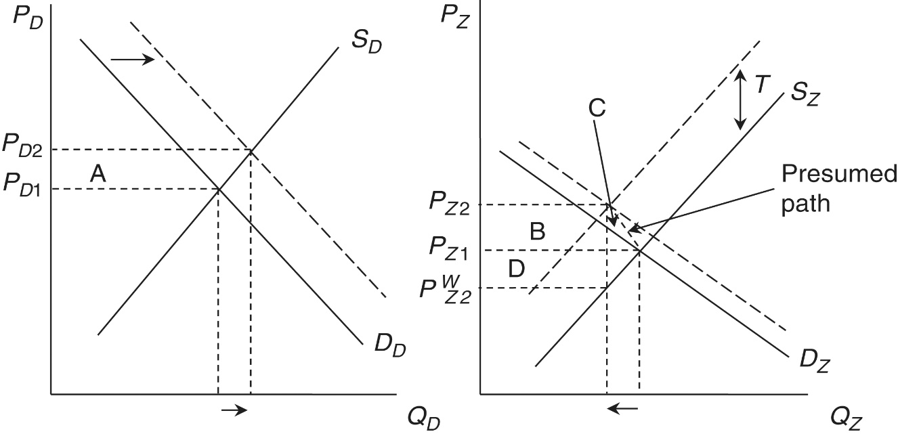
Figure 7.5: The Imperfect Substitutes Model
Figure 7.5 considers the related markets for a domestic good (D) and an imported good (Z)
The shifts in the demand curves in this figure are due to substitution effects, the magnitude of which reflects the cross-price elasticity of substitution
This is a more complicated approach to trade policy analysis but one that is widely used, including in anti-dumping analysis

Slide 24
Appendix 7.2: A Tariff Rate Quota
A Tariff Rate Quota (TRQ) involves two tariff levels
A lower tariff for levels of imports within the quota
A higher tariff for levels of imports above the quota
TRQs are used to implement minimum access levels (MALs) in agricultural sectors
TRQs are analyzed in the framework of Figure 7.6

Slide 25
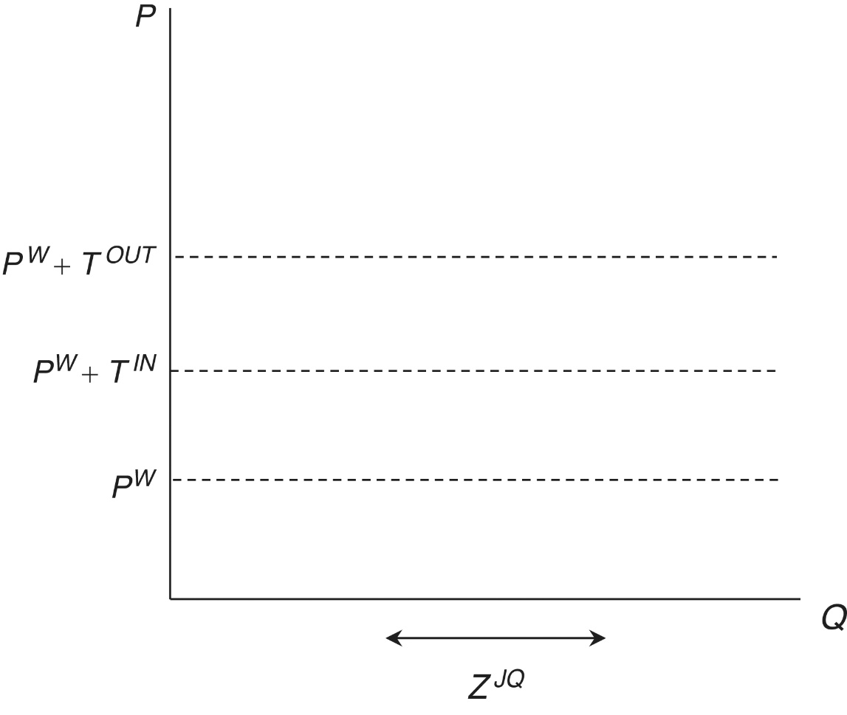
Figure 7.6: Framework for Analyzing Japan’s Tariff Rate Quota on Rice

Slide 26
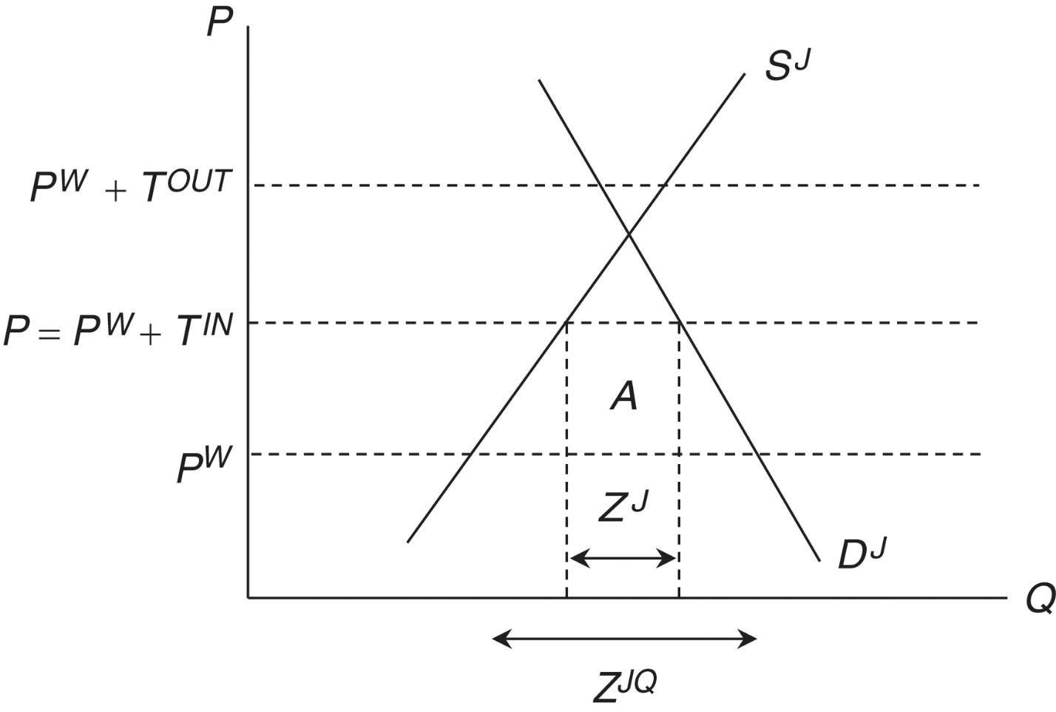
Figure 7.7: Case 1 of Japan’s TRQ on Rice
Case I: $Z^{J}<Z^{JQ}$

Slide 27
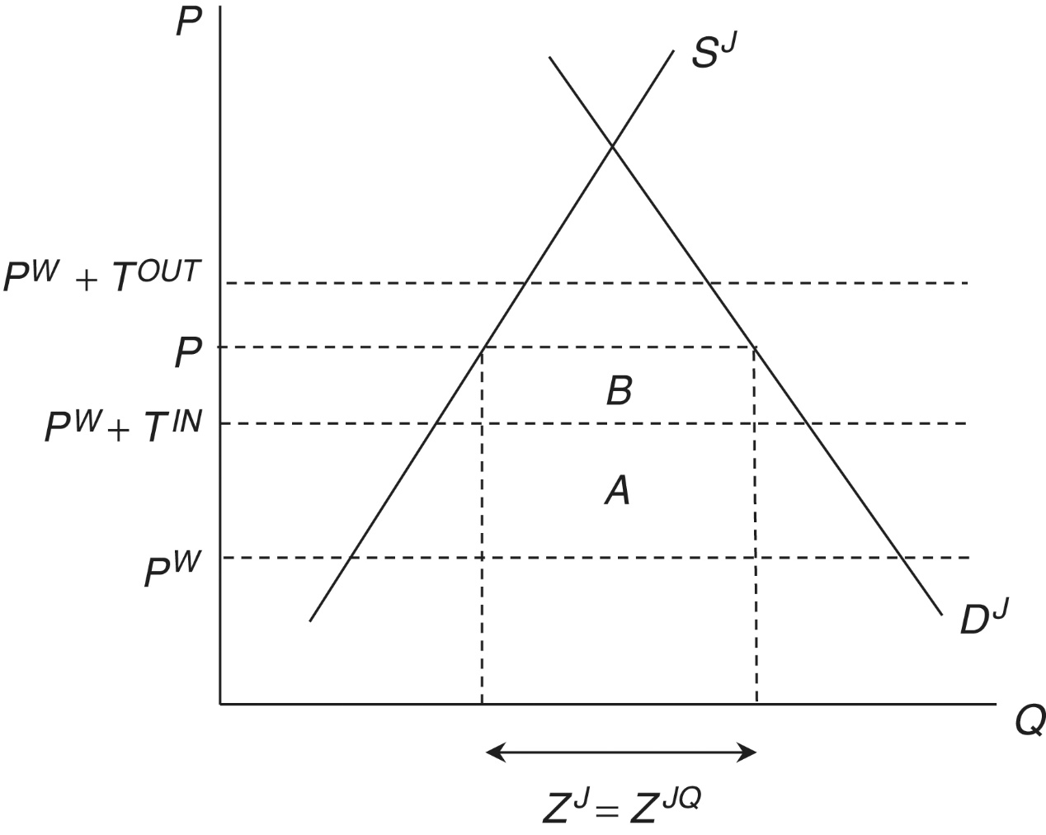
Figure 7.8: Case 2 of Japan’s TRQ on Rice
Case II: $Z^{J}=Z^{JQ}$

Slide 28
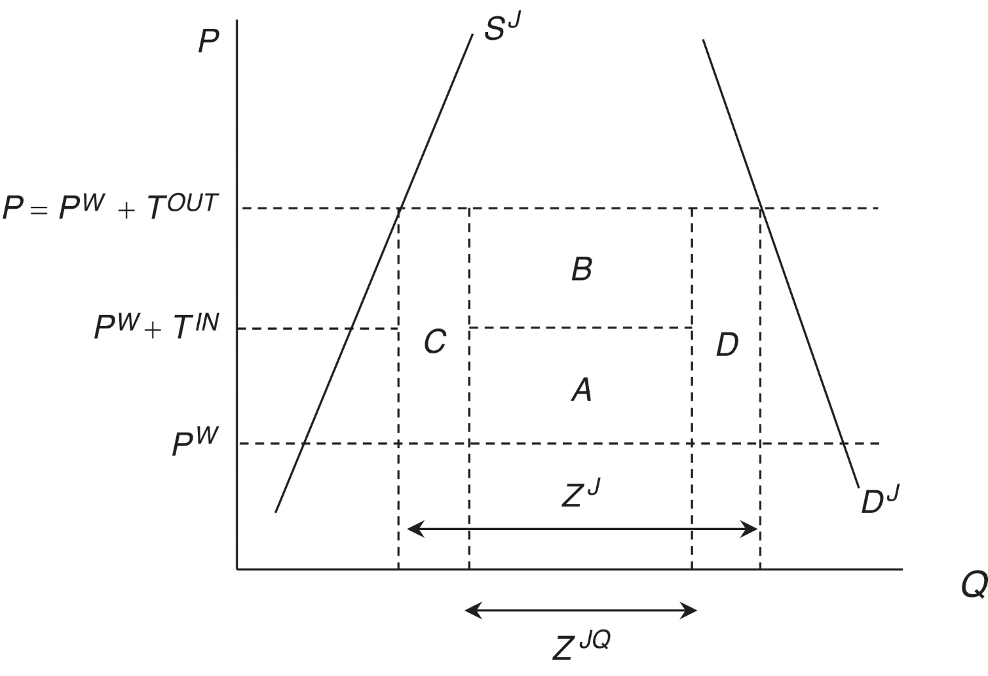
Figure 7.9: Case 3 of Japan’s TRQ on Rice
Case III: $Z^{J}>Z^{JQ}$

