Slide 1
Chapter 6: The Political Economy of Trade
An Introduction to International Economics: New Perspectives on the World Economy

Slide 2
Introduction
It is possible for countries to move from autarky to inter-industry trading relationships based on patterns of comparative advantage
Involved improvements in welfare for the countries involved
However, while Japan may experience an economic benefit from importing rice, it has a long history of preventing the importation of rice
Reluctance due to economic security and cultural reasons
Possible (and likely) certain groups lose from this change
Japanese rice producers are one such politically powerful group
Gives rise to political economy of trade
Theory of international trade begins to merge into political science

Slide 3
The Market for Protection
The market for protection approach emphasizes the supply-side and demand-side factors affecting actual protection levels.
The supply of protection is provided by national governments.
The demand for protection can take place through a variety of mechanisms suggested in Table 6.1.

Slide 4
Table 6.1: Approaches to the Political Economy of Trade
Focus | Name | Insight
Country-based | Realism | There are security externalities associated with international trade.
Country-based | Institutionalism | Institutional structures within country governments affect trade policies.
Factor-based | Heckscher-Ohlin model Stolper Samuelson theorem | Under factor mobility within a country, different factors can win or lose from trade.
Sector-based | Specific factors model | With sector-specific factors, winning/losing depends on export/import factor specificity.
Firm-based | Firm-based | Trade exposure of firms can influence their posture to trade liberalization
Adapted from Walter and Sen (2009)

Slide 5
Comparative Advantage, Trade, and Factors of Production
A factor-based analysis of the political economy of trade examines the implications of the movement from points A to B along the production possibilities frontiers

Slide 6
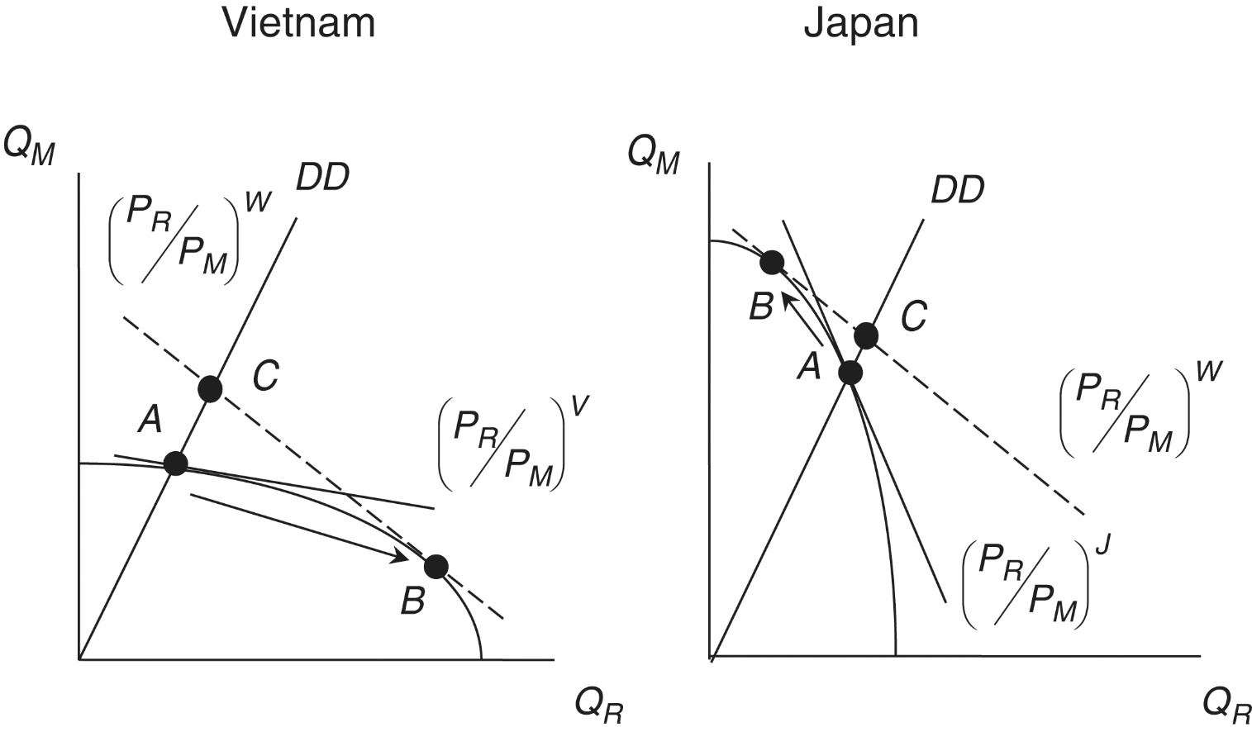
Figure 6.1: Autarky and Comparative Advantage in Vietnam and Japan

Slide 7
Trade and Factors of Production
Pattern of comparative advantage may be based on different endowments of factors of production
For instance, Vietnam may have a comparative advantage in rice due to the fact that it has a relatively large endowment of land
Factor endowments ⇔ Countries
Factor intensities ⇔ Sectors or goods
Heckscher-Ohlin model of international trade explains comparative advantage in terms of factor endowments

Slide 8
Heckscher-Ohlin Model
A country exports (imports) the good whose production is intensive in its abundant (scarce) factor
For instance, Vietnam’s comparative advantage in rice causes an increase in the output of rice at the expense of motorcycles
Results in an increase in demand for land and a decrease in demand for physical capital
Vietnamese land owners gain from trade, while Vietnamese capital owners (capitalists) lose from trade
Japan’s comparative advantage in motorcycles causes an increase in the output of motorcycles at the expense of rice
Results in an increase in demand for physical capital and a decrease in demand for land
Japanese capital owners gain from trade and Japanese land owners lose from trade

Slide 9
Heckscher-Ohlin Model
Would expect that landowners in Vietnam and capital owners in Japan would support trade
Political opposition to trade would come from capital owners in Vietnam and landowners in Japan
Thus, strong and persistent opposition to rice imports in Japan
Due in part to political clout of Japanese landowners
However, it is not “economic security and culture” that explains the opposition but income loss

Slide 10
Figure 6.2: The Heckscher Ohlin Model and the Stolper-Samuelson Theorem

Slide 11
Stolper-Samuelson Theorem
When moving from autarky to trade, the country’s abundant factor of production (used intensively in the export sector) gains, while the country’s scarce factor of production (used intensively in the import sector) loses
The Stolper-Samuelson theorem cannot be applied blindly
Applies only to trade based on different endowments in factors of production
Trade based on differences in technology can mitigate effects described by theorem
Technological considerations arise in the application of the theorem to the issue of North-South trade and wages

Slide 12
North-South Trade and Wages
More subtle issue in the ongoing debate concerning North-South trade and wages
Evidence suggests that
Developing countries in South have comparative advantage in unskilled-labor-intensive goods
Developed countries in North have comparative advantage in skilled-labor-intensive goods
According to the Stolper-Samuelson theorem, Northern workers who lose as a result of increased North-South trade are actually unskilled workers

Slide 13
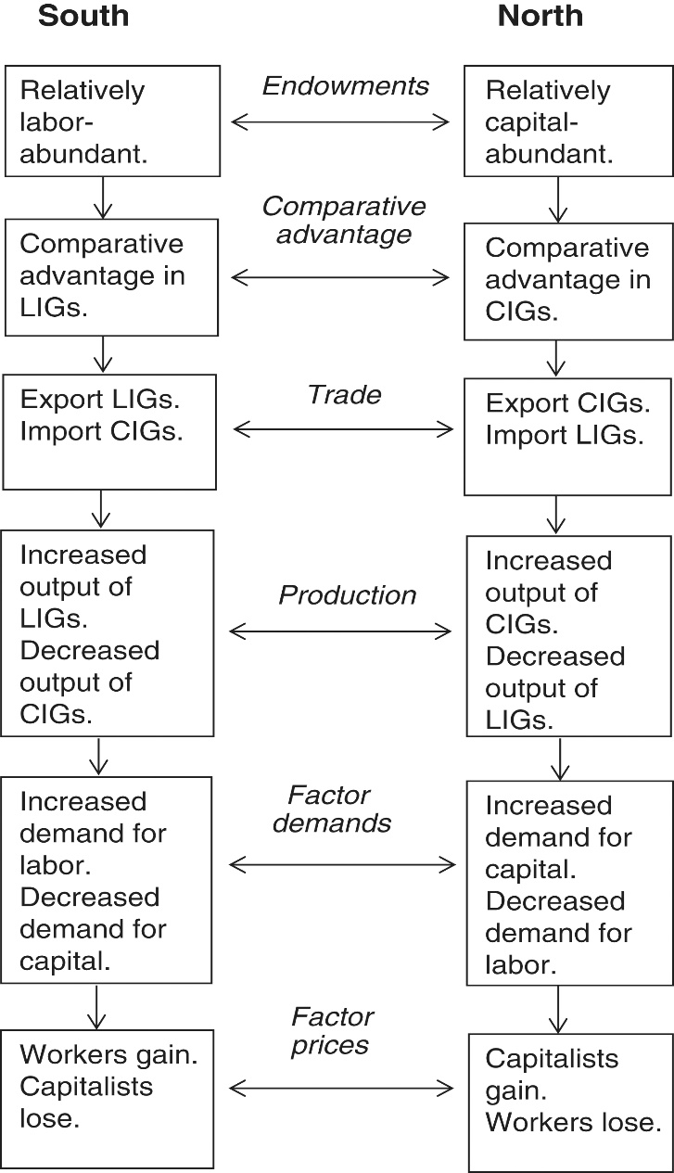
Figure 6.3 The Stolper–Samuelson theorem and North–South trade

Slide 14
North-South Trade and Wages
Concerns have prompted ongoing empirical investigation into effects of trade on Northern wages
Important empirical result is that there are two (not one) main causes for the decline in relative wages of Northern unskilled workers
Trade and technology
Stolper-Samuelson theorem suggests that Northern unskilled workers lose because North has a comparative advantage in skilled-labor-intensive goods
These effects, however, tend to be smaller than Stolper-Samuelson theorem would suggest

Slide 15
North-South Trade and Wages
Why might the Stolper-Samuelson theorem not apply?
Some evidence that export-oriented industries pay higher wages than other industries.
Labor reallocations caused by increased trade can boost average wages.
Some North-south trade is based on higher productivity (better technology) in the North rather than in differences in factor endowments.
Technology plays a large factor in decline in unskilled labor wages in the North.

Slide 16
North-South Trade and Wages
Ongoing process of technological change in the North has increased demand for skilled workers relative to unskilled workers
Trade restrictions in the North on exports from the South is probably not the best approach to the problem
Technology appears to be at least as important as trade
Trade restrictions will suppress the overall gains from trade
Trade restrictions could violate multilateral commitments at the WTO
Restrictions could harm unskilled workers in the South who are in more dire straits than their Northern counterparts.

Slide 17
North-South Trade and Wages
A more long-term and productive policy approach would be to offer other forms of support to unskilled Northern workers
Income supports (including trade adjustment assistance) or
Support to increase human capital assets (education, training)
A major factor contributing to wage and income inequality in the North is failure to complete secondary (high school) education
Remedying educational failures is imperative in Northern and Southern countries

Slide 18
The Role of Specific Factors
Central assumption of Heckscher-Ohlin model and Stolper-Samuelson theorem
Resources or factors of production such as labor, physical capital, and land can move effortlessly among different sectors of trading economies
For example, Japanese resources are assumed to be able to shift back and forth between rice and motorcycle production
For some types of analysis (particularly that applying to the long run) the assumption is reasonable
However, sometimes the assumption can be at odds with reality
Factors of production can be sector specific or specific factors and not easily move from one sector to another

Slide 19
The Role of Specific Factors
Requires a modification of the Stolper-Samuelson theorem
For example—steel production in United States
United States is relatively abundant in physical capital
Theorem suggests capital owners in United States would gain as a result of increased trade
But in 2000 US-based Weirton Steel Corporation drew attention to what it called an “import crisis” and pledged to fight the “import war”
Why would capitalists in a capital abundant country oppose increased trade in violation of Stolper-Samuelson theorem?
Weirton Steel Corporation and other US steel firms own large amounts of specific factors (steel mills) which are specific to steel production

Slide 20
The Role of Specific Factors
Need to modify the Stolper-Samueslson theorem to adjust for specific factors
Factors of production that are specific to import (export) sectors tend to lose (gain) as a result of trade
Weirton is in an import sector characterized by sector-specific physical capital (and perhaps even labor) and stands to lose as a result of increased trade

Slide 21
The Role of Specific Factors
Keep the difference between specific and mobile factors in mind when assessing politics of trade
Mobile factors of production
Stolper-Samuelson theorem applies
Abundant factor of production (used intensively in the export sector) gains
Scarce factor of production (used intensively in the import sector) loses
Specific factors of production
Stolper-Samuelson theorem does not apply
Factor of production specific to the export sector gains
Factor of production specific to the import sector loses
Fate of mobile factors is uncertain

Slide 22
Globalization and Inequality in High-Income Countries
There is evidence of declining living standards for less educated individuals (workers and the unemployed) in high-income countries
Milanovic (2016): gains in real income between 1988 and 2008/2011:
largest gains → individuals in China, India, Thailand, Vietnam, and Indonesia + “global top one percent”.
Least gain → lower middle class in high-income countries
difficult to directly attribute these changes to specific dimensions of globalization as opposed to technological changes; analytical realms of globalization and technology are now intertwined.

Slide 23
Appendix 6.1: Endogenous Protection
An addendum the Heckscher-Ohlin model that explains why the demand for and supply of protection interact to lead to positive levels of protection (tariffs).
This considers ranges in capital-labor ratios for individuals that begin at zero for a number of workers.
Capital-labor ratios then become increasingly positive for additional workers.

Slide 24
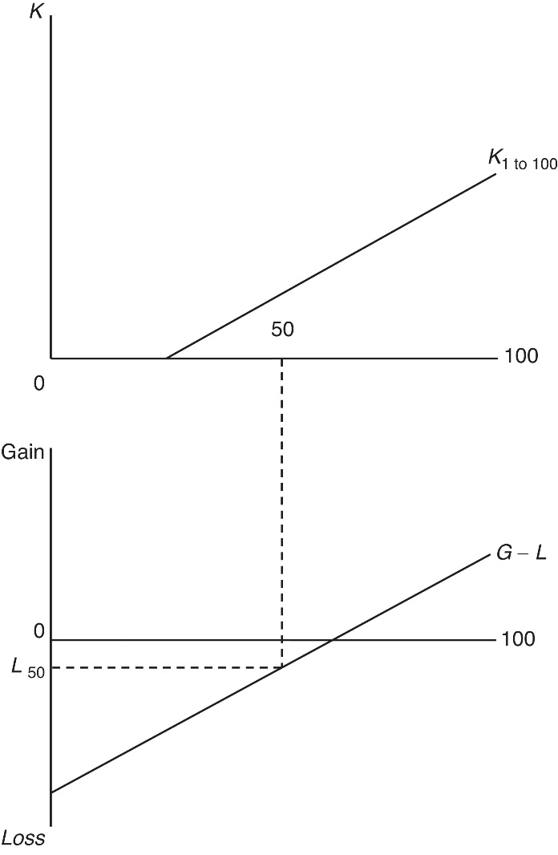
Appendix 6.1: Endogenous Protection
Associated with these capital-labor ratios is a gain-loss graph that assumes a capital-abundant country.
The median individual/voter experiences a loss as a result of trade in Figure 6.4.
The median voter model suggests that politicians will respond to the median voter and offer a supply of protection.
Figure 6.4 Endogenous protection: capital ownership among 100 residents

