Slide 1
Chapter 3: Comparative Advantage
An Introduction to International Economics: New Perspectives on the World Economy

Slide 2
Comparative Advantage: Analytical Elements
Countries
Sectors
Factors of production

Slide 3
Comparative Advantage
As incomes increases in Vietnam, consumers began to think about a motorcycle
In this chapter, we will place motorcycles alongside rice so that you can begin to understand
Concept of comparative advantage and its role in generating patterns of trade among the countries of the world
Requires the use of a production possibilities frontier (PPF)

Slide 4
Review of PPFs
PPFs depict the combinations of output of two goods (rice and motorcycles) that the economy (Vietnam or Japan) can produce given its available resources and technology.

Slide 5
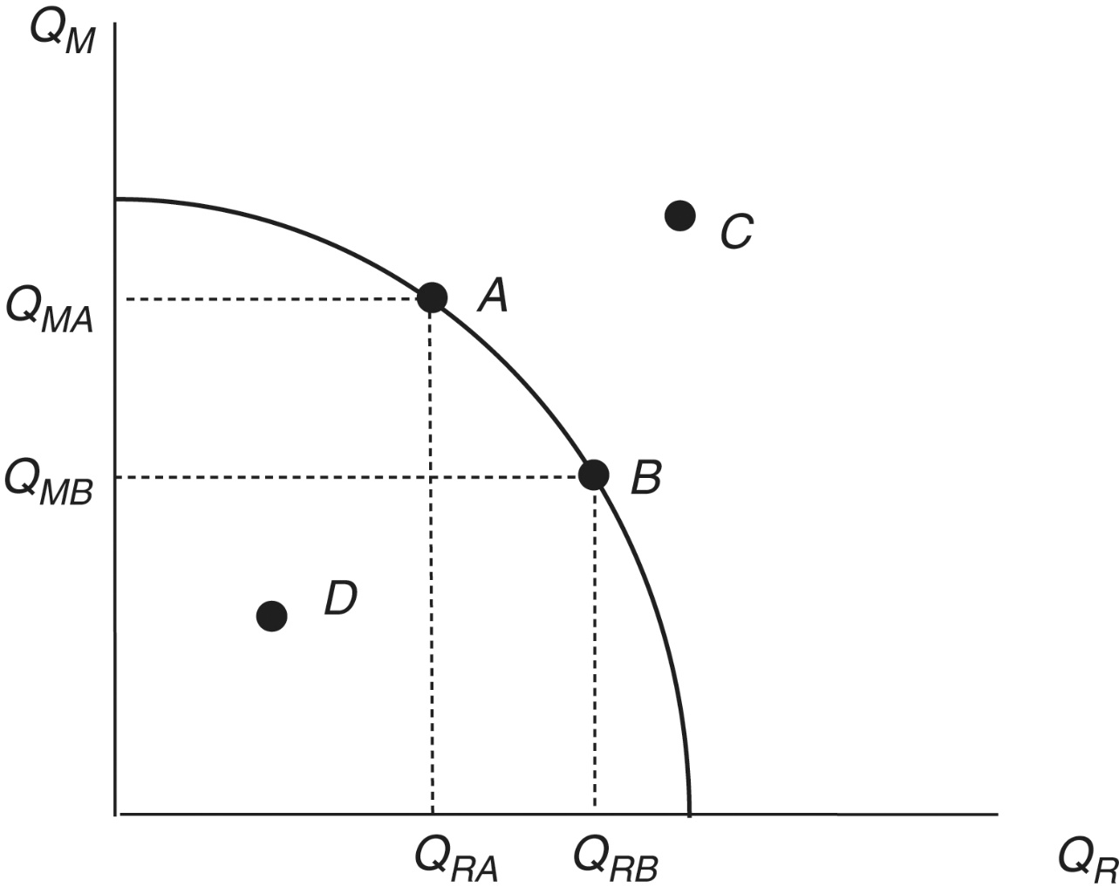
Figure 3.6: The PPF
A: full employment on the PPF
B: full employment on the PPF
C: not feasible
D: feasible with unemployed resources

Slide 6
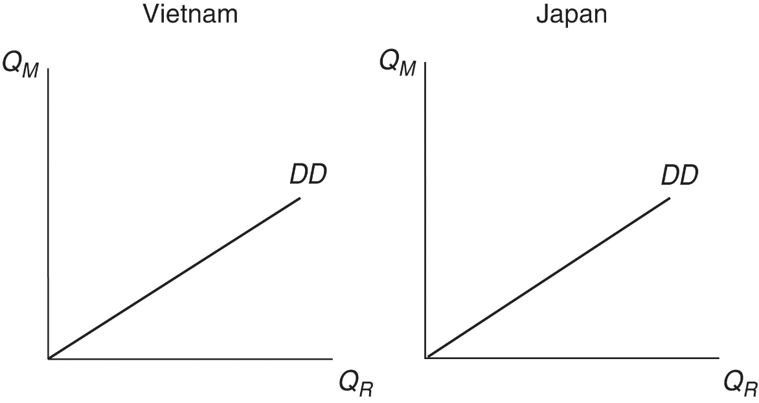
Autarky and Comparative Advantage
Consider again Vietnam and Japan
Both of these countries produce two goods—rice and motorcycles
Assume that demand for rice and motorcycles in both Vietnam and Japan is such that these two goods are consumed in the same, fixed proportions
Figure 3.1: Demand Diagonals in Vietnam and Japan

Slide 7
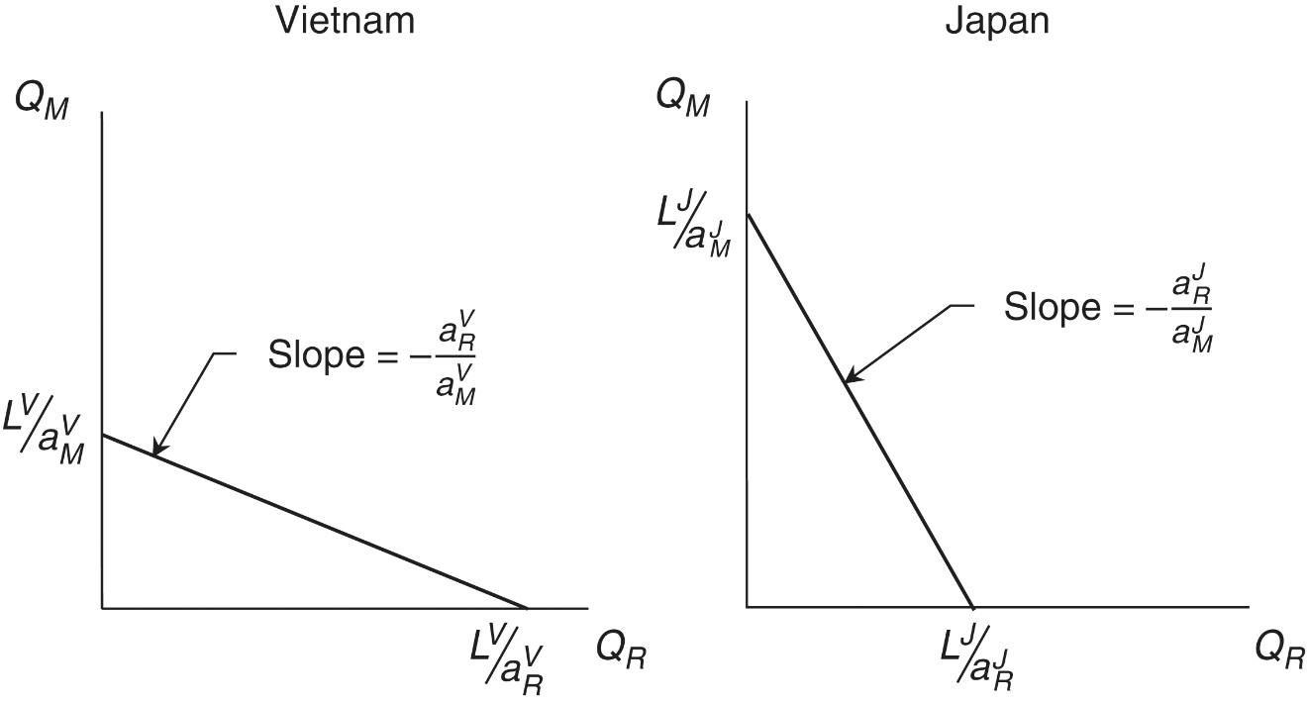
Production Possibilities Frontier
Resource or technology conditions in Vietnam give it a production possibilities frontier (PPF) that is biased towards rice
Resource or technology conditions in Japan give it a PPF that is biased towards motorcycles
Figure 3.2: Ricardian PPFs in Vietnam and Japan
Vietnam might have superior technology in rice production, and Japan might have superior technology in motorcycle production or
Vietnam might be better endowed in rice production factors (land and labor), and Japan might be better endowed in motorcycles production factors (physical capital)

Slide 8
Production Possibilities Frontier
PPFs are a special sort of resource constraint.
the slope of any resource constraint gives the opportunity cost of the item on the horizontal axis of the diagram.
(Which country has the lower opportunity cost of rice? Vietnam)

Slide 9
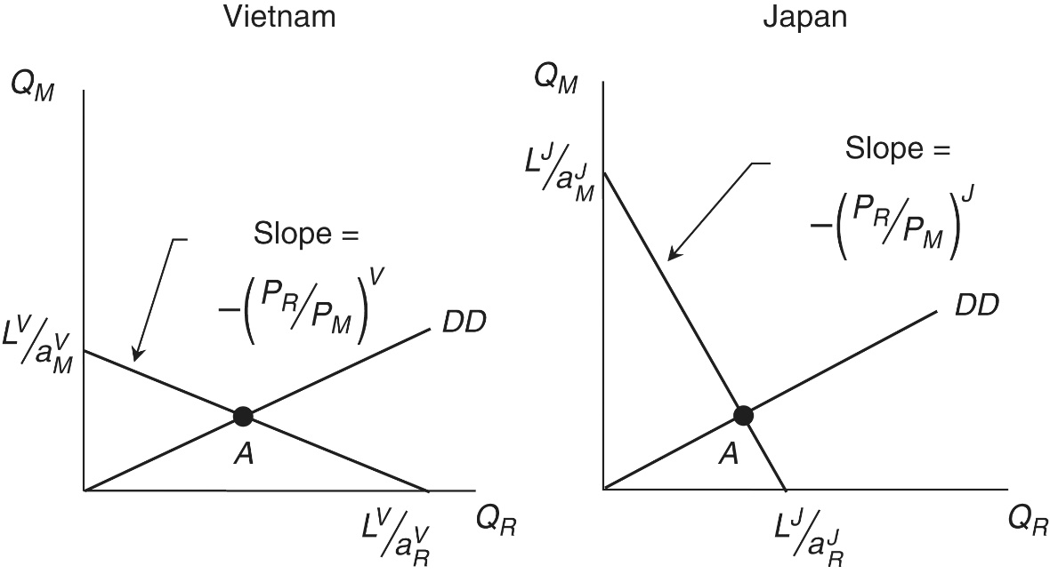
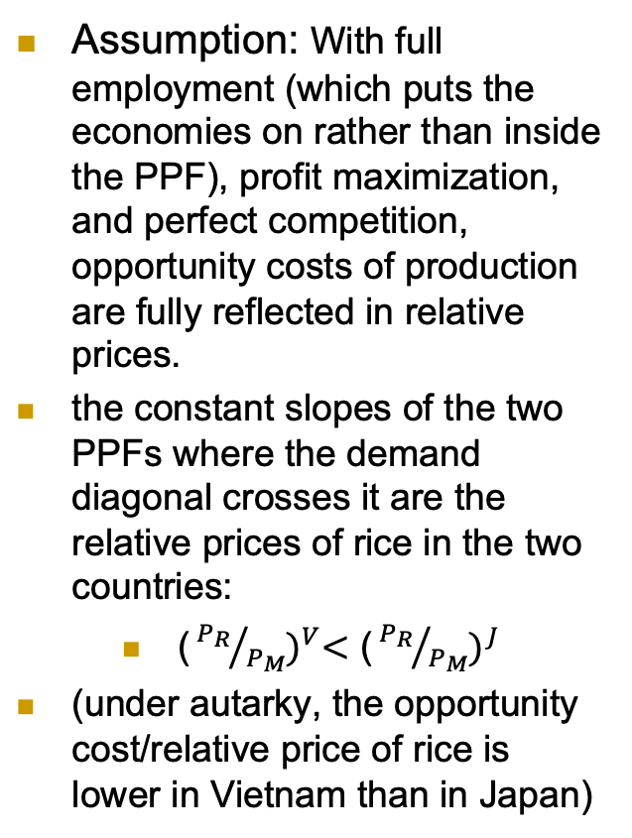
Autarky and Comparative Advantage
Assumption: With full employment (which puts the economies on rather than inside the PPF), profit maximization, and perfect competition, opportunity costs of production are fully reflected in relative prices.
the constant slopes of the two PPFs where the demand diagonal crosses it are the relative prices of rice in the two countries:
${\text{(}{P_{R}}/{P_{M}})}^{V}<$ ${\text{(}{P_{R}}/{P_{M}})}^{J}$
(under autarky, the opportunity cost/relative price of rice is lower in Vietnam than in Japan)
Figure 3.3 Autarky in the Ricardian model in Vietnam and Japan

Slide 10
Autarky and Comparative Advantage
This is an expression of the pattern of comparative advantage
Differences in economy-wide supply conditions cause differences in relative autarky prices and hence a pattern of comparative advantage
Note that comparative advantage involves four prices rather than two prices as in absolute advantage
Consequently, a country can have comparative advantage in a good in which it has an absolute disadvantage.

Slide 11
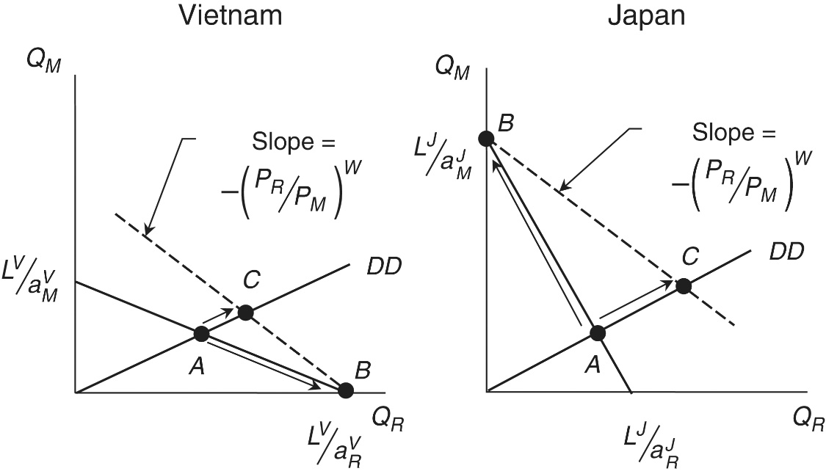
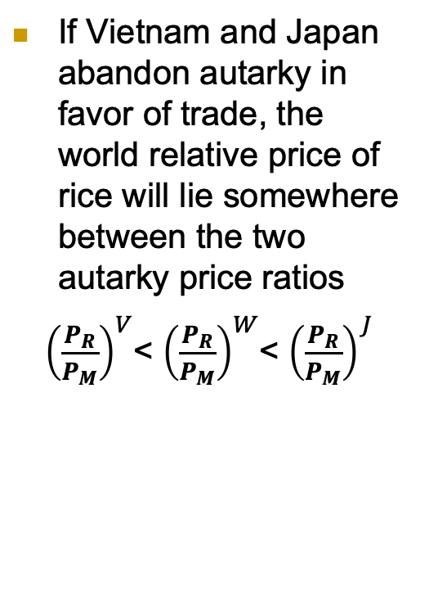
International Trade
If Vietnam and Japan abandon autarky in favor of trade, the world relative price of rice will lie somewhere between the two autarky price ratios
${\left(\frac{P_{R}}{P_{M}}\right)}^{V}$< ${\left(\frac{P_{R}}{P_{M}}\right)}^{W}$< ${\left(\frac{P_{R}}{P_{M}}\right)}^{J}$
Figure 3.4: Autarky and Comparative Advantage in Vietnam and Japan

Slide 12
International Trade
Impacts on production:
With constant opportunity costs and linear PPFs, the world price lines rest on the far corners of the PPFs.
The movement from autarky to trade (from A to B) involves complete specialization in production according to comparative advantage.
Impacts on consumption:
Countries now consume at point C.
In contrast to autarky, the consumption and production points are now different
It is possible because of trade.
Figure 3.4: Autarky and Comparative Advantage in Vietnam and Japan

Slide 13
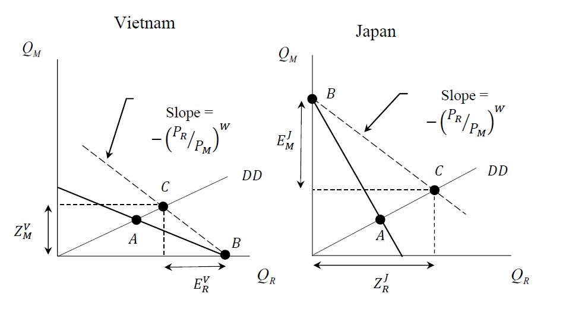
Figure 3.5 Trade in the Ricardian model between Vietnam and Japan
Japan’s exports of motorcycles
Vietnam’s imports of motorcycles
Vietnam’s exports of rice
Japan’s imports of rice

Slide 14
International Trade
Absolute advantage concept can leave the impression that a country could lack an advantage in anything
Therefore have nothing to export
An absolute disadvantage in a product does not preclude having a comparative advantage in that product
Vietnam could have an absolute disadvantage in rice, but still export rice because of its comparative advantage
Comparative advantage is a more powerful concept than absolute advantage
Perhaps the most central concept in international economics

Slide 15
International Trade: summary so far
Differences in technology-determined supply conditions between the countries of the world give rise to complementary patterns of comparative advantage. These patterns of comparative advantage, in turn, make possible complementary patterns of international trade.

Slide 16
Gains from Trade
Should a country actually give up autarky in favor of importing and exporting?
Figure 3.5 shows that the movement from autarky to trade (points A to C) increases consumption of both rice and motorcycles
Increased consumption of both goods implies that economic welfare has increased
Vietnam and Japan have experienced mutual gains from trade based on comparative advantage

Slide 17
Gains from Trade: Caveats
Strict assumptions: only one resource (labor), perfect competition, full employment, profit maximization. No international migration. Countries differ from one another in only technological efficiency.
Gains from trade occur for the country as a whole -- there will be groups that lose from increased trade
These groups will oppose increased trade despite the overall gains to their country
Some goods are traded that do not contribute to increased welfare such as land mines, heroin, and prostitution services

