Slide 1
Chapter 20: Crises and Responses
An Introduction to International Economics: New Perspectives on the World Economy

Slide 2
Analytical Elements
Countries
Currencies
Financial assets

Slide 3
Introduction
Unlike markets for most goods and services, financial markets are characterized by market “imperfections.”
These imperfections tend to make financial markets somewhat unstable, with “booms” of one kind or another being followed by “busts.”
Various types of crises

Slide 4
Types of Crises
In order to get beyond popular descriptions of crises, we need to understand the different types of crises
Six types of crises are listed in Table 20.1
Hyperinflation
Balance of payments and currency crises
Asset price deflation
Banking crises
External debt crises
Domestic debt crises
These can occur one at a time or in combinations

Slide 5
Table 20.1
Types of crises
Sources: Eichengreen (1999) and Reinhart and Rogoff (2009)

Slide 6
Hyperinflation
Hyperinflation is a period of rapid increases in the price level of a country, typically defined to be 40 percent or more
Generally speaking, periods of hyperinflation are associated with rapid expansions of the money supply
The case of Venezuela is presented in Figure 20.1

Slide 7
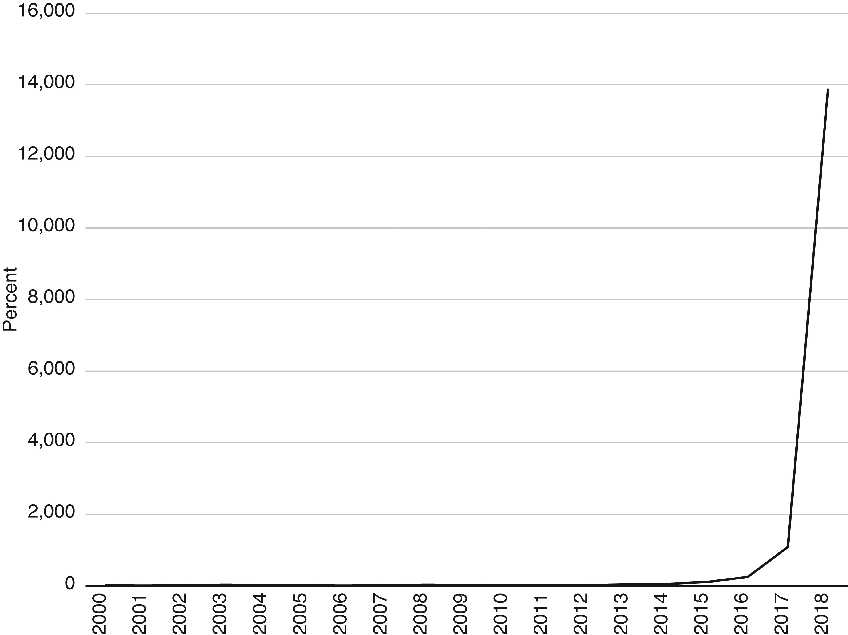
Figure 20.1 Inflation in Venezuela, 2000–2018 (percentage change in consumer prices)

Slide 8
Balance of Payments and Currency Crises
Balance of payments and currency crises consist of large devaluations or rapid depreciation in the value of domestic currencies
Periods of hyperinflation can contribute to currency crashes
Significant degrees of inflation can cause asset owners to move out domestic-currency-denominated assets in to foreign-currency-denominated assets to maintain portfolio values
This causes a decrease in the demand for the domestic currency, lowering its value

Slide 9
Asset Price Deflation
Asset price deflation involves a large and sustained decline in the prices of financial assets
This typically follows behind large increases in asset prices or asset price bubbles
The last significant episode of international asset price deflation took place between 2007 and 2009
A classic case of an asset price deflation is that of Japan in 1990, presented in Figure 20.2

Slide 10
Figure 20.2: Asset Prices in Japan, 1981-1992 (¥ trillions)
Source: Noguchi (1994)

Slide 11
Banking Crises
Banking crises involve the occurrence of bank runs, mergers, closures,, or government takeovers of banking institutions
In general, banking sectors are particularly fragile components of financial systems
This reflects their involvement in maturity transformation
Maturity transformation involves banks borrowing short term and lending long term
Bank runs can be set off by asset price deflation, capital inflows surges and financial sector liberalization

Slide 12
External Debt Crises
External debt crises involve sovereign default on debt obligations to foreign creditors or the substantial restructuring of this debt.
The classic case of this is Mexico’s defaulting in 1982 on its foreign debt, setting of a global debt crisis
Debt crises tend to follow large capital inflows

Slide 13
Domestic Debt Crises
Domestic debt crises involve sovereign default on debt obligations to domestic creditors or substantial restructuring of this debt
Reinhart and Rogoff (2009) emphasize that these events are understudied
As with banking crises and external debt crises, preceding capital inflows are often a contributing factor
Argentina in 2001 combined a banking crises, a currency crisis, both external and domestic debt crises, and asset price deflation

Slide 14
Contagion and Systemic Risk
Contagion refers to crises beginning in one country and “spreading” to other countries
This can occur through a few different mechanisms
Shifts in expectations and confidence (herding or informational cascades)
Asset prices (financial linkage)
Capital flight (sudden stops)
Sudden stops, surprise financial announcements and highly leveraged financial institutions can work together to cause contagion

Slide 15
Contagion and Systemic Risk
When contagion takes on global or near-global characteristics, it becomes what is known as systemic risk
These episodes are rare but characterized the Great Depression of the 1930s and the 2007-2009 crisis
It is becoming clear that increased financial globalization has increased the possibility of systemic risk
This is indicated by the volume of a number of key financial markets being multiples of global GDP

Slide 16
Analyzing Balance of Payments and Currency Crises
“Old fashioned” balance of payments and currency crises have their roots in over-valued, fixed exchange rates and large current-account deficits
Suppose that Mexico is successful in implementing an equilibrium exchange rate at e₀ (Figure 20.3)
Requires that the expected future exchange rate must equal the equilibrium rate
e^{e} = e₀
In turn, requires that the interest rate on the peso must equal the interest rate on the dollar
r_{M} = r_{US}

Slide 17
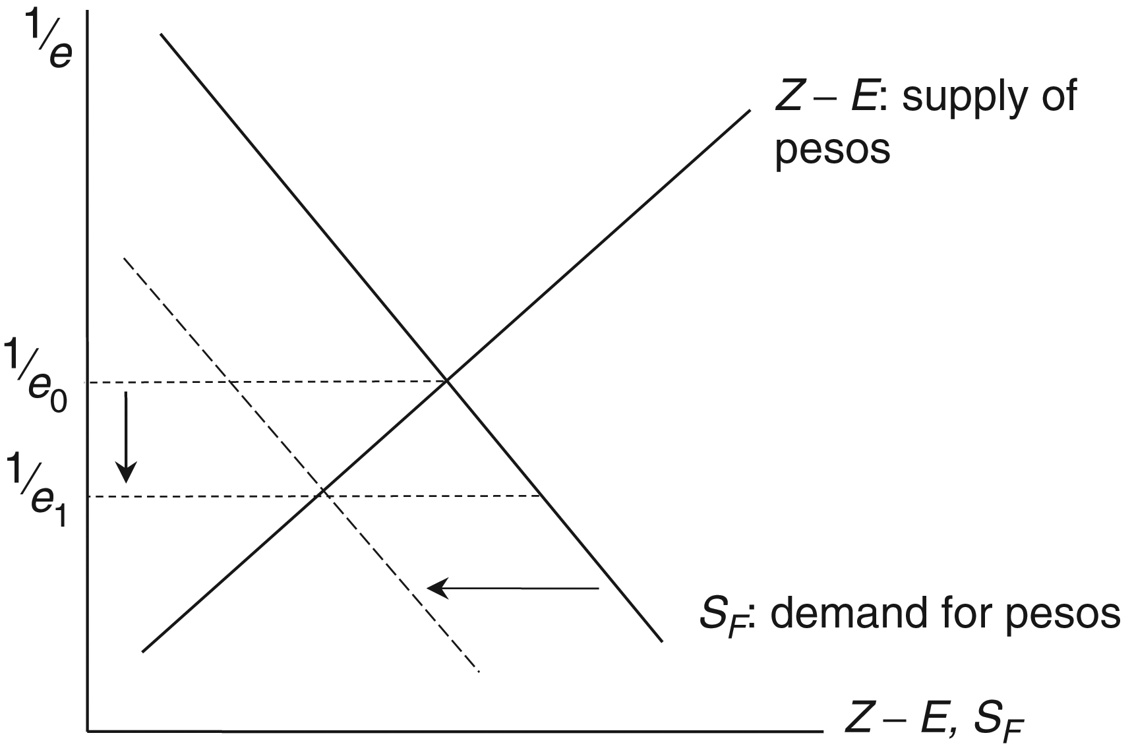
Figure 20.3 A Balance of Payments and Currency Crisis

Slide 18
Analyzing Balance of Payments and Currency Crises
Suppose that we find Mexico in a position of a current account deficit
Current account deficit is always financed by a capital account surplus
When a large trade deficit is financed by an inflow of short-term capital problems will soon develop
The denomination in dollars exacerbates the problem because any fall in the value of the home currency inflates the domestic currency value of the debt
Many domestic investors were aware of these problems and began to sell pesos during 1994

Slide 19
Analyzing Balance of Payments and Currency Crises
If you as Mexican investor feels that the Mexican government will have to devalue the peso in order to suppress the trade deficit, then you think that e^{e} > e₀
If r_{M} = r_{US} and e^{e} > e₀ then
You will buy dollars and sell pesos, participating in capital flight

Slide 20
Analyzing Balance of Payments and Currency Crises
In response to such changes, in December 1994, the Mexican government devalued the peso by 15%
This proved to be too little and fueled speculation of further devaluations
The demand for pesos graph in Figure 20.3 shifted further to the left
Mexico was forced to let the peso float
Further and sudden shifts out of peso-denominated assets sent the peso into a deep fall

Slide 21
Figure 20.4 Balance of Payments and Currency Crises

Slide 22
The Asian Crisis
“High-tech” crises typically include some elements of the balance of payments crises but also include some less-concrete factors that are often difficult to predict
Combine current account deficits with weak financial sectors (especially in the banking system) and/or inappropriate capital account liberalization
This view of crises is summarized in Figure 20.5 and characterized the Asian crisis of 1997
This crisis began in Thailand but spread through contagion effects to Malaysia, Indonesia, the Philippines, Hong Kong, South Korea, and Taiwan

Slide 23
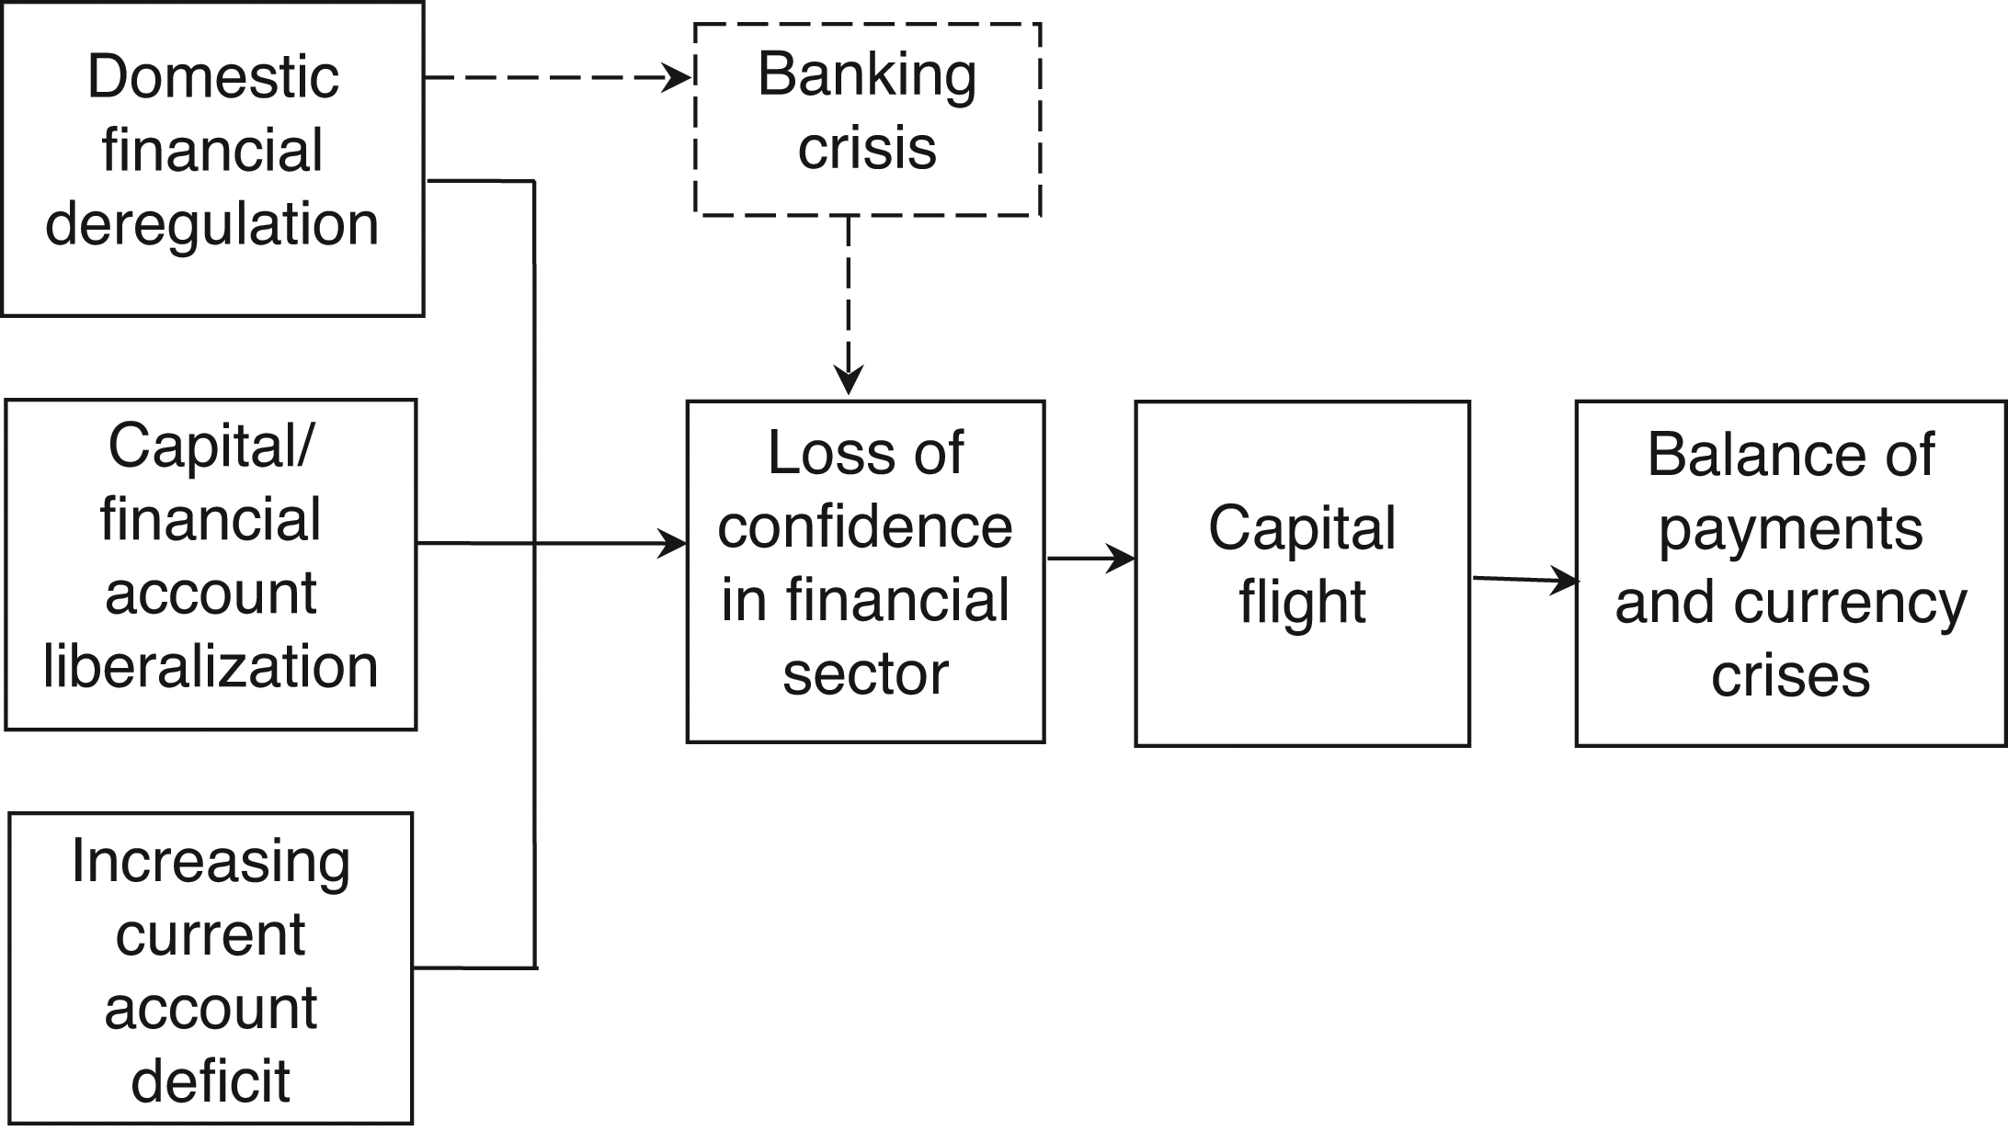
Figure 20.5 A “High-Tech” Balance of Payments Crisis

Slide 24
The Asian Crisis
The Asian crisis of 1997 involved the large devaluations featured in Figure 20.6
The high-tech features of the Asian crisis included
Exposures of financial firms (including banks) to real estate and equity markets
Capital account liberalization
Poor regulation of banks
The absence of hedging (see Chapter 14)
The loss of confidence in the financial sectors of the Asian countries involved was a main culprit in the crisis

Slide 25
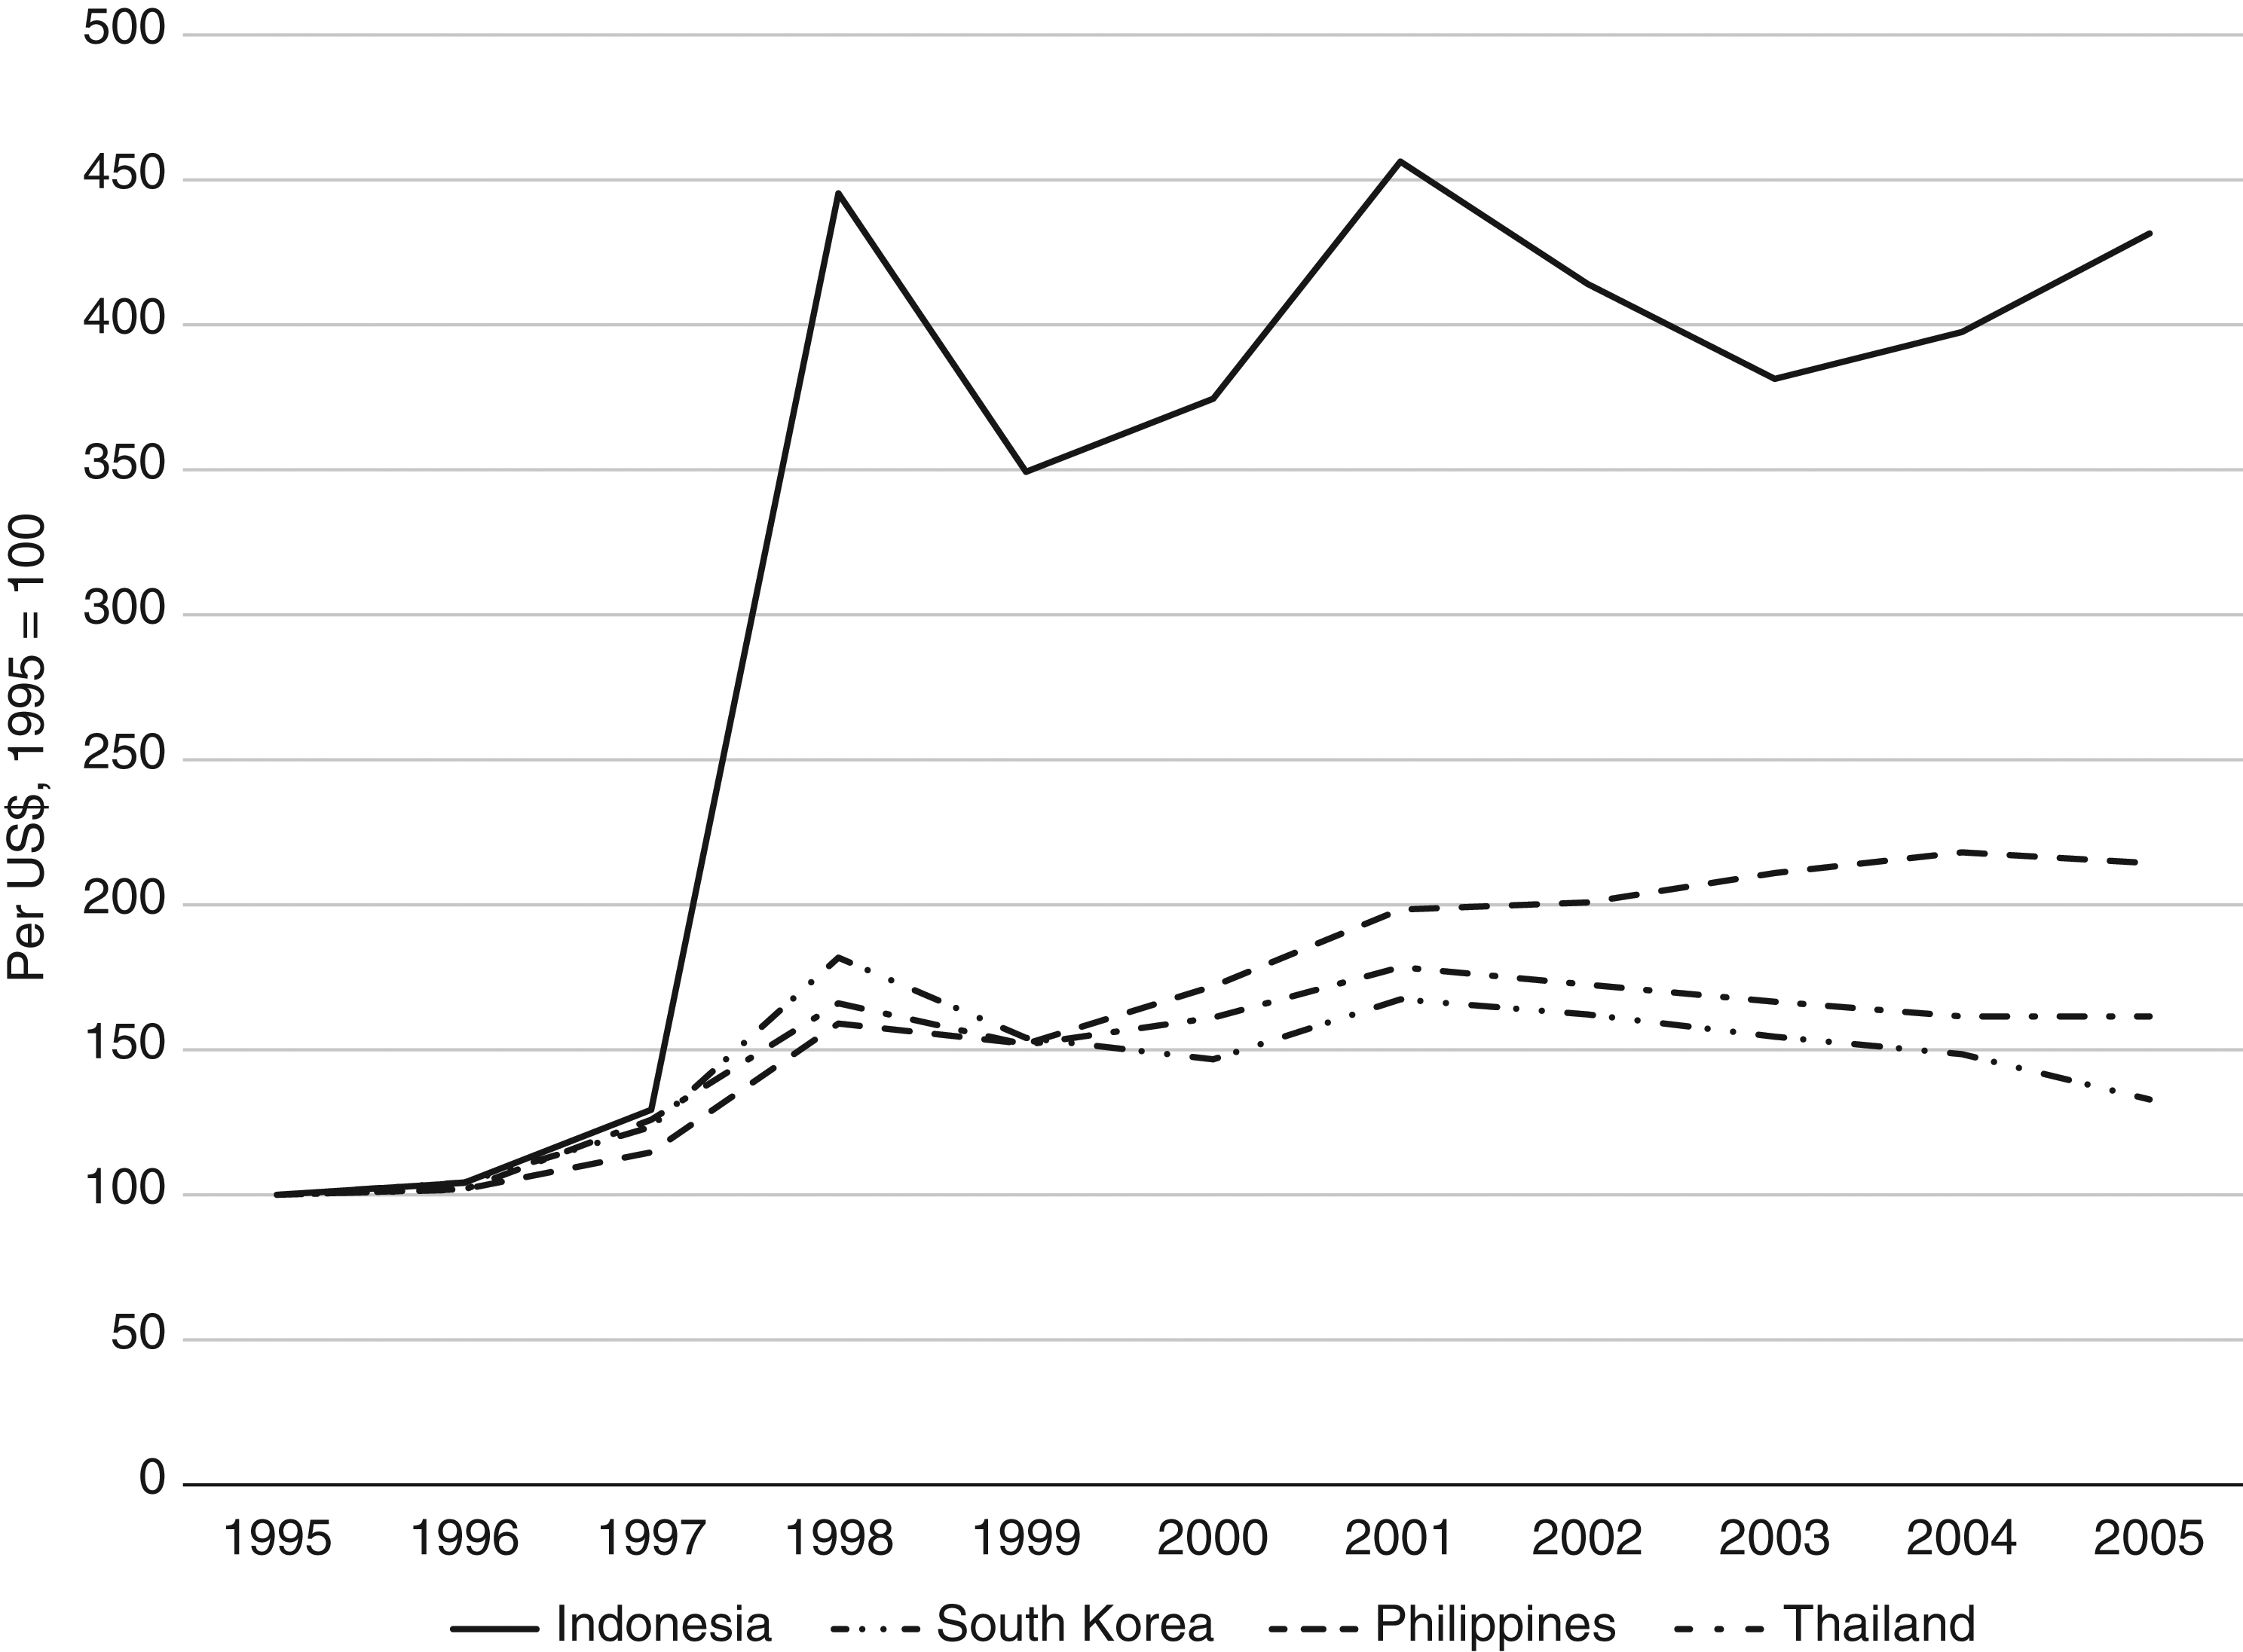
Figure 20.6: Nominal Exchange Rates of Four Asian Countries, 1995-2005

Slide 26
The IMF Responses
The IMF’s response to the 1997 Asian crisis and the 1999 Brazilian crisis became a point of serious contention and debate
IMF’s response can be characterized with three elements
Interest rate increases
Fiscal austerity
Structural reforms
The IMF required the afflicted economies increase their interest rates, as an increase in the domestic interest rate tends to increase the equilibrium value of a country’s currency.

Slide 27
The IMF Response
However, interest rate increases also tended to suppress domestic demand and sometimes fed into a sense of panic
Fiscal austerity measures ignored the fact that the Asian crisis was not the result of profligate governments but profligate private sectors
Structural reform requirements had two weaknesses
They were overly broad
They encroached on the traditional realm of the World Bank
The specifics of this economic history are still being debated

Slide 28
The IMF Response: Indonesia
IMF condition included:
Dismantling of monopolies in cloves and palm oil owned by Suharto associates
Removing government food and energy subsidies
Particularly controversial was the IMF’s closing of 16 insolvent Indonesian banks
Critics alleged that this fed into panic and made matters worse
Whatever the case, continued rioting in 1998 finally ended the 32-year reign of President Suharto

Slide 29
The Global Financial Crisis
Financial crises can and do occur in developed or high-income countries
Causes include
Capital inflows
Financial liberalization
Asset price inflation
Over-borrowing
The sub-prime crisis emerged in the United States in 2007 to 2008
This involved sub-prime mortgages that had been bundled into mortgage-backed securities (MBS)

Slide 30
The Global Financial Crisis
Losses in US housing markets were transmitted around the globe via a pyramid of financial instruments, include MBS
Thereby, a crisis originating in one country took on a global profile through systemic risk described above
Addressing this crisis had profound fiscal impact for the United States that have not yet been adequately addressed
It also sparked a crisis in Europe to be discussed in Chapter 21
The GFC was an example of systemic crisis.

Slide 31
Prudential Regulation and the Basel Standards
The most fundamental imperfection in financial markets is imperfect information, particularly asymmetric information
Therefore, financial systems, particularly banking systems, can benefit from prudential regulation.
Prudential regulation aims to help support the solvency of financial intermediaries and limit contagion and systemic risk.
In practice, much of the attention in prudential regulation is on capital adequacy ratios (CARs), which measure banks’ available capital as a ratio of a risk-weighted measure of credit exposure.

Slide 32
Prudential Regulation and the Basel Standards
The Basel Committee on Banking Supervision was established in 1974
In 1988, the Basel Committee introduced a banking capital measurement standard known as the Basel Capital Accord and later Basel I (see Table 20.2)
A new set of standards went into effect in 2004 in the form of Basel II based on three pillars
Minimum capital requirements
Supervisory review
Disclosure for market discipline

Slide 33
Table 20.2: The Basel Accords
Stage | Years of Issue | Components
Basel I | 1988 | Proposed regulatory capital requirements of 8 percent and introduced two tiers of capital.
Basel II | 2004 | Introduced three pillars of bank regulation (minimum capital requirements, supervisory review, and disclosure for market discipline) and two tiers of capital. Effectively reduced the capital requirement and allowed asset measurements to be risk adjusted by banks’ internal models.
Basel III | Phased 2010-2017 | Improved asset risk adjustment and increased capital requirements to 7 percent, and allowed for countercyclical capital requirements.

Slide 34
Basel Standards
As the Global Financial Crisis testified, Basel II was insufficient
Its conditions were simply too lax
In response, Basel III was announced in 2010
Basel III tightens up the Basel II standards, for example, by tightening standards on Tier I and Tier II and increasing capital requirements from 2 to 7%
Some observers think that even 7% is too lax

Slide 35
Capital Controls
Capital controls, aka capital account regulations (CARs) and capital flow (management) measures (CFMs)
The purpose of capital controls is to address the volatile nature of gross capital flows
To the extent that such volatility contributes to crises, capital controls might help with crisis prevention.
In the wake of the GFC the IMF revisited capital controls and gave them an endorsement:
market-friendly capital controls can help countries cope with surges of capital inflows, which can end in sudden stops and contribute to crises

